Slide 1
Foundations of Civilization
Peopling of the World
Neolithic Revolution
Characteristics of civilization

Slide 2
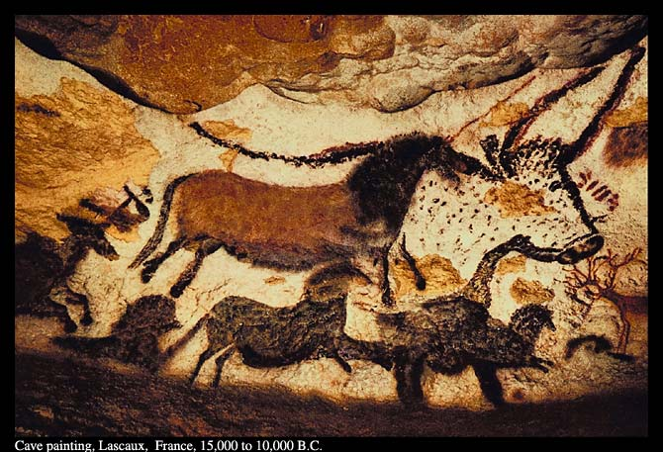
I. Peopling of the world
Early humans were nomadic hunters & gatherers.
Some hunters & gatherers were advanced, but were never able to develop complex societies because they had to migrate to find food.

Slide 3
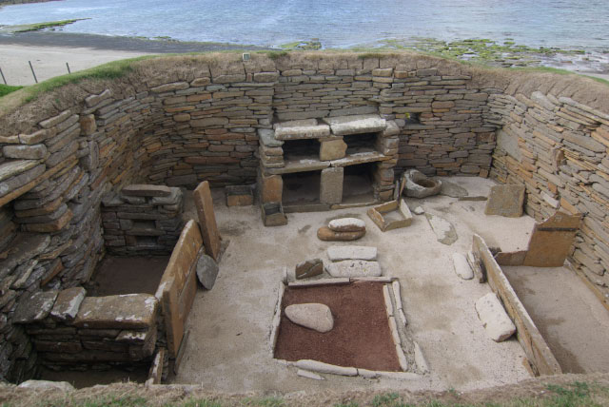
ii. Neolithic revolution
Around 8,000 B.C., the Neolithic Revolution occurred & early humans discovered how to farm & domesticate animals
The wide-scale transition of many human cultures from a lifestyle of hunting and gathering to one of agriculture and settlement, allowed for the ability to support an increasingly large population.

Slide 4
ii. Neolithic revolution
Farming changed the way humans lived:
People no longer had to be nomads
Food surpluses led to population increases
Farming villages became established along river valleys for their good soil & irrigation

Slide 5
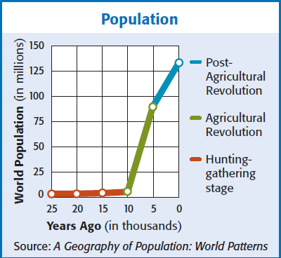
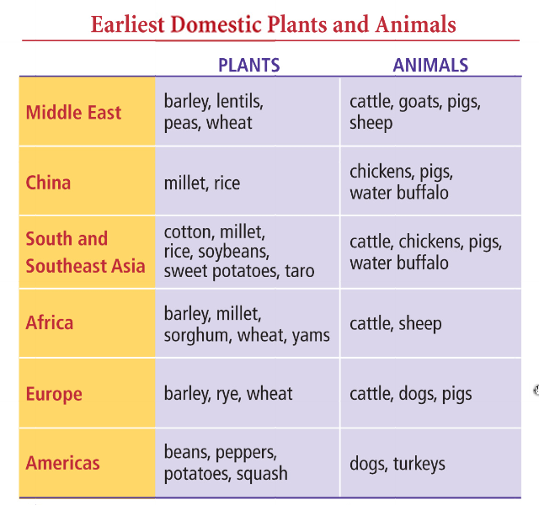
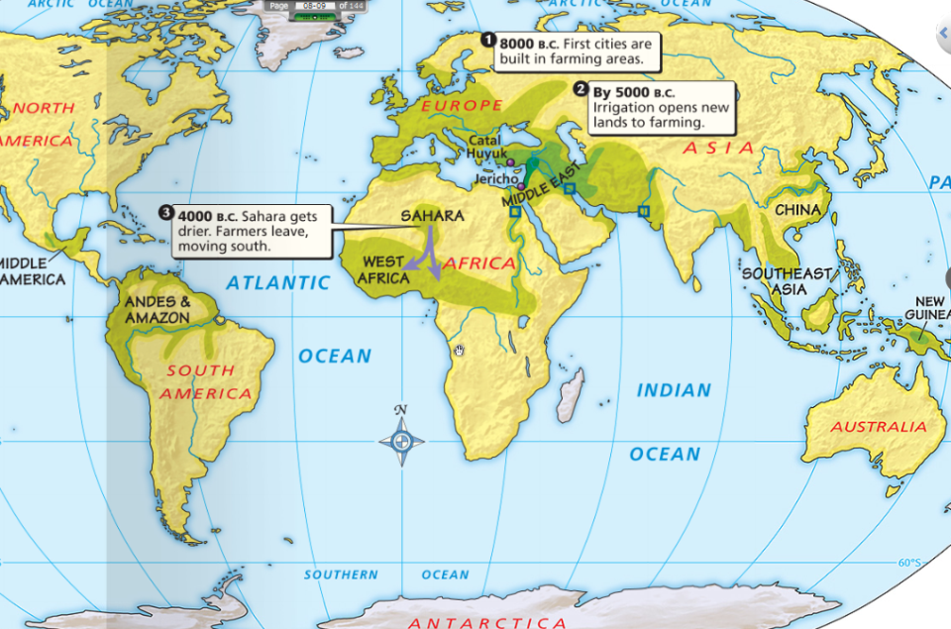
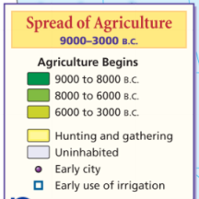
ii. Neolithic revolution

Slide 6
ii. Neolithic revolution
Around 3,000 B.C., some farming villages became complex civilizations.
Brainstorm: What characteristics are needed to makes people a “civilization”?
?
Advanced cities

Slide 7
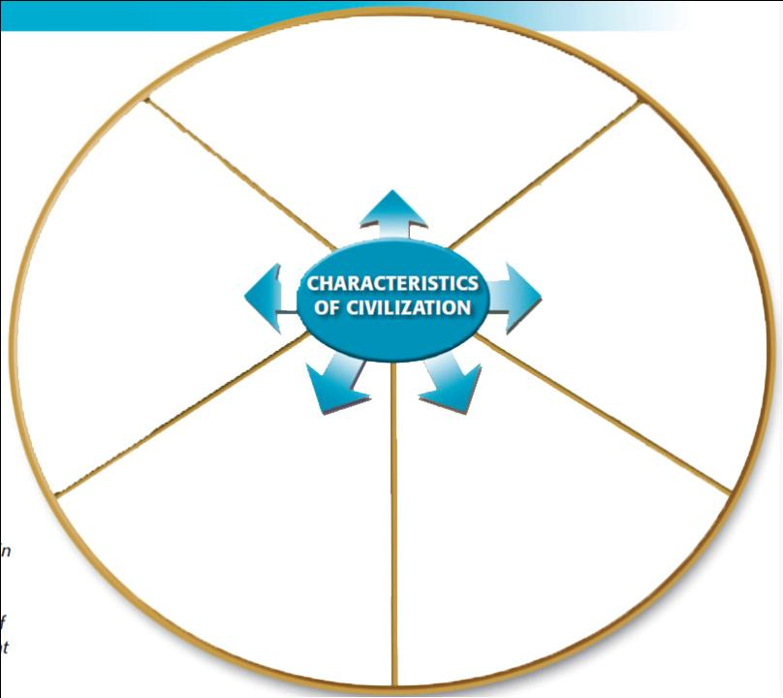
Characteristics of Civilizations
iii. Characteristics of civilization
?
?
?
?
?

Slide 8
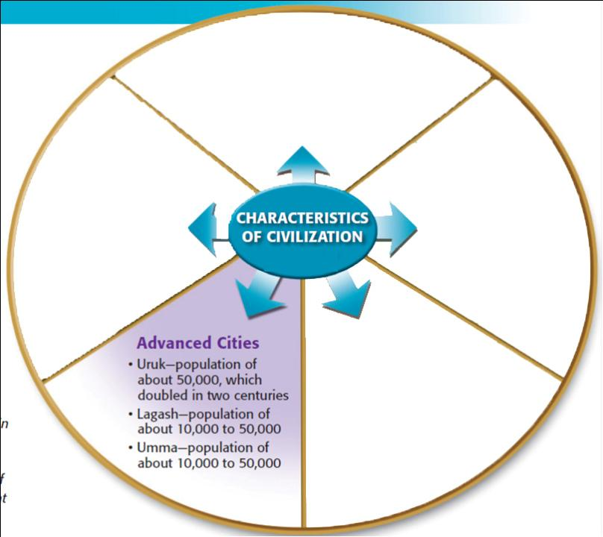
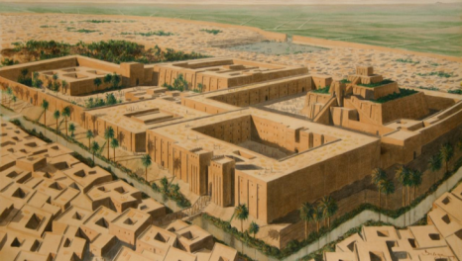
Civilizations must have cities that are centers of trade
They must be heavily populated

Slide 9
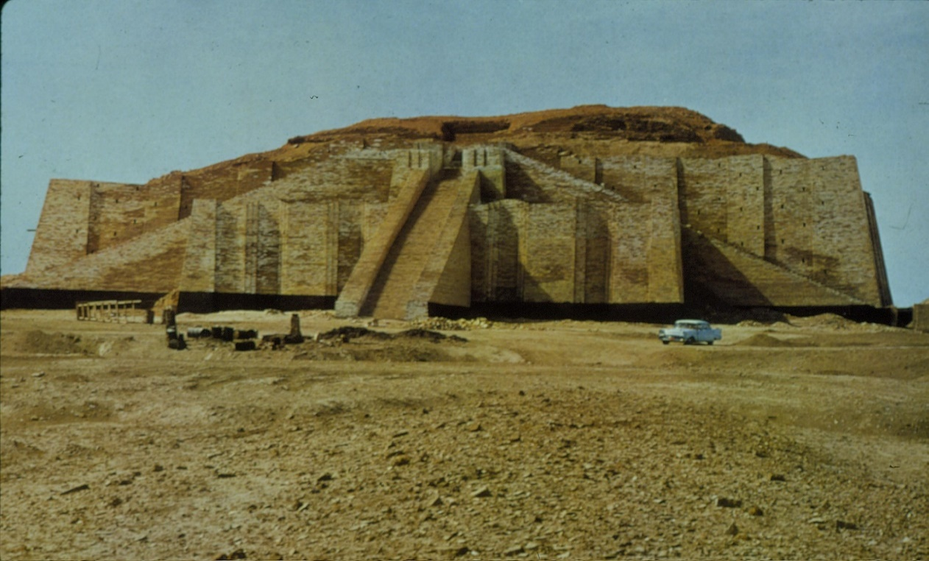
Cities:
Sumerian city-states were protected by high walls
At the city center was a temple called a ziggurat
Ziggurat – The 1st stepped pyramids ever created – possibly for local religious practices

Slide 10
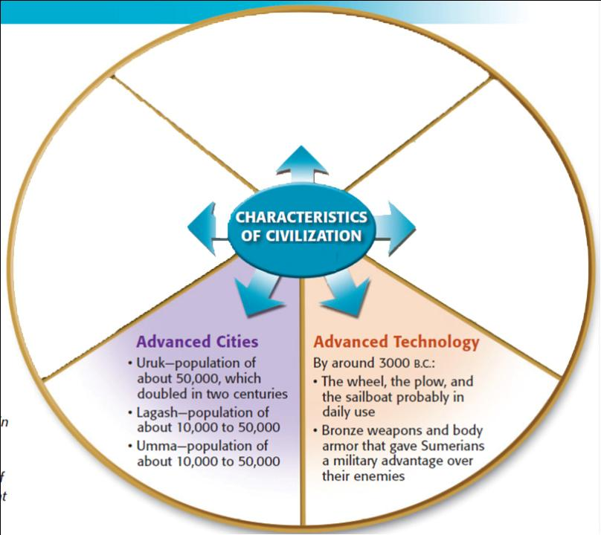
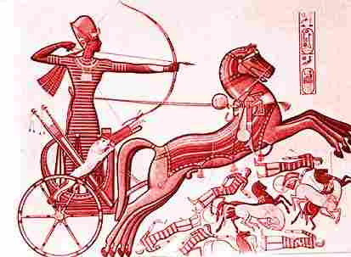
Civilizations must have technologies that make their lives easier

Slide 11
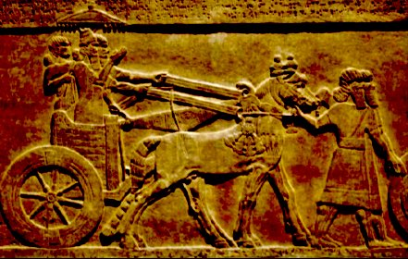
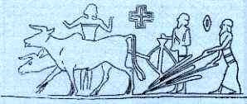
2. Technology:
Sumerians inventions include the wheel, sail, plow, & bronze metalwork
These advances allowed the Sumerians to advance at a rapid pace

Slide 12
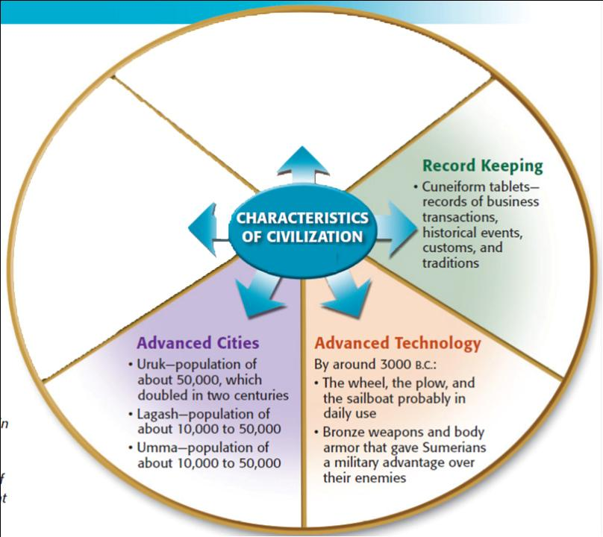
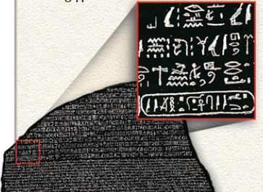
Civilizations must have writing in order to keep records of taxes, laws, or trade
They keep a record of their historical tradition
The Rosetta Stone!
https://youtu.be/ptXlmZzSVV8

Slide 13
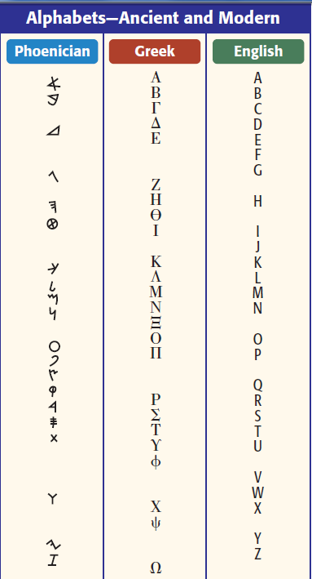
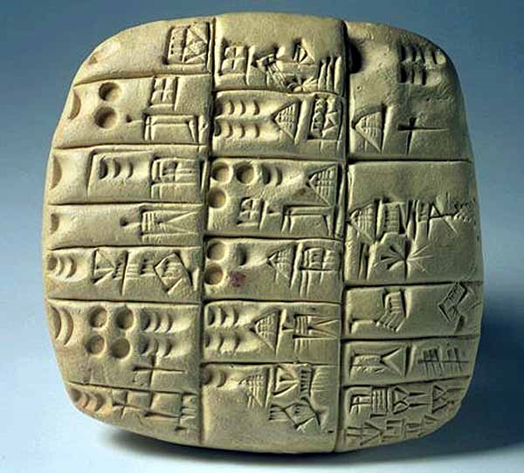
3. Writing:
Sumerians made the world’s 1st writing called cuneiform

Slide 14
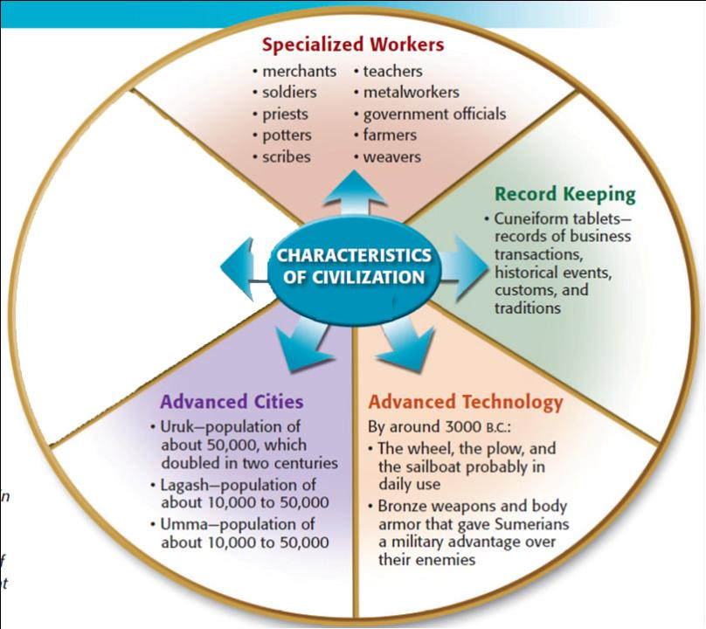
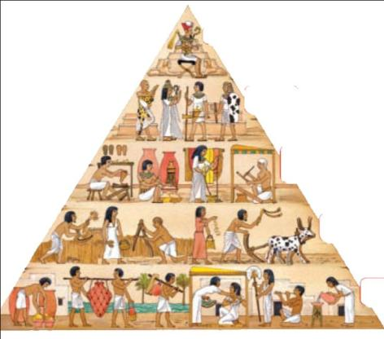
iii. Characteristics of civilization
Civilizations must have specialized workers that create a class system
Must have farmers, priests, metalworkers, etc.

Slide 15
4. Specialized Workers:
At the top of society were priests, and then kings
In the middle were skilled workers, like merchants
At the bottom, were common farmers & slaves

Slide 16
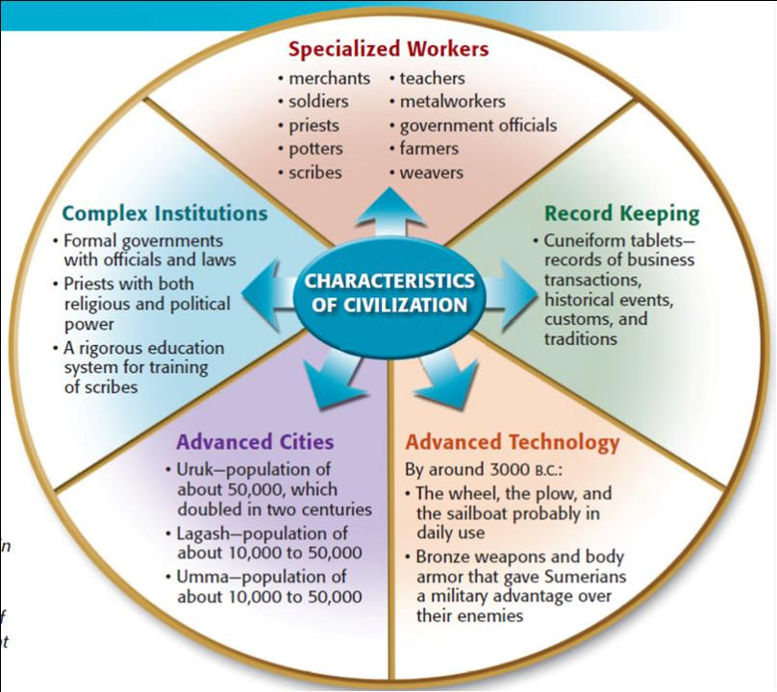
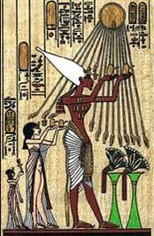
Civilizations must have complex institutions like government & religion to keep order
They have complex Governments
They have complex religious systems

Slide 17
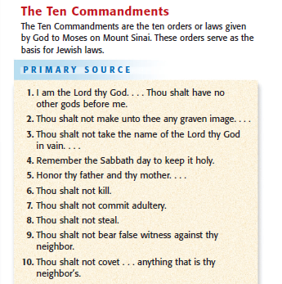
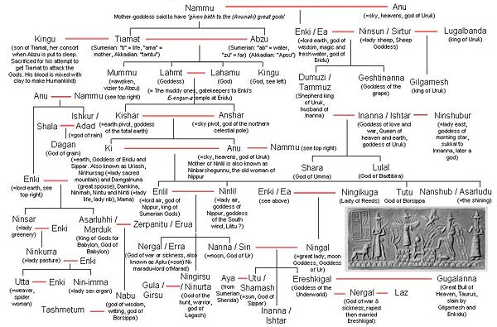
5. Complex Institutions
Religion:
Sumerians & Babylonians were polytheistic – believing in many different Gods.
The Hebrews (Jewish) in Palestine were the 1st group in history to be monotheistic – believing in 1 God

Slide 18
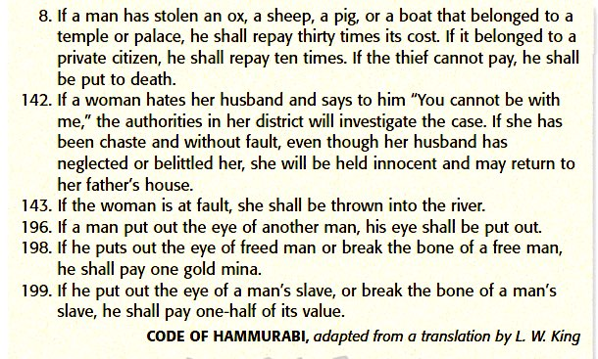
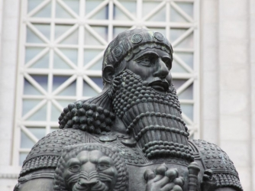
5. Complex Institutions
Government:
Babylonian King Hammurabi created the first legal code

Slide 19
5 characteristics of civilizations
Civilizations must have cities that are centers of trade for large areas
Civilizations must have technologies that make their lives easier
Civilizations must have writing in order to keep records of taxes, laws, or trade
Civilizations must have specialized workers that create a class system
Civilizations must have complex institutions like government & religion to keep order
TO RECAP!

