Slide 1
THE FIRST CIVILIZATIONS
I. Mesopotamia
II. Indus River valley
III. China
IV. Eastern Mediterranean

Slide 2
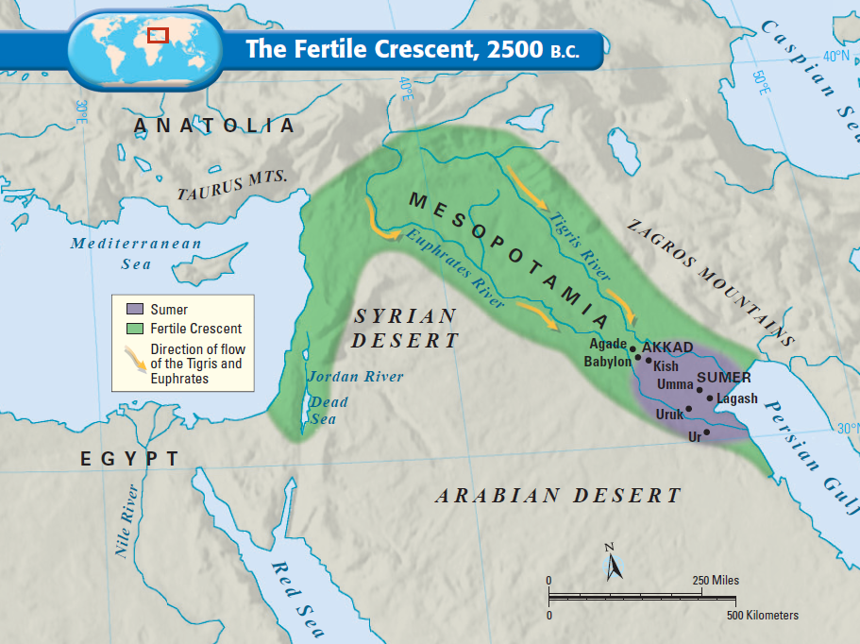
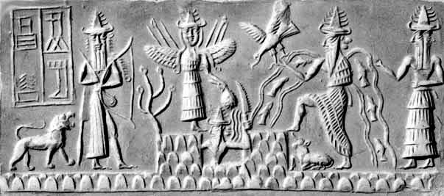
I. Mesopotamia
The Tigris and Euphrates Rivers flooded once per year, leaving behind fertile soil ideal for farming
The first civilization began in an area known as Mesopotamia
Mesopotamia means “land between the rivers” & is often called the “Fertile Crescent” or as the “Cradle of Civilization”

Slide 3
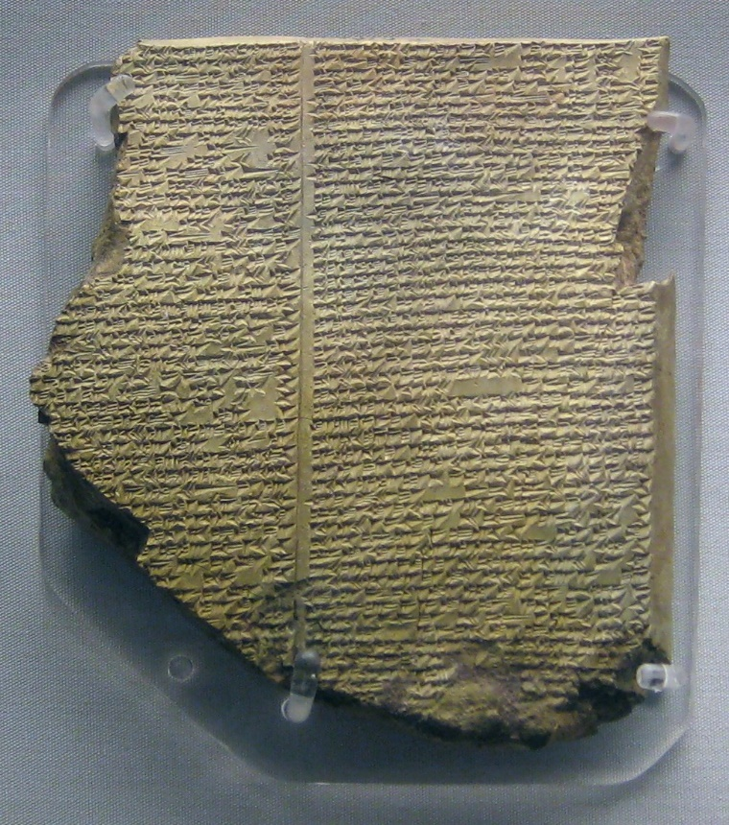
I. Mesopotamia
Using Cuneiform writing, Sumerians analyzed astronomy and numbers
Sumerians wrote the 1st epic of history – The Epic of Gilgamesh
The first civilization developed in the Fertile Crescent: Sumer

Slide 4
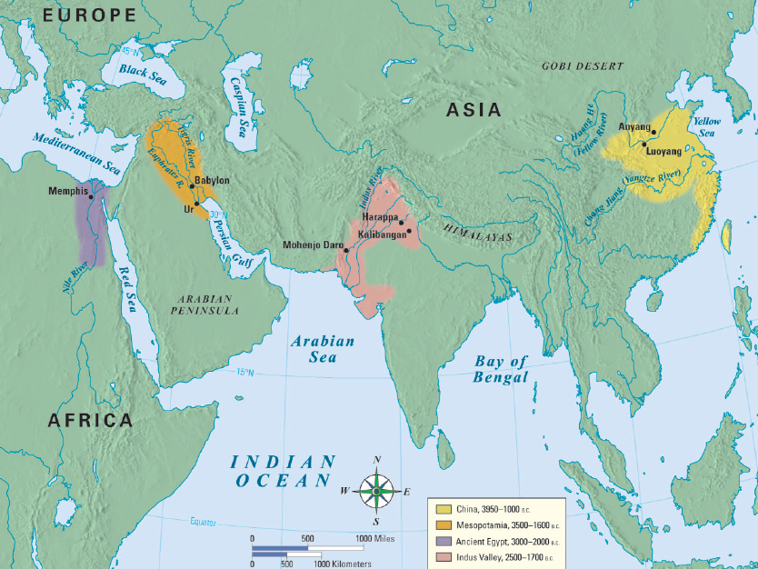
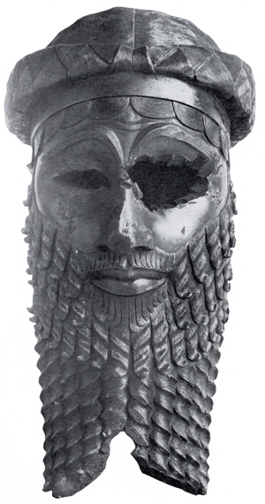
i. mesopotamia
The 1st empire of Mesopotamia was the Akkadian Empire – founded in 2300 BC
7,000 texts are found from the Akkadian Empire.
This ancient empire is mention in the Old Testament of the Bible.
Reached its height under Sargon the Great – 2330 BC

Slide 5
i. mesopotamia
https://youtu.be/Ks1UW0y0L9A
Babylon was destroyed and then reemerged in 600 BC under the leader Nebuchadnezzar
Famous for creating one of 7 wonders of the ancient world – the Hanging Gardens of Babylon
Babylonian Empire included Hammurabi and his Law code.
Hammurabi’s Code had 282 laws based on justice & retaliation (an eye for an eye)
The code had different punishments for the various levels of society

Slide 6
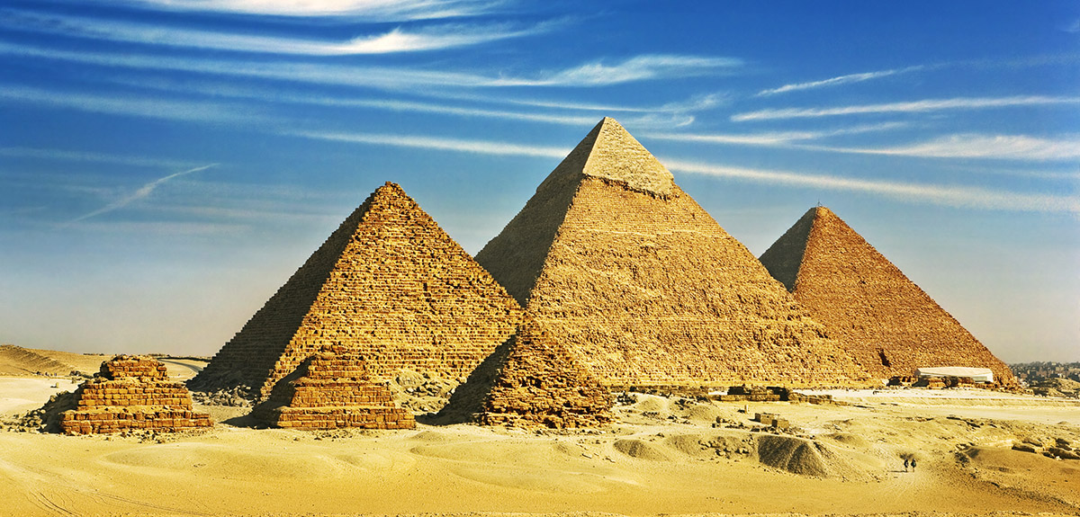
ii. egypt
Egypt emerges by 3200 BC
They have a centralized government under a pharaoh
They use Hieroglyphics as the main source of writing
Wrote on Papyrus scrolls

Slide 7
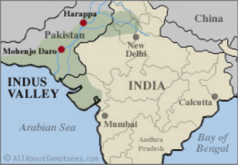
III. INDUS VALLEY
Modern day Pakistan and Western India on the Indus River
Two major cities were Harappa and Mohenjo-Daro
They had writing, but it is still a mystery
Civilization collapsed under invasion

Slide 8
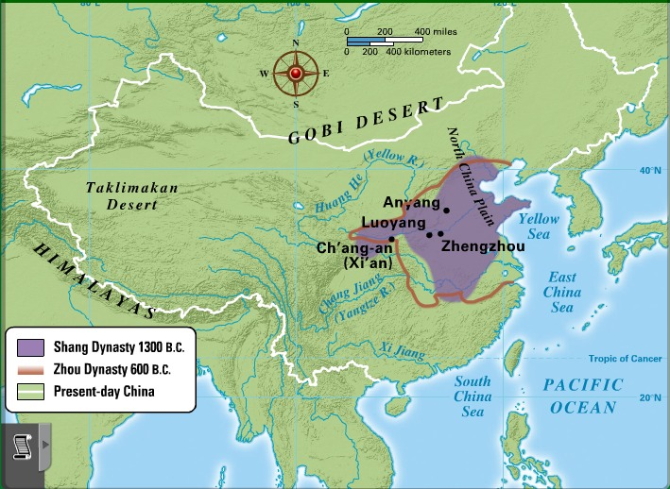
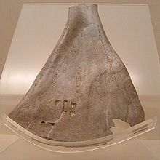
IV. CHINA
Began along the Yellow River
This is the most isolated of the early civilizations.
Created pottery, Iron, writing and religion
Wrote on oracle bones
The Xia dynasty was the first civilization in China 20170 – 1600 BC
The Shang dynasty was the 2nd civilization in China – 1600 BC – 1000 BC
https://youtu.be/dEYqzkbMZWg

Slide 9
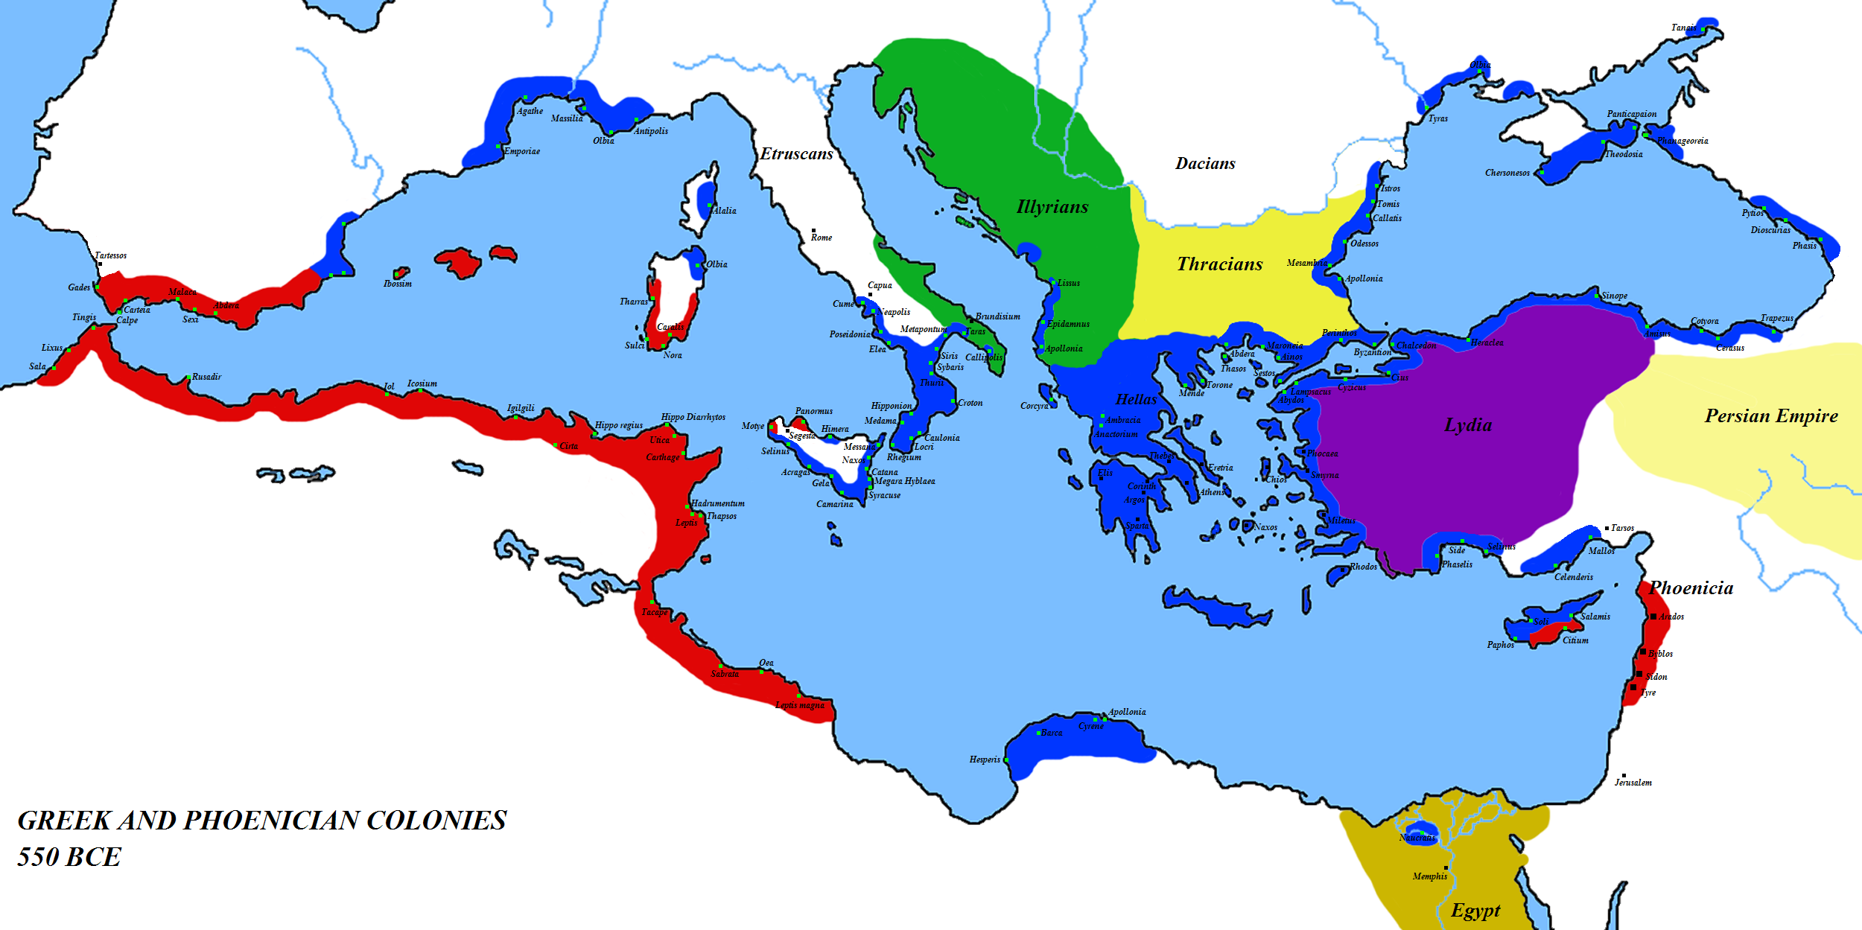
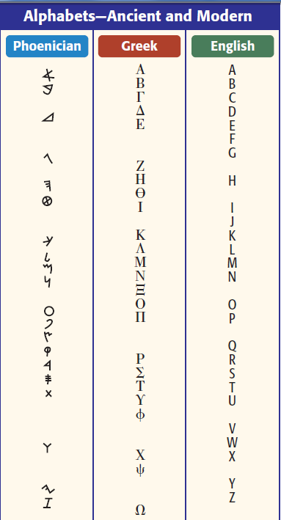
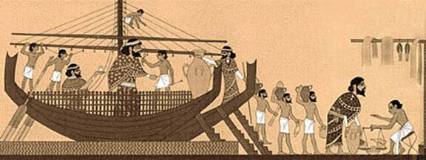
V. Eastern Mediterranean
Phoenicians were sea traders who conquered most of the coastlines around the Mediterranean sea
They established City-States
Simplified the Alphabet to 22 letters– for trading purposes
This alphabet influenced Latin, Greek & English
Had a monopoly on Purple Dye – used to dye cloth Purple – the color of royalty

Slide 10
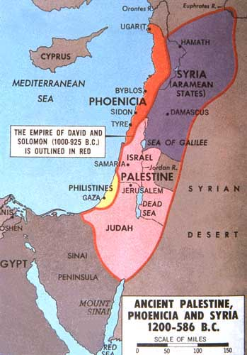
V. Eastern Mediterranean
Hebrew people are native to Israel and moved around a lot
They were founded by Abraham
They were enslaved by Egyptians, Babylonians and Assyrians.
Moses led the Hebrews from 1400 BC into modern Israel
Moses had the 10 Commandments to govern the Israelites
The holy book of Judaism is the Torah
Over the next several centuries Israel became a powerful nation under Saul, David, and Solomon.

Slide 11
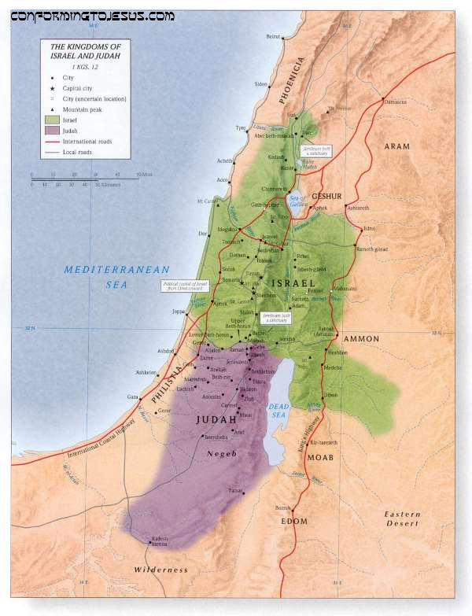
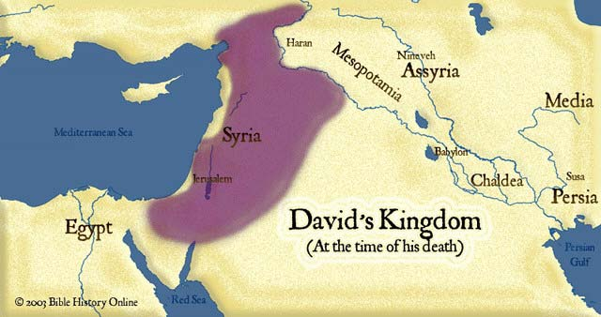
V. Eastern Mediterranean
After Solomon’s death the Kingdom was divided in two parts.
After the Babylonians conquered Judah they made most of the people move to Babylon (Iran/Iraq) for 500 years– this is called the Diaspora
Jews have been slaves more than any other people ever!
Eventually the Jews returned to their homeland.
Next they were conquered by the Greeks…
Then they were conquered by the Romans…

Slide 12
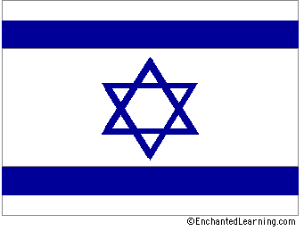
V. Eastern Mediterranean
The Romans occupied Israel until 70 CE when they finally expelled the Jews.
The Jews travelled all over the world not having a country of their own for the next 1800 years until just after the second world war when the nation of Israel was reformed in Palestine. (1948).

