Slide 1
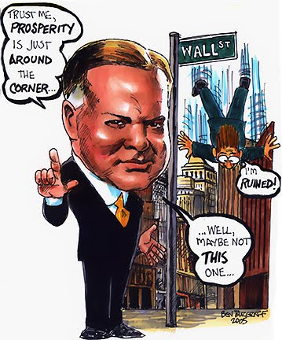
From 1929 to 1932, President Hoover was criticized for not doing more to end the depression
Tens of thousands of businesses failed and unemployment rose to 25%
The American banking system collapsed
Hoover initially relied on rugged individualism but offered relief checks and job programs, but it was seen as too little, too late

Slide 2
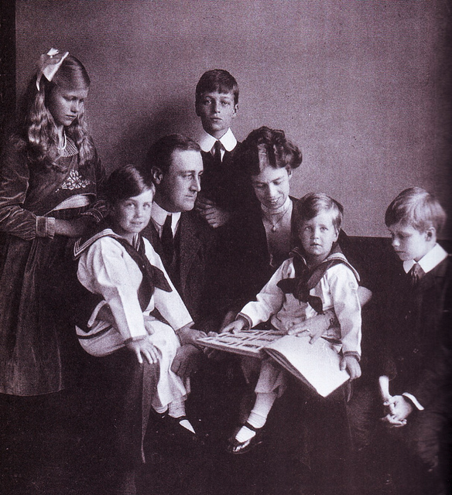
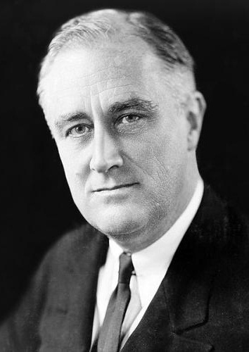
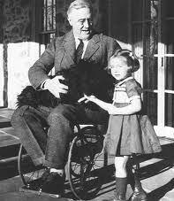
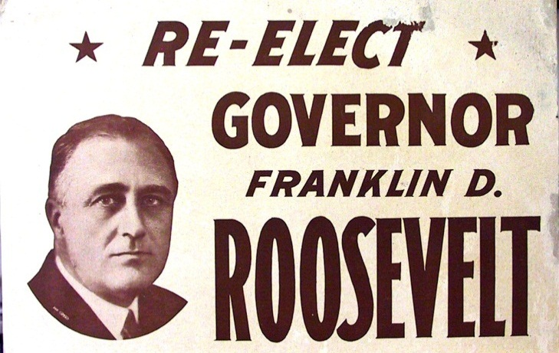
FDR Biography

Slide 3
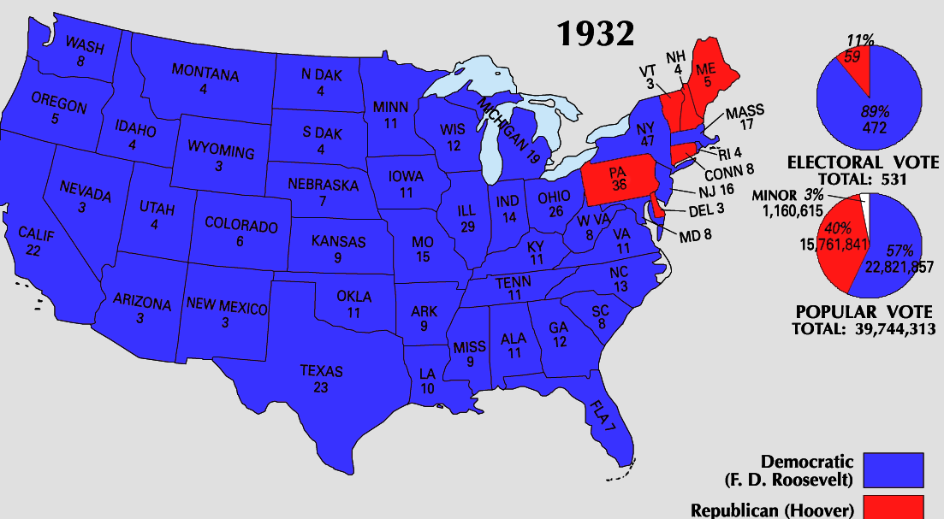
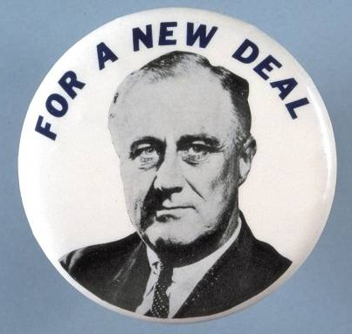
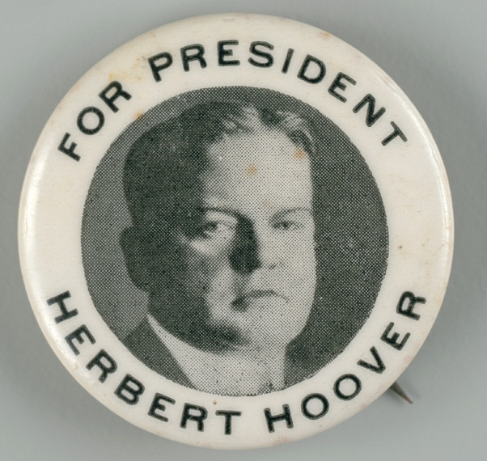
By the election of 1932, Hoover ran for re-election but Americans wanted hope and strong leadership
Democratic candidate Franklin Roosevelt defeated Hoover and won the presidency

Slide 4
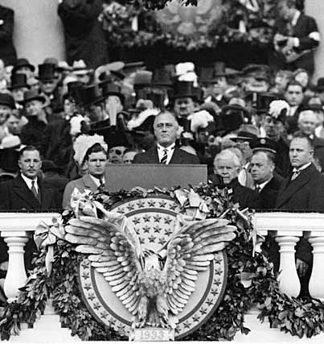
When Roosevelt was inaugurated as president, unemployment was at an all-time high
In his inaugural address, FDR inspired hope, declaring “the only thing we have to fear is fear itself”
“Let me assert my firm belief that the only thing we have to fear is fear itself; nameless, unreasoning, unjustified terror which paralyzes needed efforts to convert retreat into advance.”

Slide 5
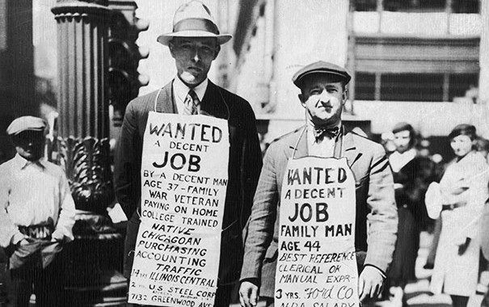
When FDR became president be promised decisive gov’t action to fight the depression
FDR believed the gov’t should use deficit spending (spending that causes debt) to stimulate the economy

Slide 6
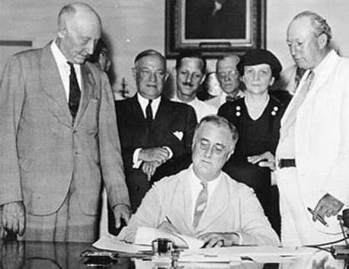
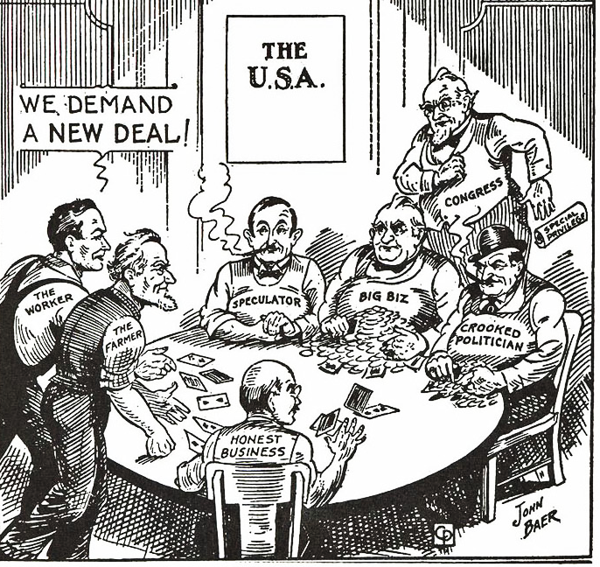
In his first 100 days in office, FDR and Congress passed a broad platform of legislation to attack the depression called the “New Deal”

Slide 7
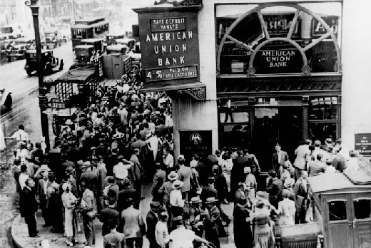
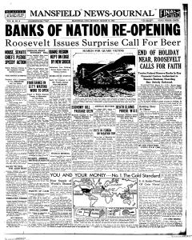
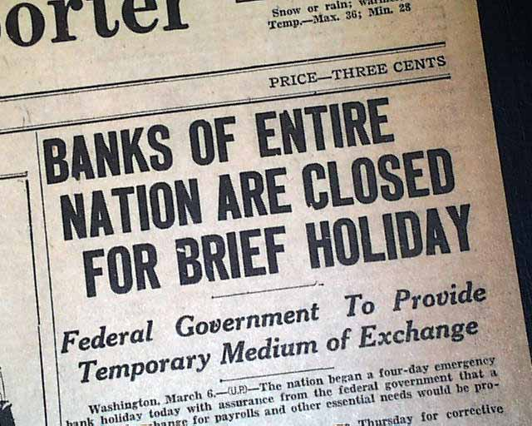
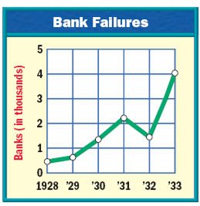
FDR’s first action was to address the bank crisis
By 1933, 25,000 banks had failed and the USA was in a complete financial collapse
FDR declared a four-day “bank holiday”: all banks were closed and inspected by federal regulators to determine which banks were healthy…
…Only healthy banks could reopen after the bank holiday

Slide 8
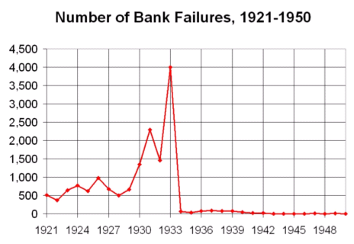
After the bank holiday, few U.S. banks failed and Americans slowly began to regain confidence in banks

Slide 9
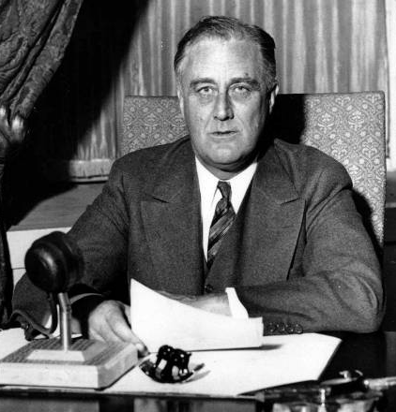
FDR used the power of the radio to communicate to the American people the steps the government was taking to address the problems of the depression
FDR’s “fireside chats” used simple, clear language to explain New Deal programs
These weekly radio addresses gave people confidence that the government was actively fighting the Great Depression

Slide 10
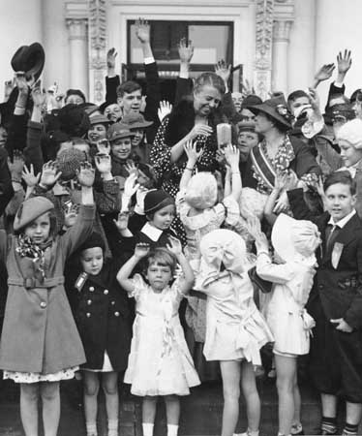
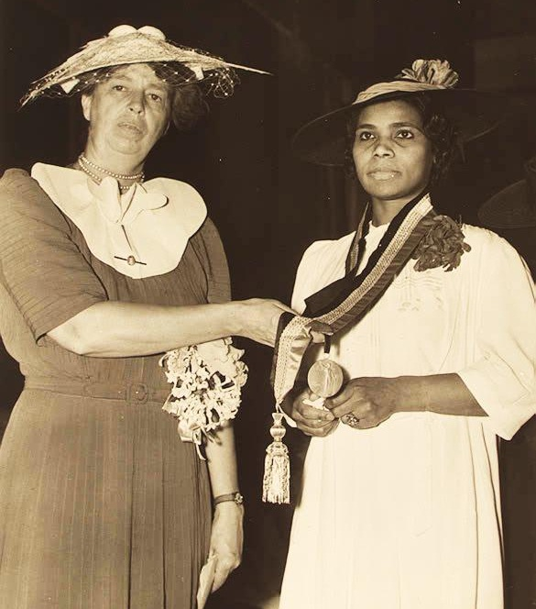
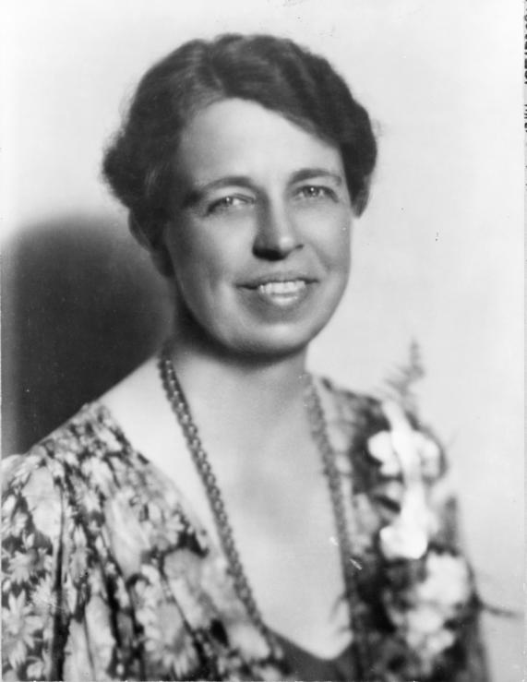
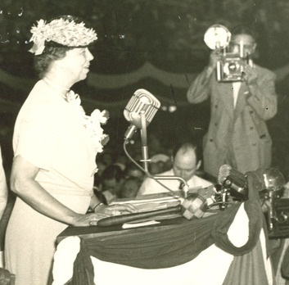
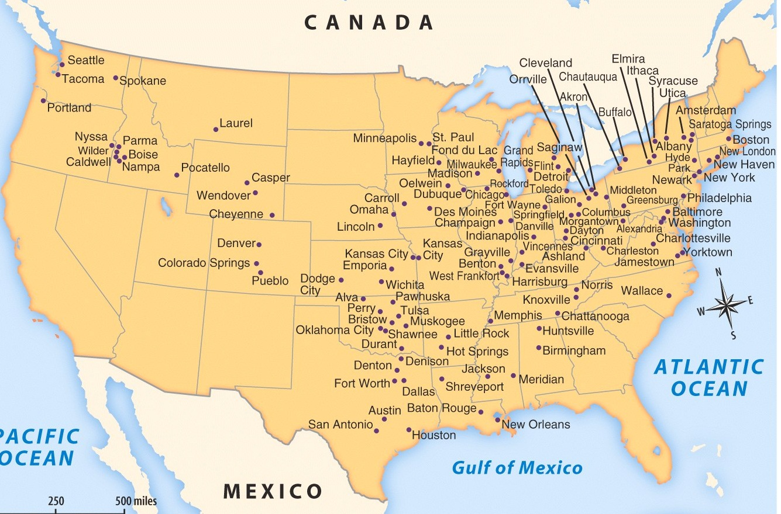
First Lady Eleanor Roosevelt served as FDR’s “legs and eyes” as she toured the nation
Eleanor became the “conscious of the New Deal” as she expressed concern for the needs of the American people
She was the first First Lady to give lectures, radio broadcasts, write a daily newspaper column, and speak out on behalf of African Americans

Slide 11
The New Deal focused on the three “Rs”
New Deal Programs
Relief Relief checks and job programs to lower unemployment
Recovery Programs to stimulate agriculture, industry, and the economy to end the depression
Reform Programs to correct problems in the economy and prevent future depressions

