Slide 1
Essential Question:
What were the important contributions of Hellenistic Greece?
Warm-Up Question:
How did geography affect the development of ancient Greece?

Slide 2
Greek Achievements
The ancient Greeks made contributions in many fields of learning & developed new innovations because:
The Greeks emphasized education & the pursuit of knowledge
Many Greeks could afford to support academies & centers of learning
Greece’s location along the Mediterranean Sea allowed for trade, the spread of diverse ideas, & the ability to build n achievements from other parts of the ancient world

Slide 3
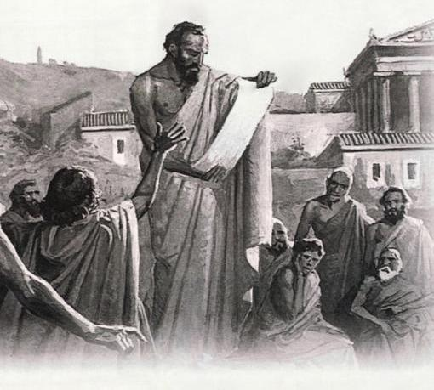
Greek Democracy

Slide 4
Greek Democracy
The foundation for our democratic republic began in Athens with their development of direct democracy.
Athenian citizens participated in government decisions by voting.
A council would propose laws and then all men over 18 years that wanted to could vote. The approved ideas would become laws.

Slide 5
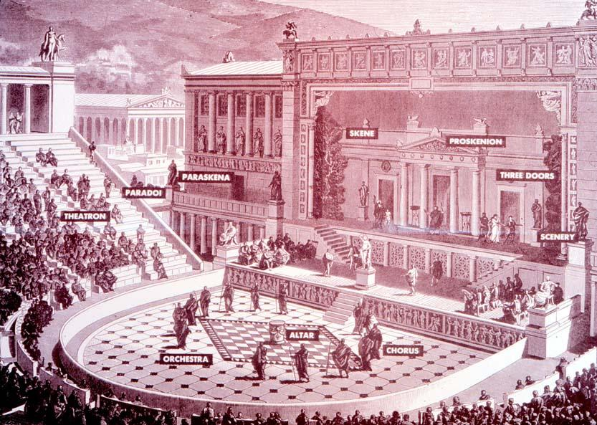
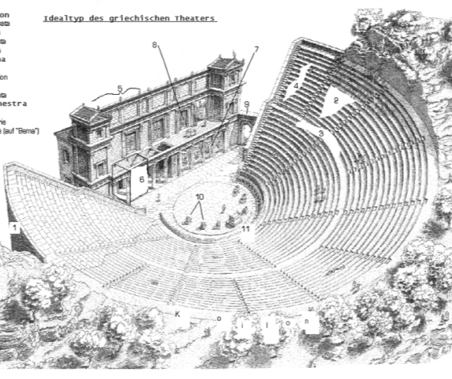
Greek Literature & Drama
Examine the images and answer these questions:
How does the seating arrangement in theater make it easy for the audience to see & hear what is happening?
Why would it be important for actors to wear large masks and colorful costumes?

Slide 6
Greek Literature & Drama
Homer, the poet wrote the famous stories of The Odyssey and The Iliad, which are read in Language Arts classes all over the world.
Drama was also important to the ancient Greeks. They were the first to develop comedies and tragedies.
Theaters were built that were open-air and built in a way that everyone in the audience could hear and see the action.

Slide 7
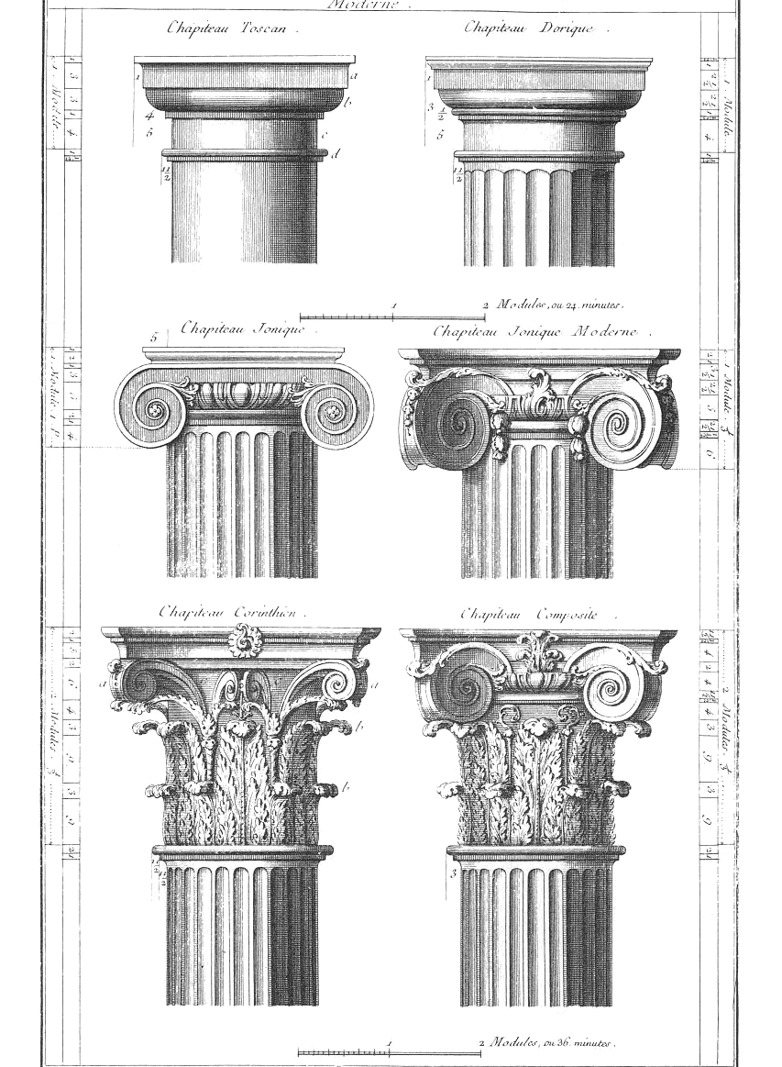
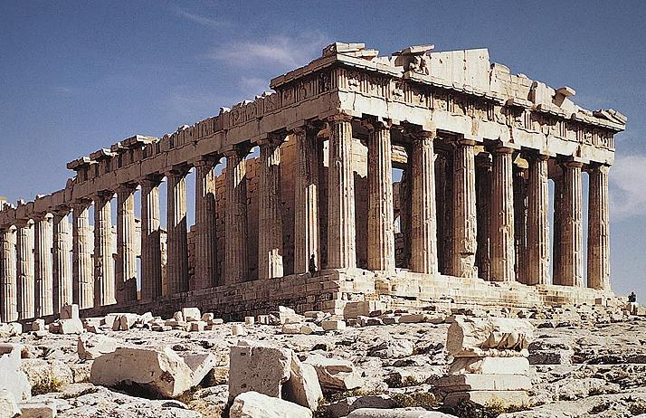
Greek Architecture
Which column do you think is the best style? Make a sketch of that style in the activity box of your notes for this station

Slide 8
Greek Architecture
The Greeks were among the most talented architects of the ancient world
The Parthenon, a temple made of marble in honor of the goddess Athena, is probably one of the most famous examples of Greek architecture.
The Greeks used columns (Doric, Ionic and Corinthian) & displayed murals of mythological scenes in their buildings.

Slide 9
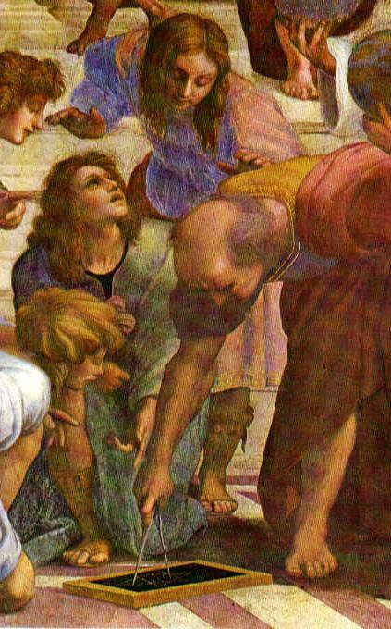
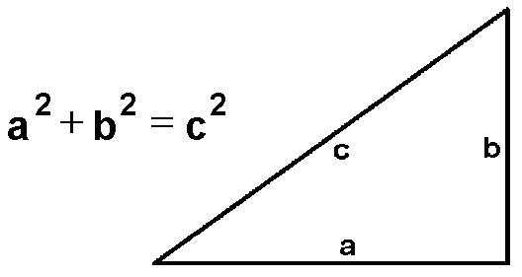
Greek Mathematics
Use the Pythagorian Theroum to solve for “c”.
The value of “a” is 3 and
“b” is 6

Slide 10
Greek Mathematics
Ancient Greek mathematicians developed many important concepts that are still used today. Scientists used pi to find circumference of circles.
Euclid developed proofs that became the basis for modern geometry
Pythagoras tried to explain everything in mathematical terms. He created a theorem about relationships of sides of right triangle that is used all over the world called the Pythagorean Theorem

