Slide 1
Essential Question:
What was the impact of the spread of Hellenic culture under Alexander the Great?
Warm-Up Question:
What are the top 3 Greek innovations? Explain how our world is better because of these 3 achievements.

Slide 2
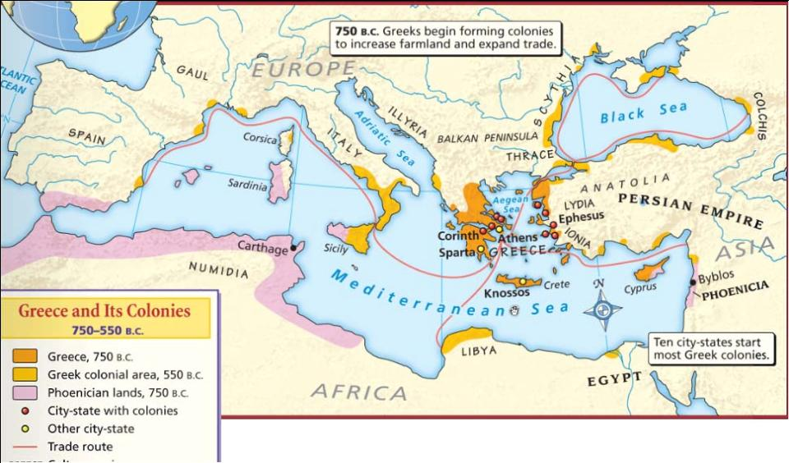
Ancient Greece
Mountains divided the Greeks into independent city-states, like Athens & Sparta
Access to the sea increased trade & cultural diffusion (sharing ideas) with other cultures

Slide 3
The Greek city-states, especially Athens, developed cultural innovations that are still used today which transformed Greece into a “classical civilization”

Slide 4
Greek wealth & innovation made it a target to outside invasion; From 493 B.C. to 479 B.C., Persian kings Darius & Xerxes tried (but failed) to conquer the Greeks in the Persian Wars

Slide 5
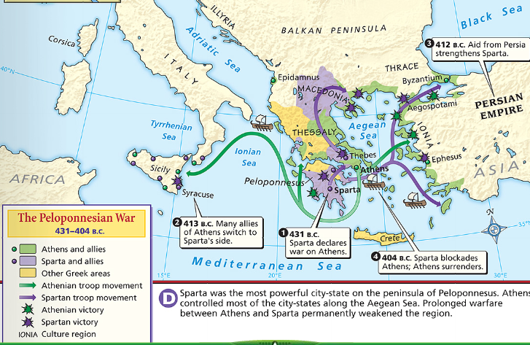
The Peloponnesian Wars left the Greeks weak & open to invasion
After the Persian Wars, the Greek city-states, led by rivals Athens & Sparta, fought each other in the Peloponnesian Wars

Slide 6
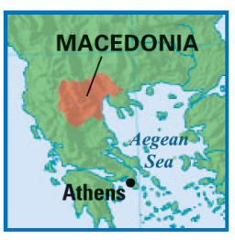
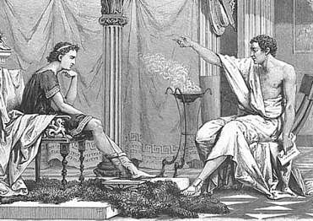
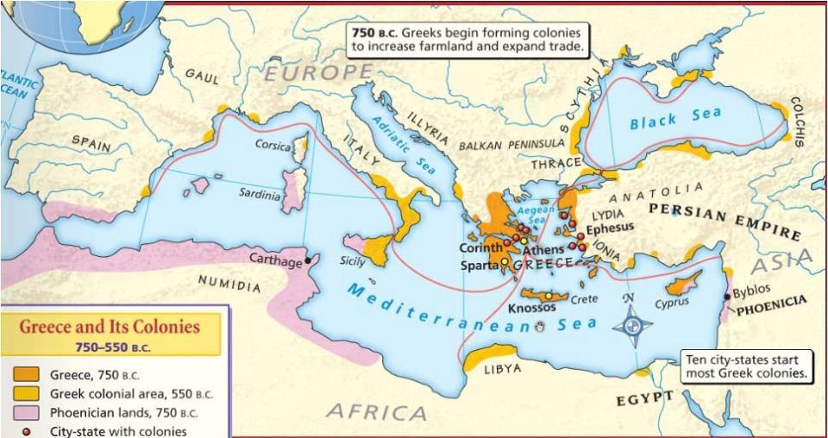
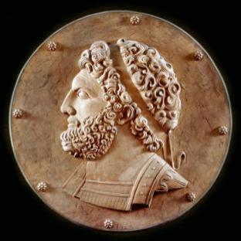
In 338 B.C., King Philip II of Macedonia attacked & conquered the Greeks, but he died soon after
Macedonians viewed themselves as Greeks & shared much of their culture; King Philip II hired Aristotle to tutor his son Alexander

Slide 7
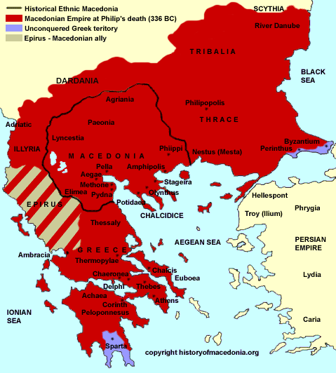
King Alexander of Macedonia
Alexander was only 20 years old when he became king of Macedonia:
But he proved to be ambitious & a brilliant military strategist
Once in power, Alexander began to expand his empire

Slide 8
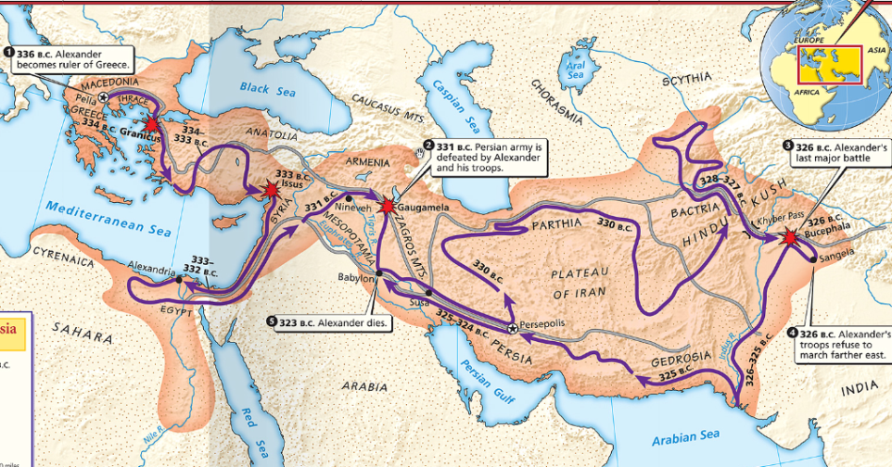
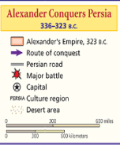
The Empire of Alexander the Great
Alexander began his conquest by crushing a Greek revolt in Thebes; He ordered the death of 6,000 people & sold everyone else into slavery; His brutality convinced other Greeks to not rebel
Alexander set his sights on the Persian Empire & began his attack by conquering Egypt; Egyptians viewed Alexander as a liberator

