Slide 1
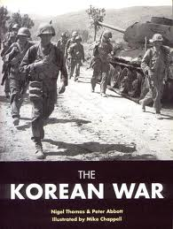
Korean & Vietnam Wars

Slide 2
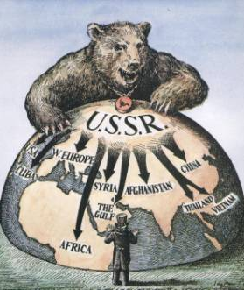
The U.S. response to the fall of China was to more aggressively confront communism the world
The USA was afraid of a “domino theory” in which communist nations turn their neighbors communist
As a result, the USA vowed to contain the spread of communism anywhere in the world
The USA acted when communism threatened Korea

Slide 3
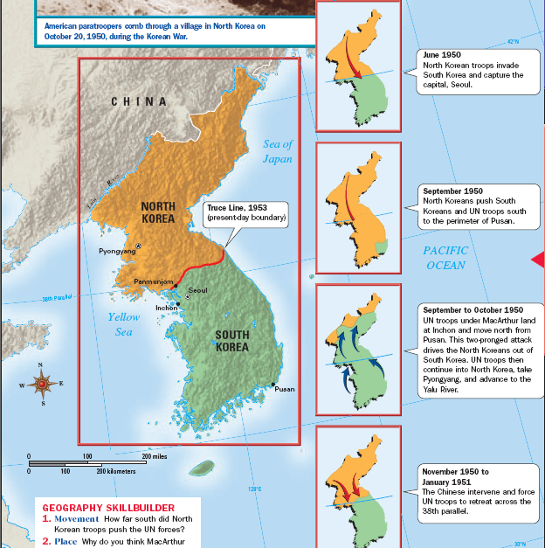
In 1950, North Korea (using Soviet supplied weapons) crossed the 38° & attacked South Korea
During World War II, Korea was liberated from Japanese control by the U.S. army in the South & the Soviet army in the North
When South Korea appealed to the United Nations, the USA sent troops to Korea to contain communism
But, when the USA pushed too close to China, the Chinese Army entered the war & helped North Korea
After WWII, Korea was divided along the 38° with a communist gov’t in North Korea & a democracy in South Korea

Slide 4
The USA successfully stopped communism from spreading into South Korea & showed that it was willing to fight to contain communism
Today, Korea remains divided between a communist North & a democratic South
After 3 years of fighting, a ceasefire was agreed to in 1953, the fighting stopped, & the 38° was restored as the boundary between North & South Koreas

Slide 5
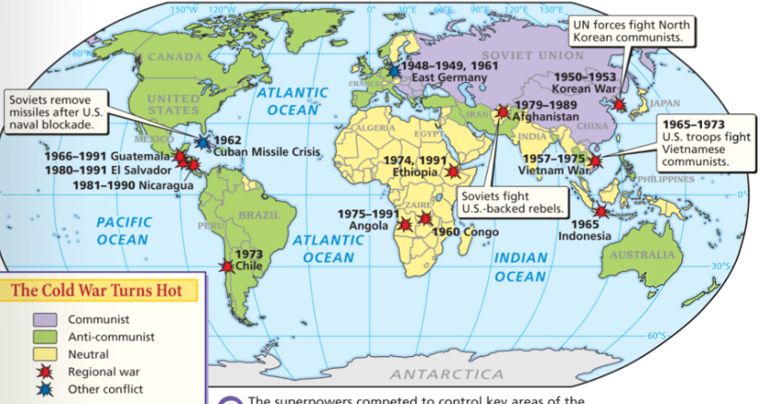
The fighting in Korea convinced many nations to not choose a side during the Cold War
These “neutral” countries during the Cold War were known as the “non-aligned nations”
While Korea was a success, the Cold War would escalate in the 1950s & 1960s as communism threatened Africa, Southeast Asia, & Latin America

Slide 6
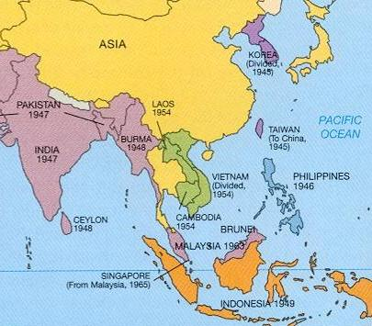
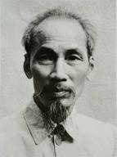
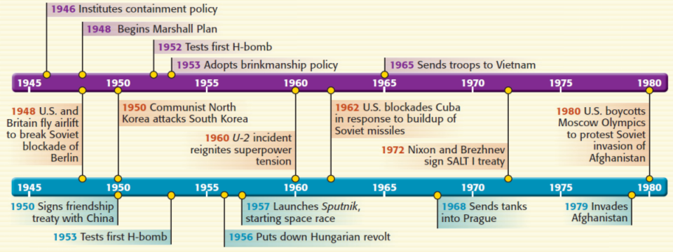
From 1965 to 1973, the USA became involved in the Vietnam War
When communist leader Ho Chi Minh gained independence for Vietnam, the USA feared communism in SE Asia

Slide 7
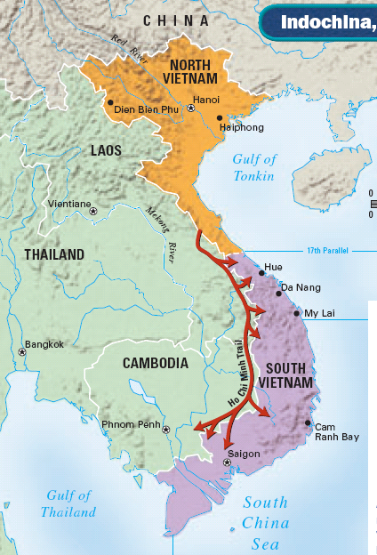
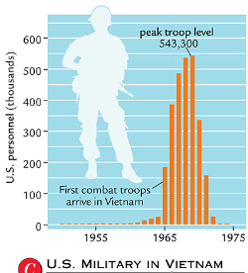
Vietnam was divided into a communist North & a democratic South
In South Vietnam, communists known as the Vietcong worked to unify North & South Vietnam
To contain communism, the USA sent troops to Vietnam starting in 1965

Slide 8
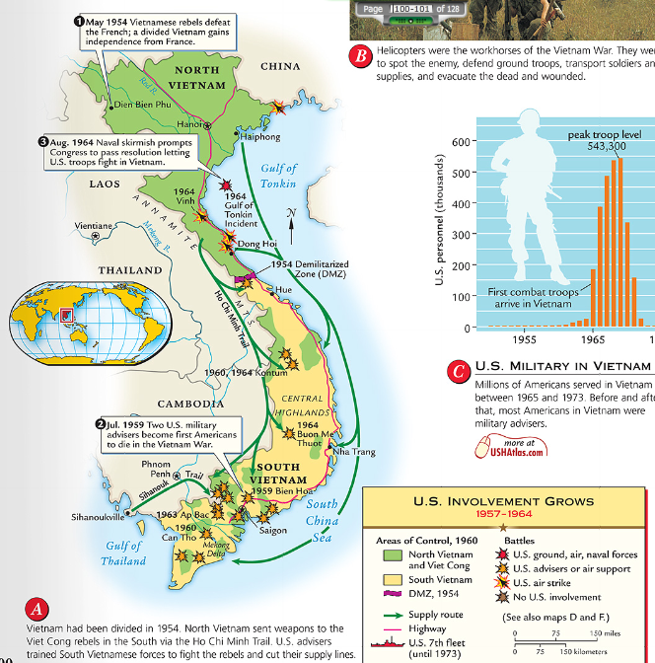
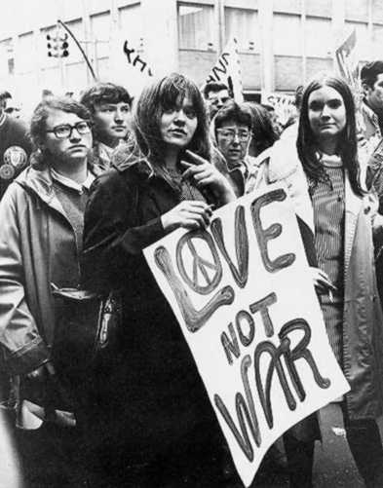
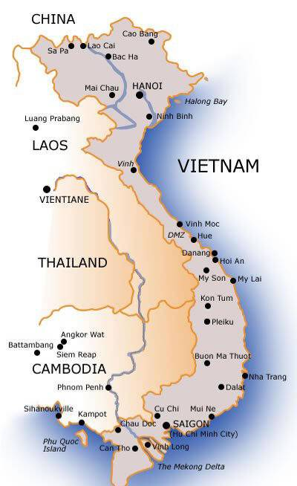
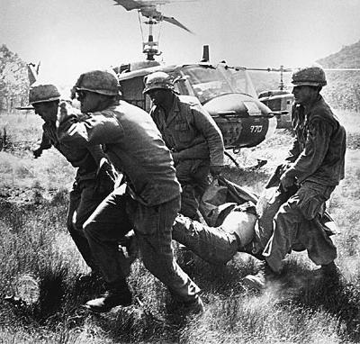
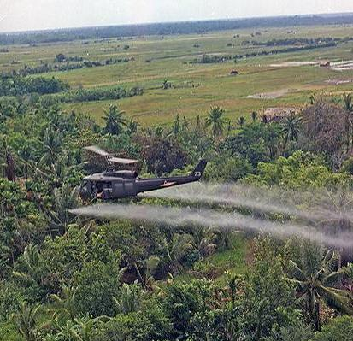
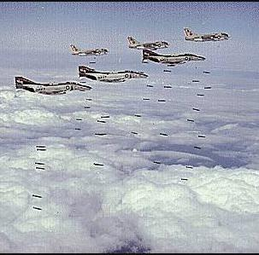
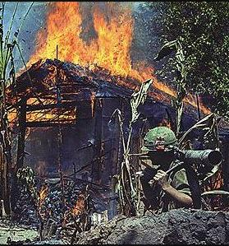
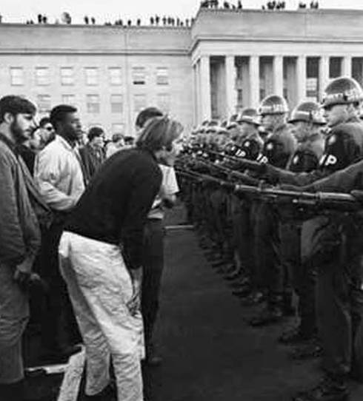
The American military used bombing raids, pesticides, & search-and-destroy missions to fight the communists
Despite these efforts, the U.S. was unable to defeat the communist enemy
The Vietnam War was expensive, hurt the U.S. economy, & became unpopular with anti-war protestors in the USA.
In 1973, the USA withdrew from Vietnam & 2 years later communists unified Vietnam

