Slide 1
Essential Question:
  In what ways did President Franklin Roosevelt’s “New Deal” provide relief, recovery, and reform during the Great Depression?

Slide 2
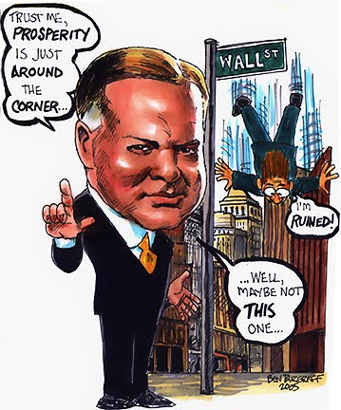
From 1929 to 1932, President Hoover was criticized for not doing more to end the depression
Tens of thousands
of businesses failed
and unemployment rose to 25%
The American banking system collapsed
Hoover initially relied on rugged individualism but offered relief checks and job programs,
but it was seen as
too little, too late

Slide 3
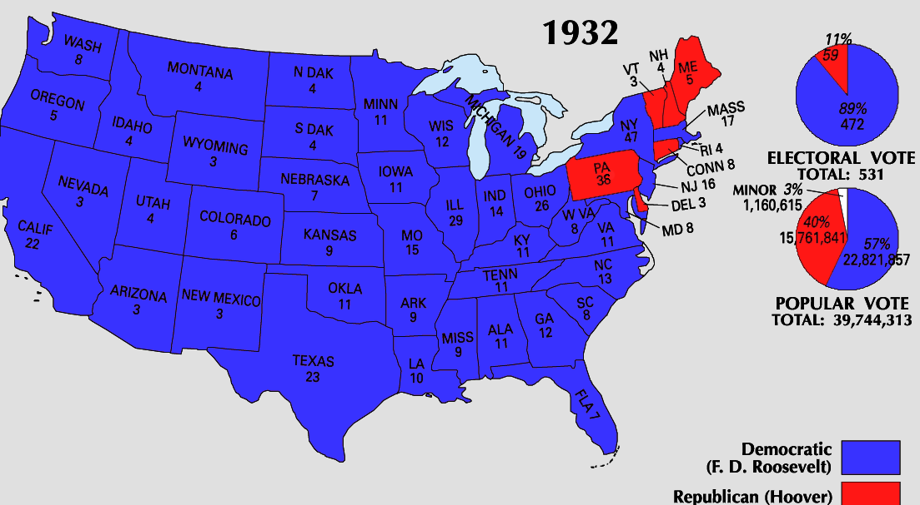
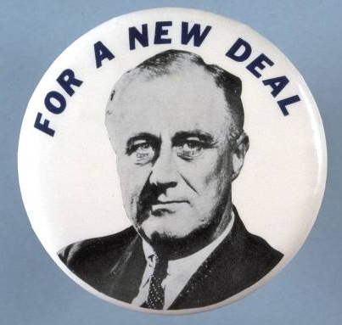
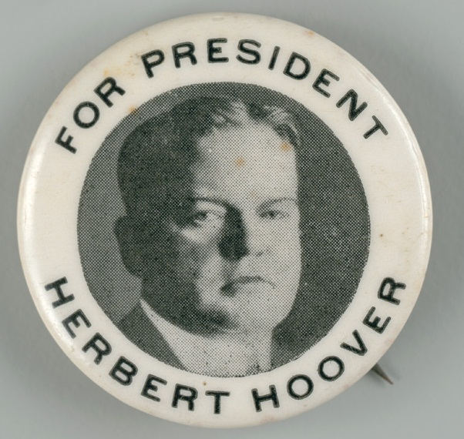
By the election of 1932, Hoover ran for re-election but Americans wanted hope and strong leadership
Democratic candidate Franklin Roosevelt defeated Hoover and won the presidency

Slide 4
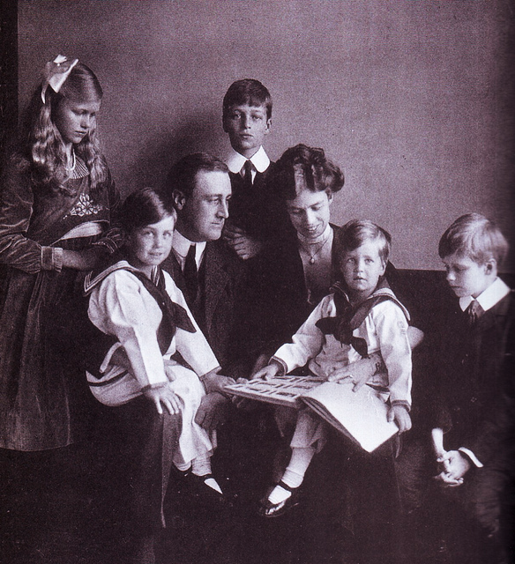
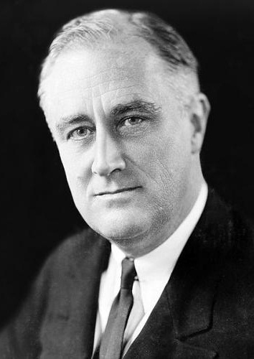
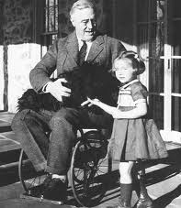
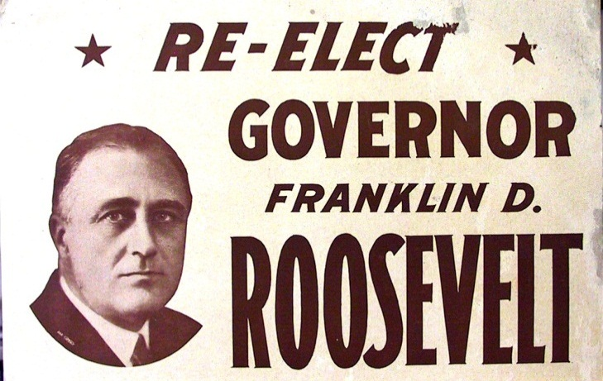
FDR Biography

Slide 5
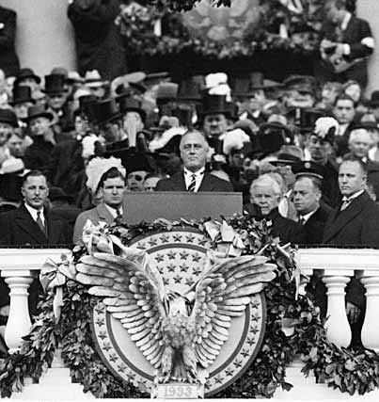
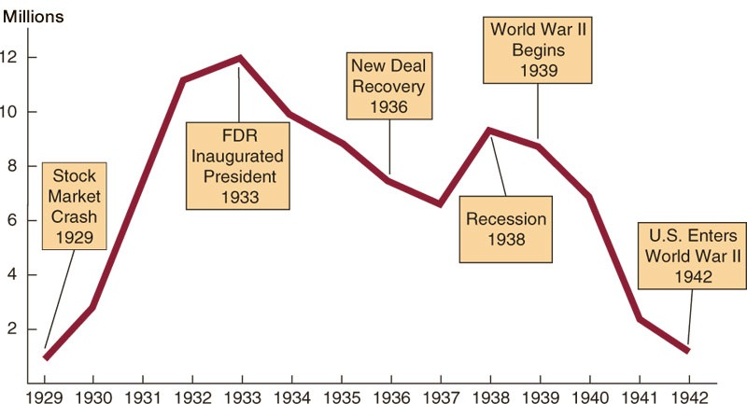

When Roosevelt was inaugurated as president, unemployment was at
an all-time high
In his inaugural address,
FDR inspired hope, declaring “the only thing we have to fear is fear itself”
“Let me assert my
firm belief that the only thing we have to fear
is fear itself; nameless, unreasoning, unjustified terror which paralyzes needed efforts to convert retreat into advance.”

Slide 6
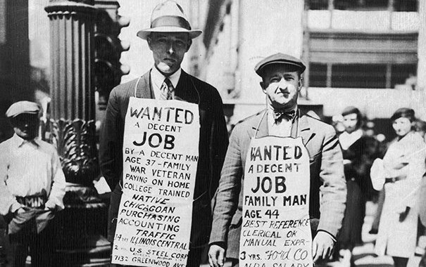
When FDR became president be promised decisive gov’t action
to fight the depression
FDR believed the gov’t should use deficit spending (spending that causes debt) to stimulate the economy

Slide 7
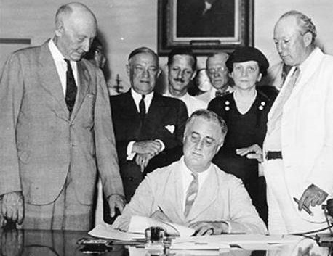
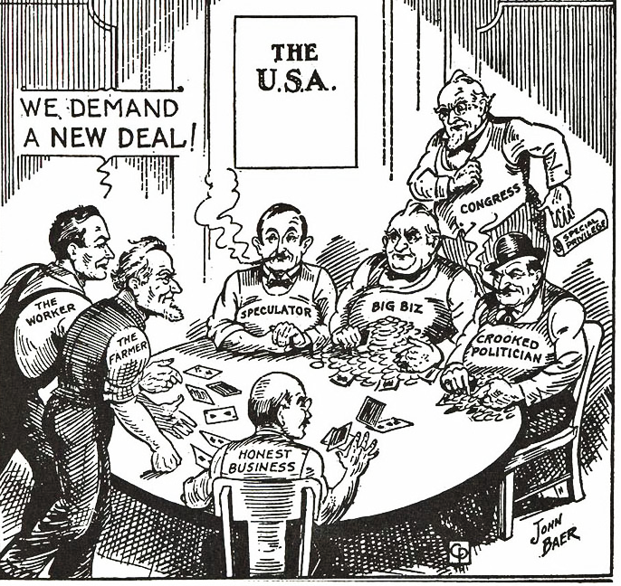
In his first 100 days in office, FDR and Congress passed a broad platform of legislation to attack the depression called the “New Deal”

Slide 8
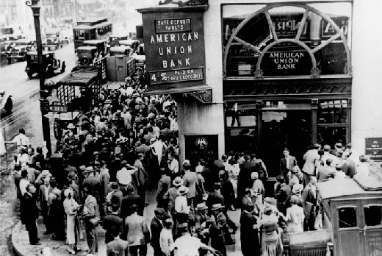
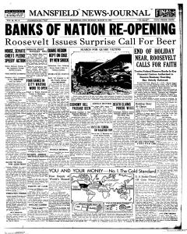
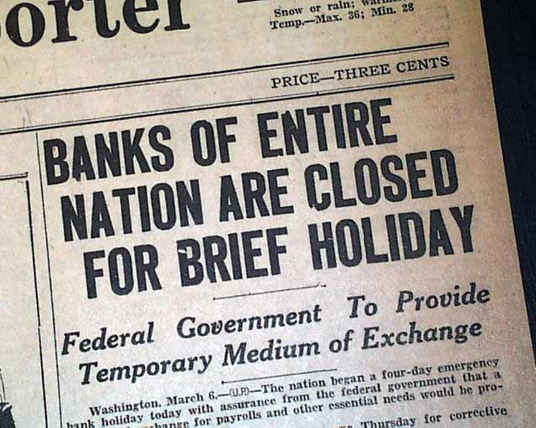
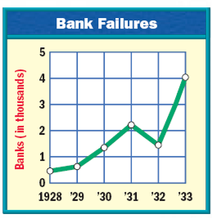
FDR’s first action was to address the bank crisis
By 1933, 25,000 banks had failed and the
USA was in a complete financial collapse
FDR declared a four-day “bank holiday”:
all banks were closed and inspected by federal regulators to determine which banks were healthy…
…Only healthy banks could reopen after
the bank holiday

Slide 9
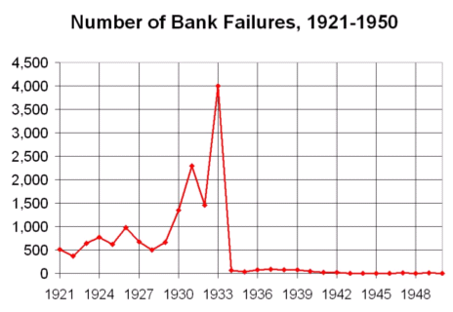
After the bank holiday, few U.S. banks failed and Americans slowly began to regain confidence in banks

Slide 10
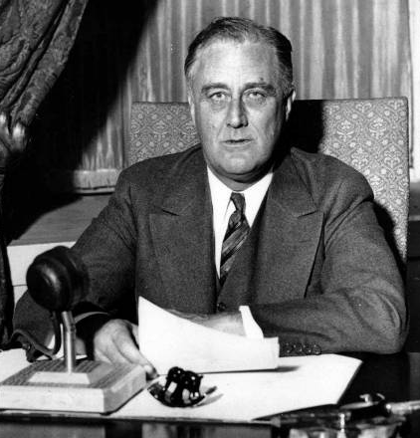
FDR used the power of the radio to communicate to the American people the steps the government was taking to address the problems of the depression
FDR’s “fireside chats” used simple, clear language to explain New Deal programs
These weekly radio addresses gave people confidence that the government was actively fighting the Great Depression

Slide 11
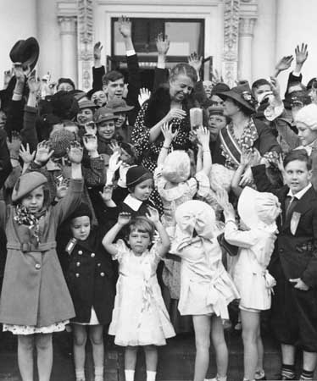
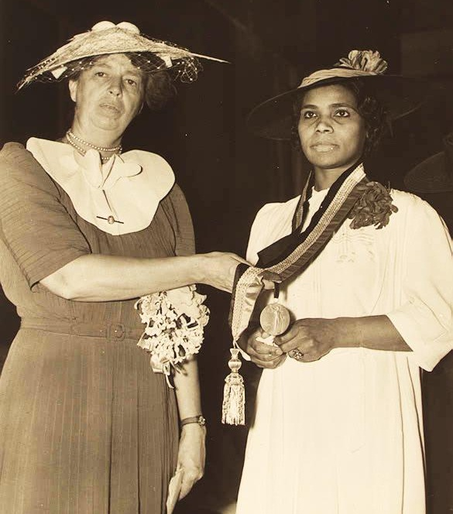
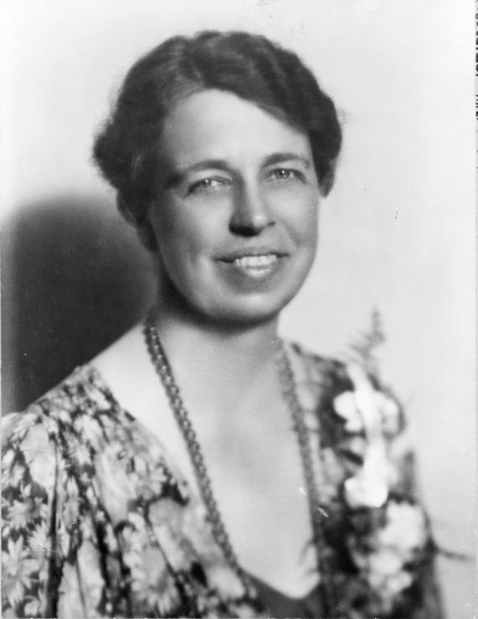
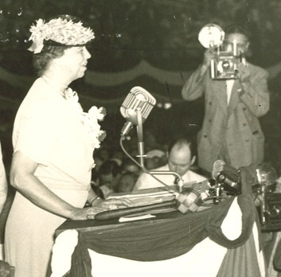
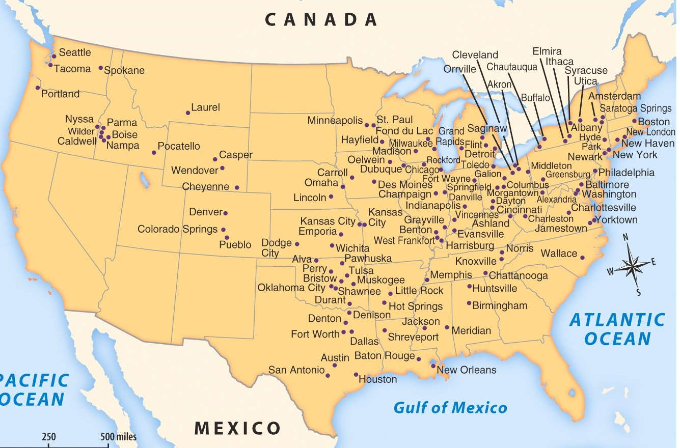
First Lady Eleanor Roosevelt served as FDR’s “legs and eyes”
as she toured the nation
Eleanor became the “conscious of the New Deal” as she expressed concern for the needs of the American people
She was the first
First Lady to give lectures, radio broadcasts, write a daily newspaper column, and speak out on behalf of African Americans

Slide 12



The New Deal focused on the three “Rs”
New Deal Programs
Relief
Relief checks and job programs
to lower unemployment
Recovery
Programs to stimulate agriculture, industry, and the economy to end the depression
Reform
Programs to correct problems in the economy and prevent future depressions

Slide 13
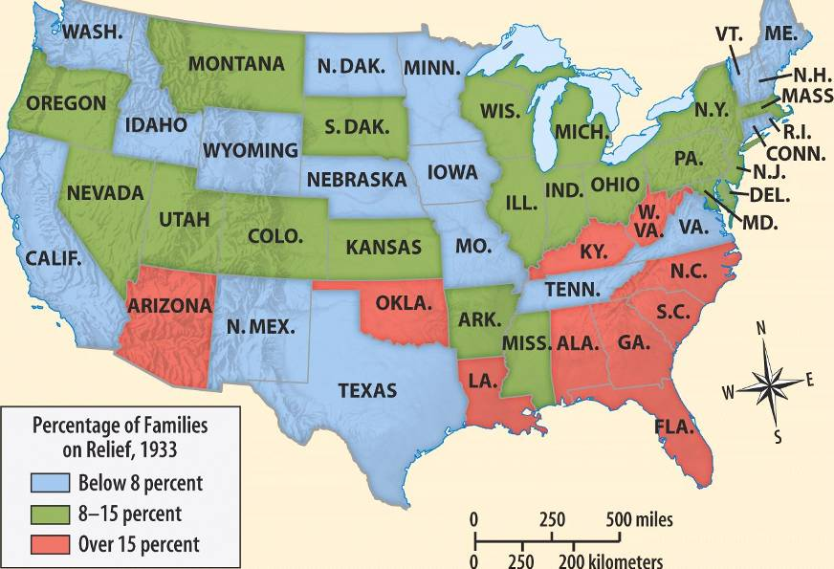
The greatest success of the New Deal was its
ability to offer relief to unemployed citizens
with unemployment checks and job programs
During the New Deal, the gov’t provided relief checks to
15% of Americans

Slide 14
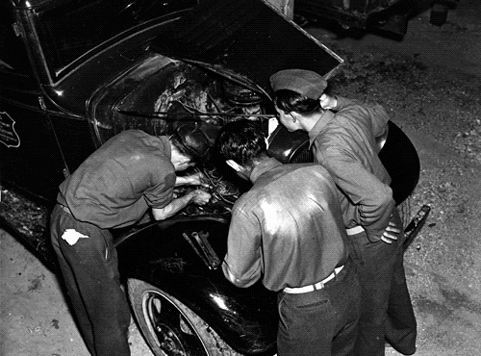
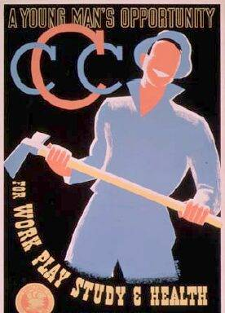
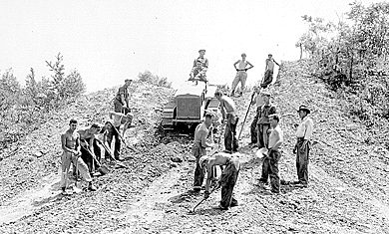
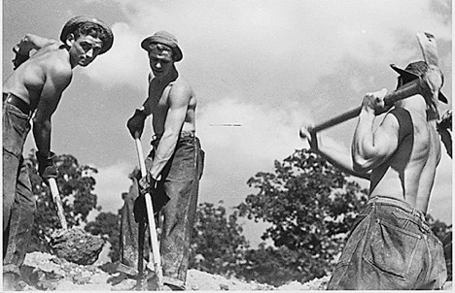
The government helped relieve
unemployment by creating jobs
The Civilian Conservation Corps (CCC) was a work program for young men aged 18-25 years old…
  The CCC built roads, parks, soil erosion project, and employed 3 million men

Slide 15
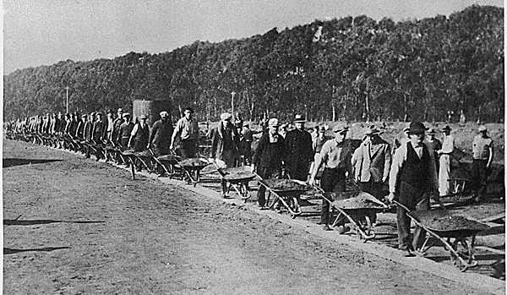
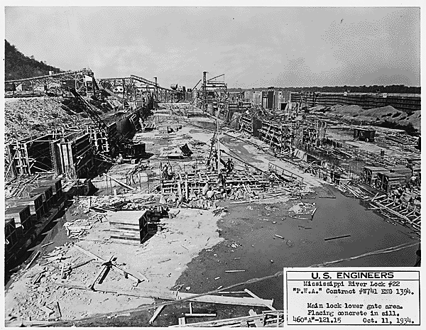
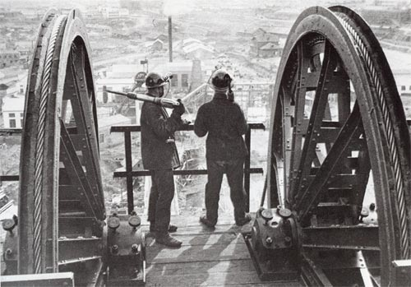
The government helped relieve
unemployment by creating jobs
The Public Works Admin (PWA) hired 2 million to build airports, dams, schools, hospitals, parks
Notes:
The PWA funded the construction of more than 34,000 projects, including airports, electricity-generating dams, and aircraft carriers; and seventy percent of the new schools and one third of the hospitals built during that time

Slide 16


The New Deal created long-term reforms
to address weaknesses in the American economy and address the causes of the Great Depression
Securities and Exchange Commission (SEC) was created to regulate the stock market and prevent another crash

Slide 17
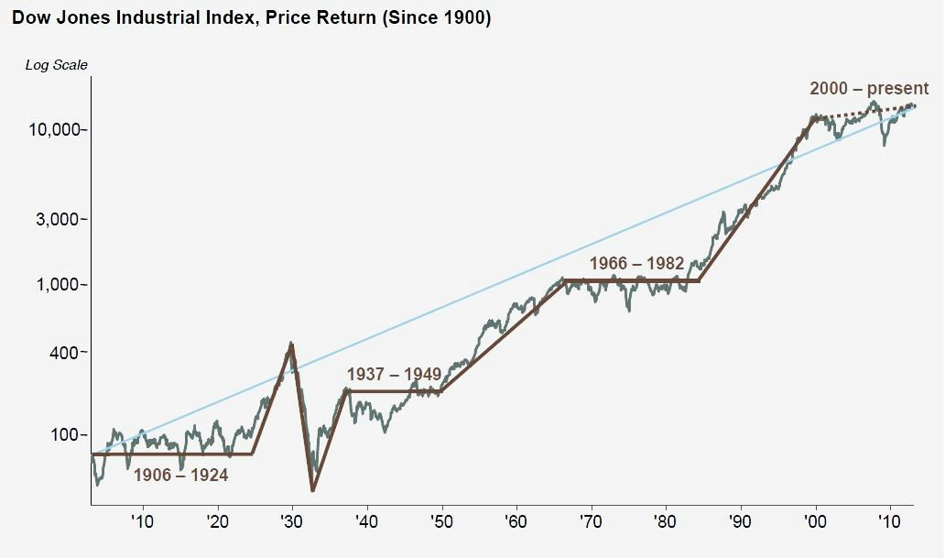
The New Deal created long-term reforms
to address weaknesses in the American economy and address the causes of the Great Depression

Slide 18
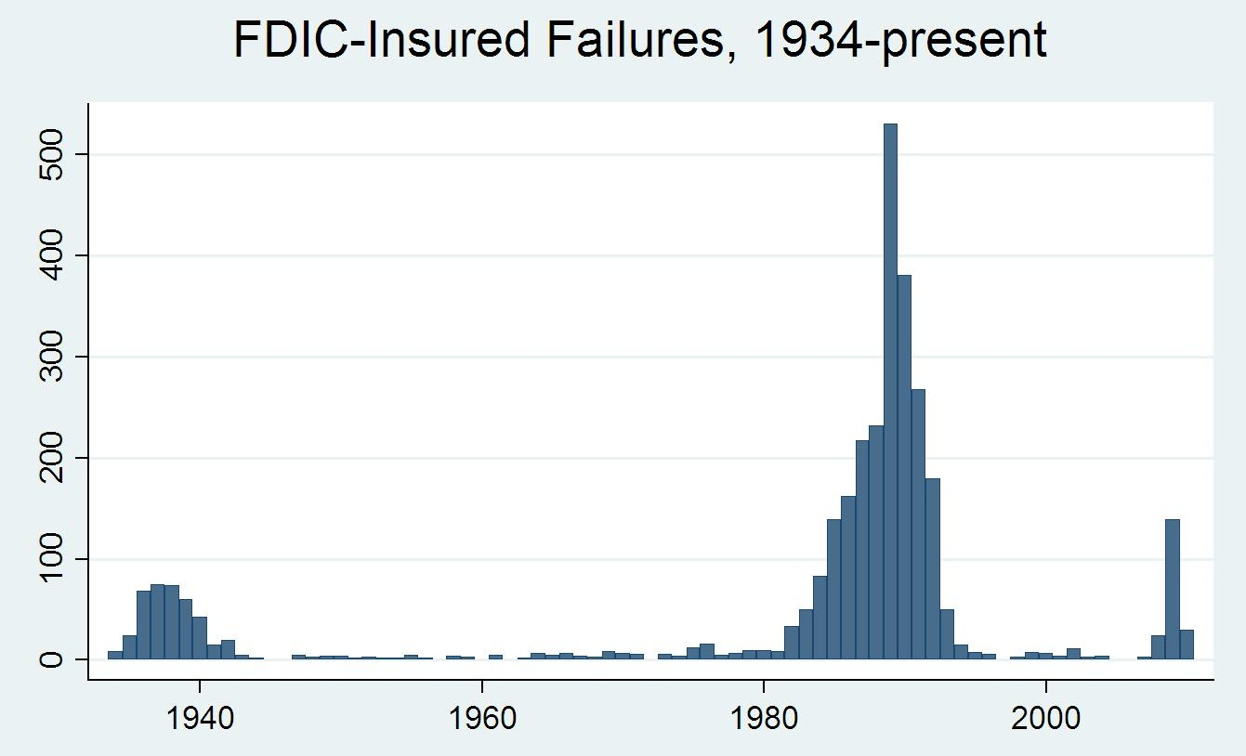
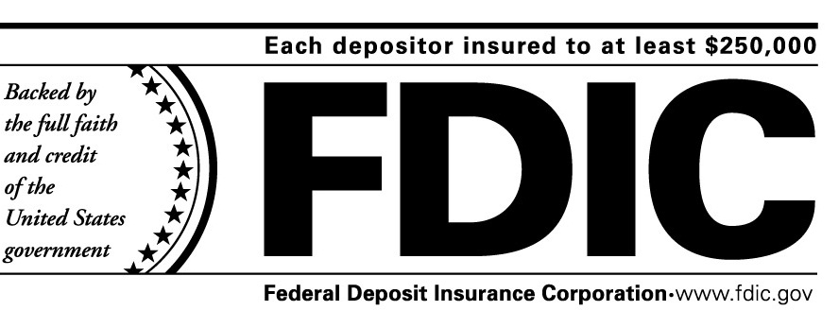
The New Deal created long-term reforms
to address weaknesses in the American economy and address the causes of the Great Depression
The Federal Deposit Insurance Corporation (FDIC) was created to guarantee customer bank accounts and restore public confidence in banks
The government insures up to $250,000 in each bank account

Slide 19

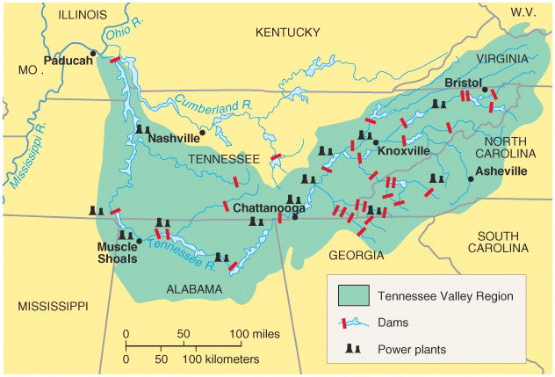
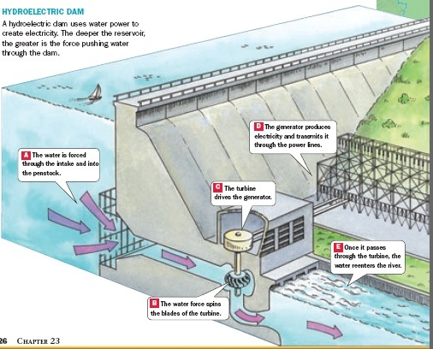
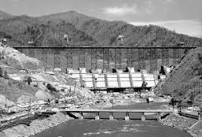
The New Deal created long-term reforms
to address weaknesses in the American economy and address the causes of the Great Depression
The Tennessee Valley Authority (TVA) was created to bring electricity to the South and create jobs
The TVA built hydroelectric power plants in seven Southern states providing issued
cheap power

Slide 20
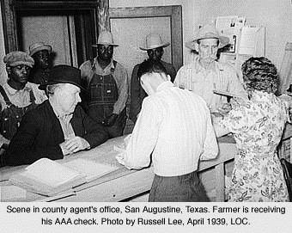
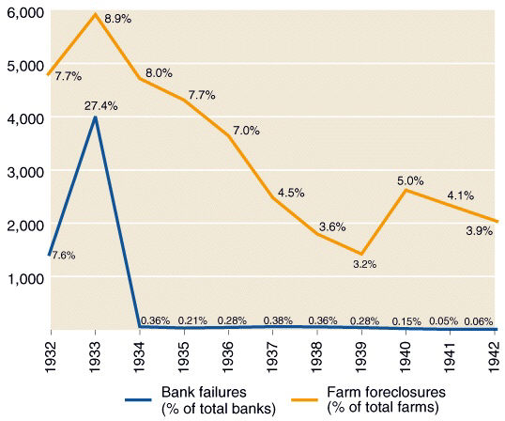
New Deal programs tried to recover the
economy by stimulating industry and farming
Agricultural Adjustment Act (AAA) was created
to help farmers and stimulate agriculture
  The AAA paid farmers not to produce; The gov’t hoped to increase crop prices by reducing supply
  The AAA helped farmers, but they never made enough money to stimulate the economy

Slide 21
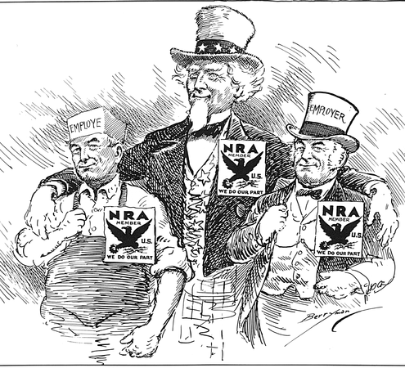

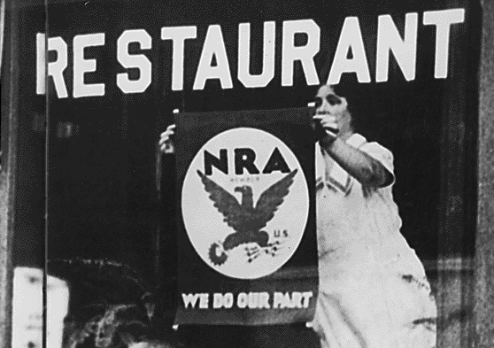
New Deal programs tried to recover the
economy by stimulating industry and farming
The National Recovery Administration (NRA) was created to stimulate industry
The NRA tried to set fair wages and hours for workers and minimum prices for products
The NRA failed to
create fair competition, stimulate industry, or end the depression

Slide 22
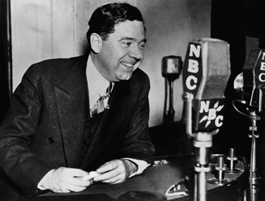
From 1933 to 1935, FDR’s New Deal programs helped lower unemployment and restored hope, but the Great Depression had not come to an end
FDR’s failure to end the depression led to criticism of the New Deal
The most vocal
critic was Louisiana Senator Huey Long
Huey Long’s
Share the Wealth plan proposed taxing all personal income over $1 million and give each U.S. family $2,500 per year
The “first”
New Deal

Slide 23
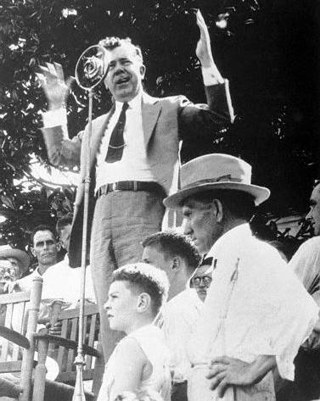
“The Kingfish” Huey Long
“How many men ever
went to a barbecue and would let one man take off the table what's intended for 9/10th
of the people to eat?
The only way you'll
ever be able to feed the balance of the people is to make that man come back and bring back some of that grub that he ain't got no business with!...
…But when they've got everything on God's loving earth that they can eat and they can wear and they can live in, and all that their children can live in and wear and eat, and all of their children's children can use,…
…Now, how are you
going to feed the
balance of the people?
What's Morgan and Baruch and Rockefeller and Mellon going to do with all that grub?
They can't eat it,
they can't wear the clothes, they can't
live in the houses…
…then we've got to call Mr. Morgan, Mr. Mellon, and Mr. Rockefeller back and say: “Come back here, put that stuff back on this table here that you took away from here that you don't need. Leave something else
for the American people to consume.”
Huey Long threatened to run as a 3rd party candidate but was assassinated in 1935
Notes:
Kingfish

Slide 24
In 1935, FDR began
an aggressive series
of laws called the Second New Deal
The Second New Deal was passed by Congress in a
rapid succession known as the Second Hundred Days
The “First”
New Deal
The “Second”
New Deal

Slide 25
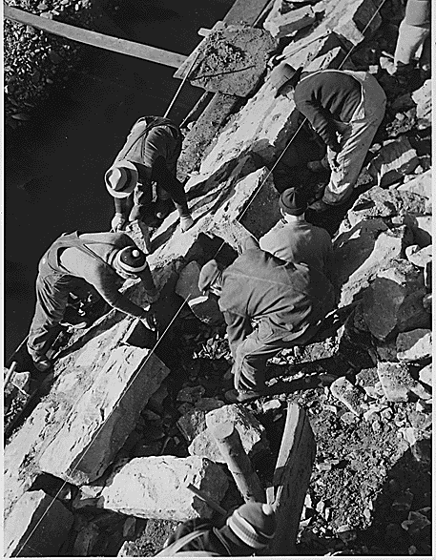
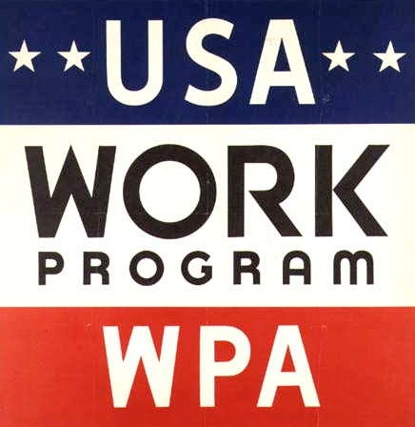
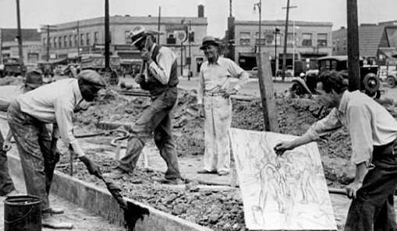
The most ambitious works program of the New Deal was the Works Progress Administration (WPA)
By 1935, most New Deal work programs were non-skilled building jobs
The WPA was created to provide as many as 10 million jobs for men, women, and youths in
building projects…

Slide 26
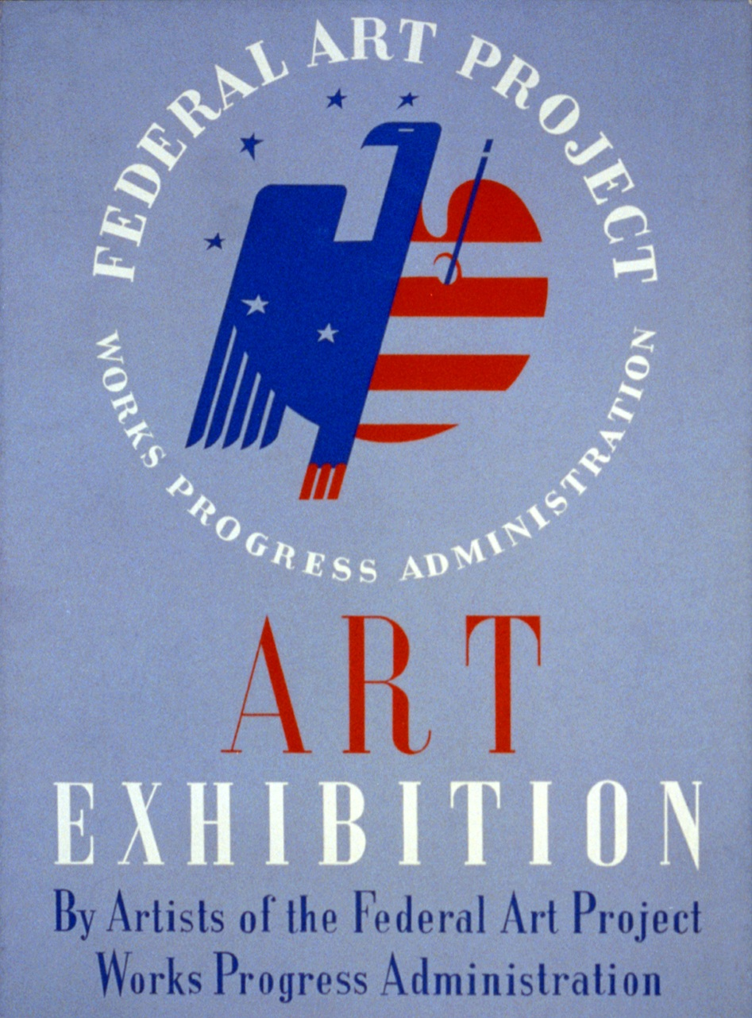
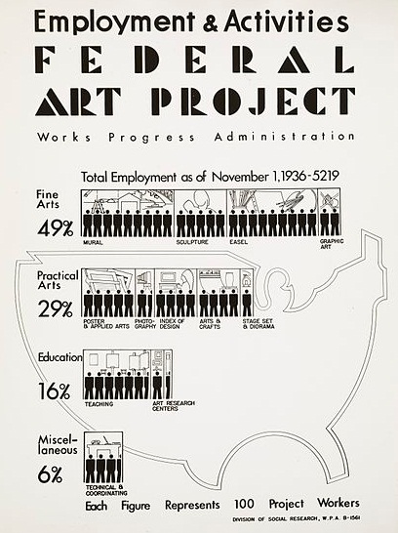
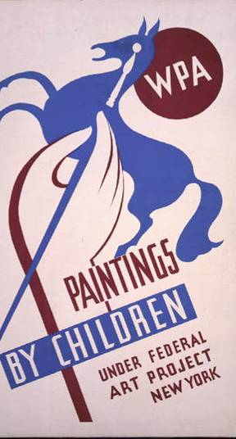








…as well as a variety of professions including
artists…

Slide 27


…as well as a variety of professions including
artists, writers,…

Slide 28




…as well as a variety of professions including
artists, writers, teachers,...

Slide 29



…as well as a variety of professions including
artists, writers, teachers, doctors

Slide 30



To combat poverty among the elderly and disabled, Congress created the Social Security Act
  Social Security provided old-age pensions for Americans at age 65
Social Security was also America’s first welfare program because it provided payments for blind, handicapped, and needy children

Slide 31


One of the most important reforms on the New Deal was the Wagner Act
The law protected workers’ right to strike and collectively bargain
It created a Fair Labor Practices Commission to regulate unfair practices used by companies to discourage union membership
Due to the Wagner Act, union membership in the USA increased

Slide 32

New Deal Posters
Create a New Deal poster advertisement:
  In your group, create an advertisement for one of
  8 New Deal programs
  You cannot name the program, but you need to illustrate its features
  Include your group number
  (1-8) and post it on the wall
Go around the room and use your charts to guess which
group was assigned which topic

Slide 33

In 1936, FDR was overwhelmingly elected to a second term…
…But his second term would prove more difficult than his first

Slide 34

By 1937, President Roosevelt faced criticisms
that the New Deal was too expensive, did not eliminate unemployment, or end the depression
FDR backed off government funded job programs and unemployment quickly rose
The New Deal was not stimulating the economy to end the Great Depression
The “First”
New Deal
The “Second”
New Deal

Slide 35




In addition, two New Deal recovery
programs (AAA and NRA) were declared unconstitutional by the Supreme Court
FDR feared that the Supreme Court would weaken the New Deal
FDR threatened to “pack the Supreme Court” and increase the number of justices from 9 to 15
People were outraged as FDR appeared to be overstepping his Constitutional powers

Slide 36
After 1938, Congress focused on trying to control spending and did not pass any more New Deal laws
The “First”
New Deal
The “Second”
New Deal

Slide 37
After 1938, Congress focused on trying to control spending and did not pass any more New Deal laws
Class Discussion:
How effective was
the New Deal at relief, recovery, and reform?
New Deal Programs
Relief
Job programs to lower unemployment
Recovery
Programs to stimulate the economy and end the depression
Reform
Programs to correct problems in the economy and prevent future depressions
Success or failure?
Evidence?
Success or failure?
Evidence?
Success or failure?
Evidence?

Slide 38


FDR’s New Deal dramatically changed America
The New Deal was successful in offering relief programs like the CCC, PWA, WPA to help people through the Depression
New Deal was successful in offering reform to the stock market (SEC), banking (FDIC), unions (Wagner Act, FLPC),
elderly (Social Security)

Slide 39
FDR’s New Deal dramatically changed America
But, the New Deal did not lead to recovery in the American economy
By 1938, nearly
10 million
people were unemployed
Wealth remained unevenly divided

Slide 40


FDR’s charisma and active involvement in the economy in changed the role of the presidency and expectations of gov’t
FDR’s leadership unified African Americans, unions, immigrants, and poor voters under the Democratic Party

Slide 41



For the first time, the gov’t used deficit spending and created welfare programs to help groups in need

Slide 42



