Slide 1
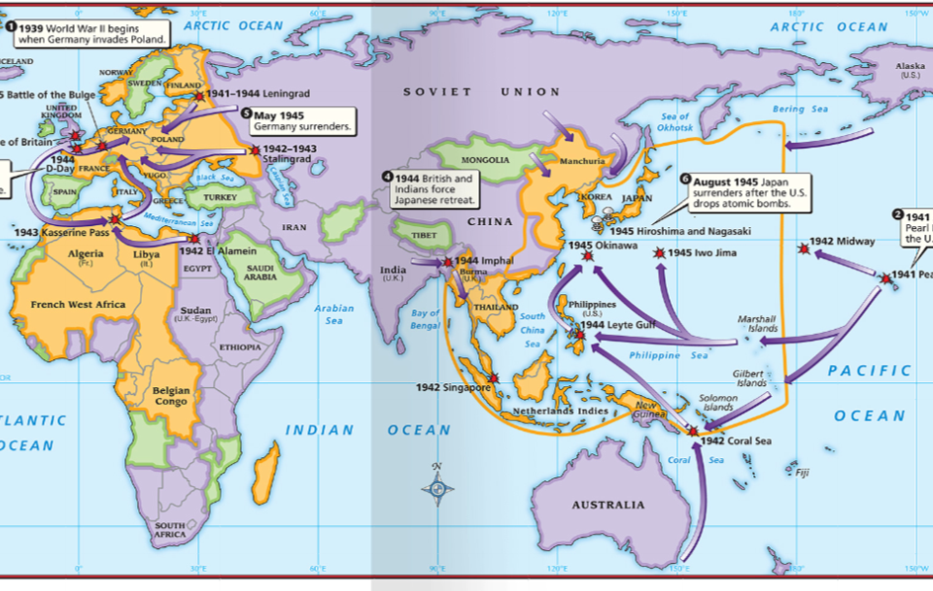
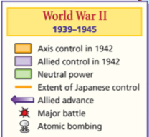
The end of World War II led to important changes in the world:

Slide 2
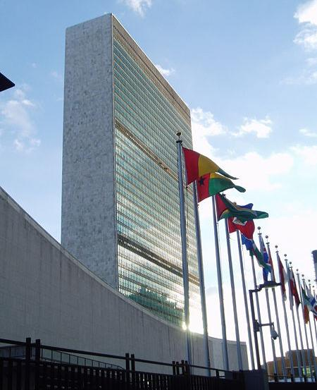
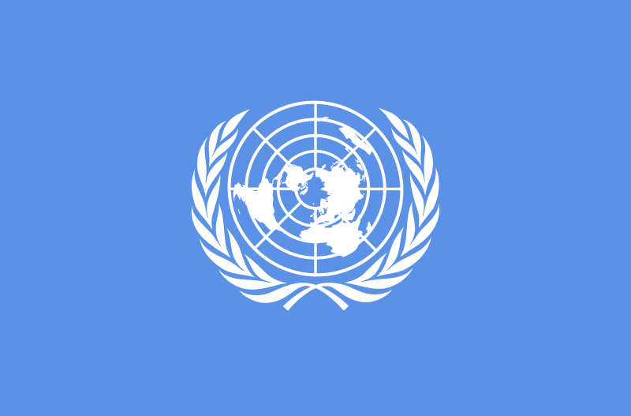
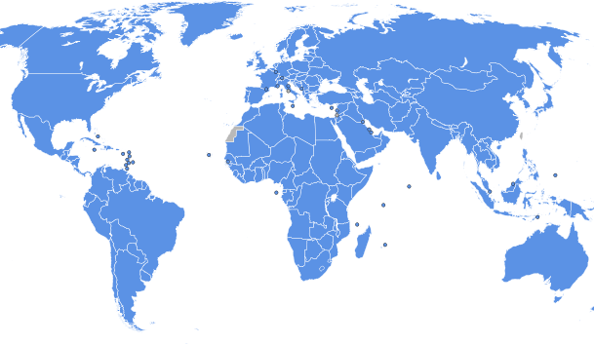
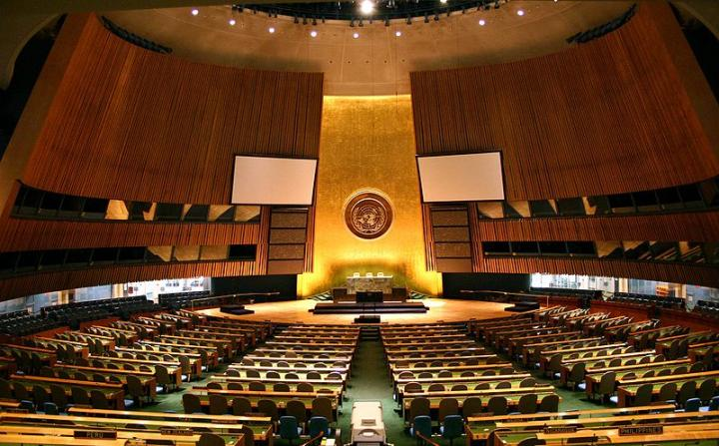
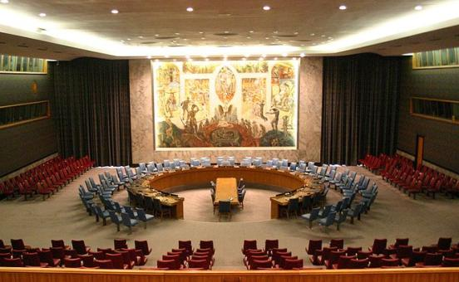
The United Nations was created which replaced the League of Nations
United Nations Headquarters is in New York City
Executive Council
General Assembly
Member Nations

Slide 3
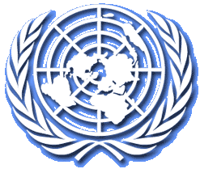
United Nations
United Nations was created in 1945 to correct the problems of the League of Nations
The UN was founded on principles of equal rights & international peace
Made up of 51 nations, but 5 permanent members (England, China, France, USA, USSR) could decide if the UN would use its military to enforce international law

Slide 4
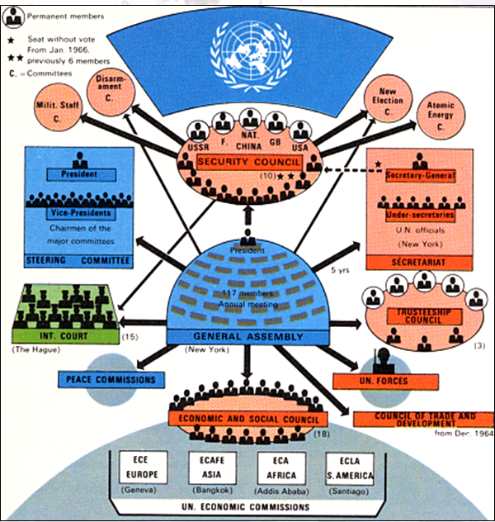

Slide 5
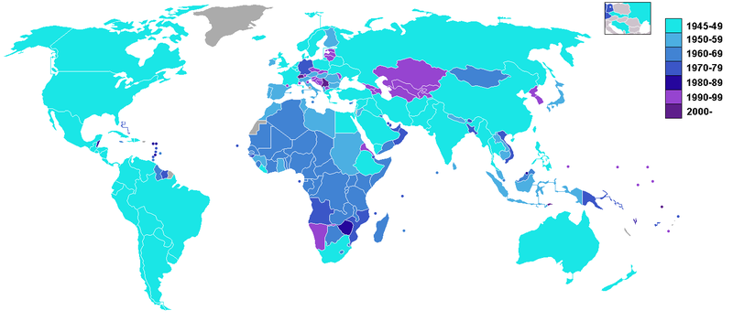
United Nations Members & When Each Country Joined

Slide 6
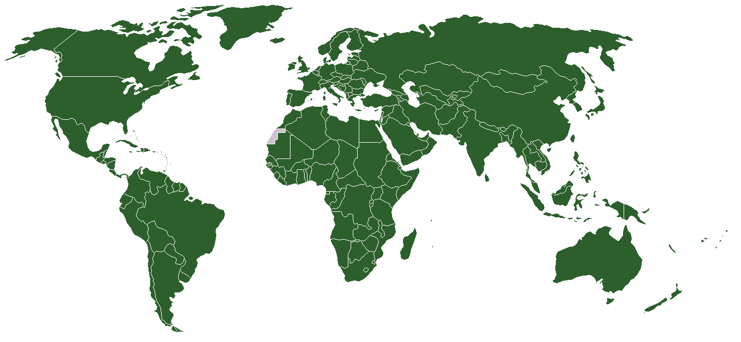
Current UN Member States

Slide 7
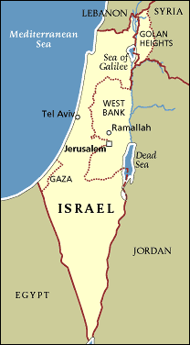
Creation of Israel
Since the early 1900s, Jews wanted to build a separate Jewish country in Palestine
After the Holocaust, a Zionist movement (Jews who want their own state) grew & became popular

Slide 8
Creation of Israel
In 1948, the United Nations created Israel, but Arab leaders were angered
24 hours after its creation, Israel was attacked by Syria, Lebanon, Iraq, Egypt, Jordan
Israel won the battle & shared Jerusalem with the Arabs, but Arab Muslims never accepted the Jewish claim to Israel

Slide 9
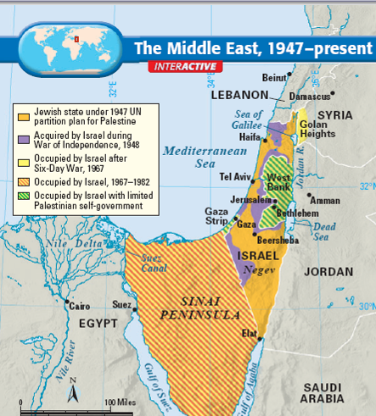
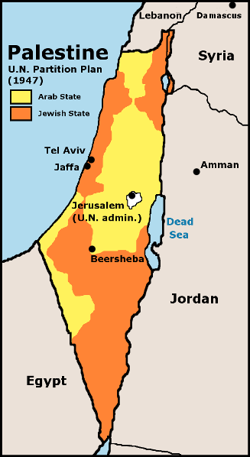
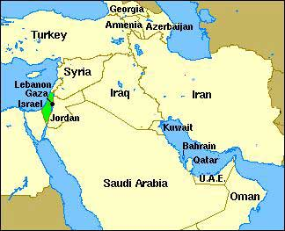
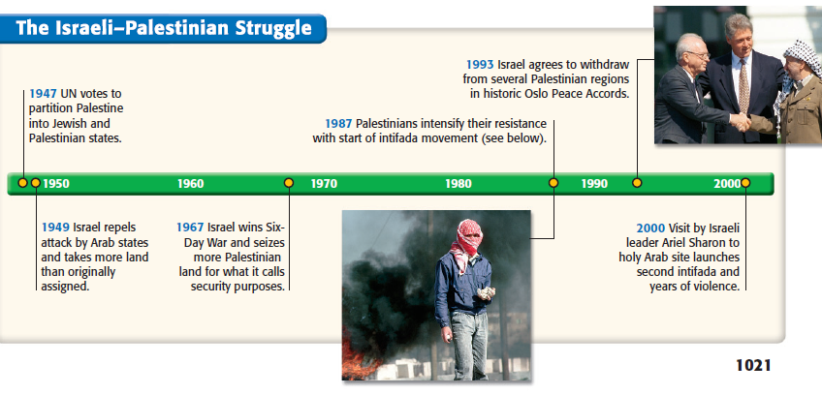

Slide 10
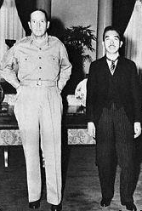
“Allied” (really US) Occupation
General Douglas MacArthur was sent to occupy & govern Japan after WW2; he was determined to help the Japanese recover
A new Japanese Constitution was created that took power from the emperor & created a democracy

Slide 11
“Allied” (really US) Occupation
Japan could not have a military; Japan would be protected by the US military in exchange for military bases in South East Asia
US military protection
Japan
USA

Slide 12
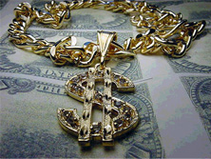
Economic Recovery
The Allied occupation allowed Japan to focus on rebuilding its economy, not its military
By the 1980s, Japan was the leading world economic power; now Japan exports more than it imports (called a trade surplus)

Slide 13
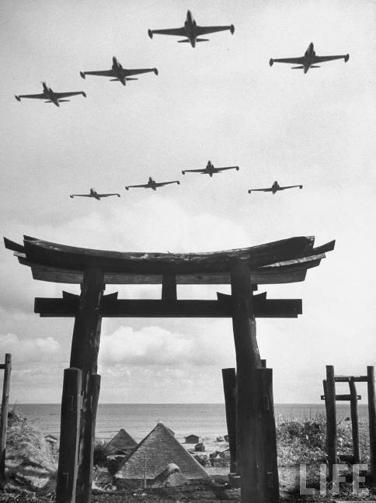
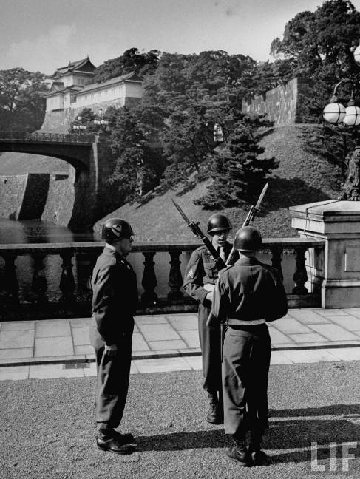
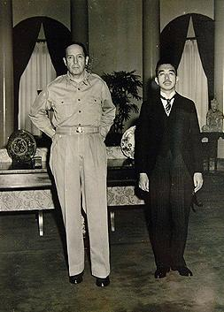
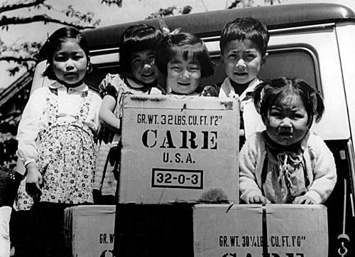

Slide 14
Decolonization
World Wars 1 & 2 eroded the supremacy of the major imperialist powers (i.e. France & England)
Following World War 2, India & many nations of Africa & Southeast Asia began to rebel (peacefully in most cases) from their imperialist countries & gain their independence

Slide 15
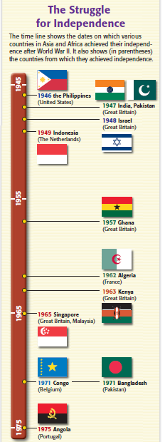
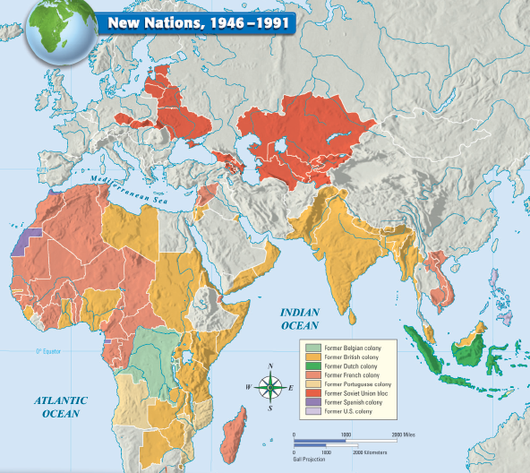

Slide 16
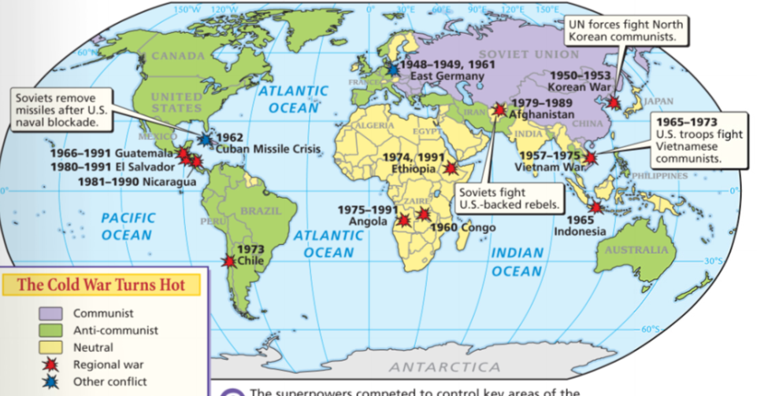


The United States
& Soviet Union were superpowers & rivals who dominated world politics
One of the most important changes after World War II was the beginning of the Cold War
From 1945 to 1991,
the United States &
Soviet Union entered an era of distrust & hostility known as the Cold War
What were the major ideologies of the USA & USSR?
Notes:
The most important change in U.S. foreign policy after WWII was the beginning of the Cold War
The Cold War was an era of distrust & hostility between the USA & USSR from 1945-1991
It was an era of competing ideologies: The USA promoted democracy & capitalism while the USSR tried to spread communism

Slide 17
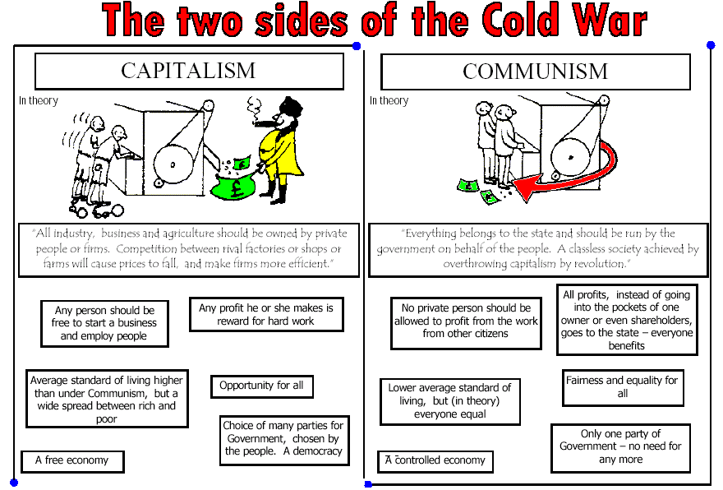


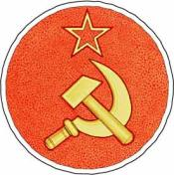


Slide 18
The United States
& Soviet Union were superpowers & rivals who dominated world politics
One of the most important changes after World War II was the beginning of the Cold War
This was an era of competing ideologies: the USA promoted democracy & capitalism while the USSR tried to spread communism
During the Cold War,
the United States &
Soviet Union entered an era of distrust & hostility from 1945 to 1991
The different ideologies between USA & USSR and their desires to spread these ideas led to an era of distrust, hostility, proxy battles, & near nuclear war

Slide 19
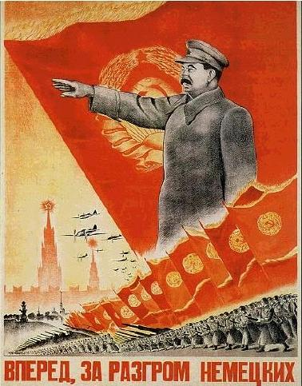
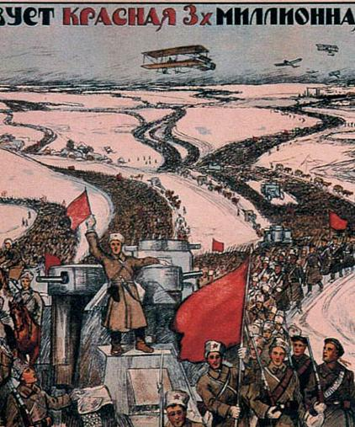
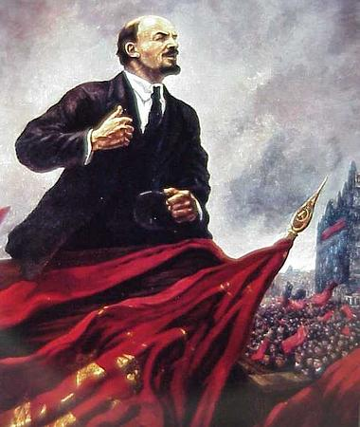
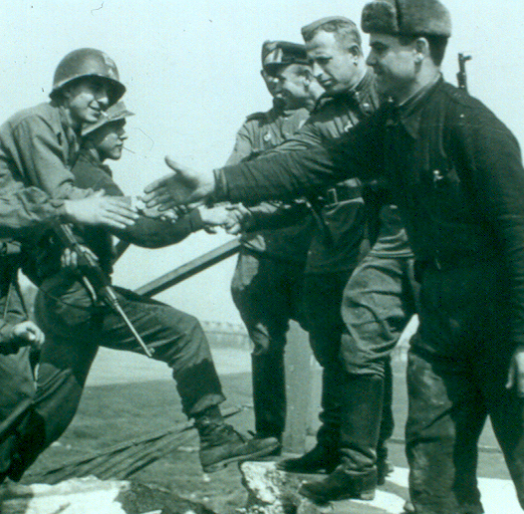
What Caused the Cold War?
In 1917, Lenin led
the Bolsheviks in the Russian Revolution
& created the world’s first communist gov’t
Distrust began when the USA sent troops to fight the “Red Army” during the Russian Civil War
After Lenin’s death in 1924, Joseph Stalin became dictator of the Soviet Union
During WWII, the
USA & USSR worked together to defeat the Axis Powers, but…

Slide 20
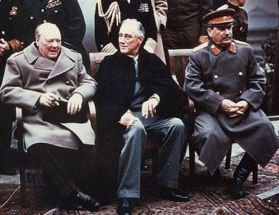
…World War II increased tensions between the
USA and USSR
Stalin never trusted
the Britain or the USA during World War II
The Manhattan Project gave the USA a monopoly on nuclear weapon technology

Slide 21
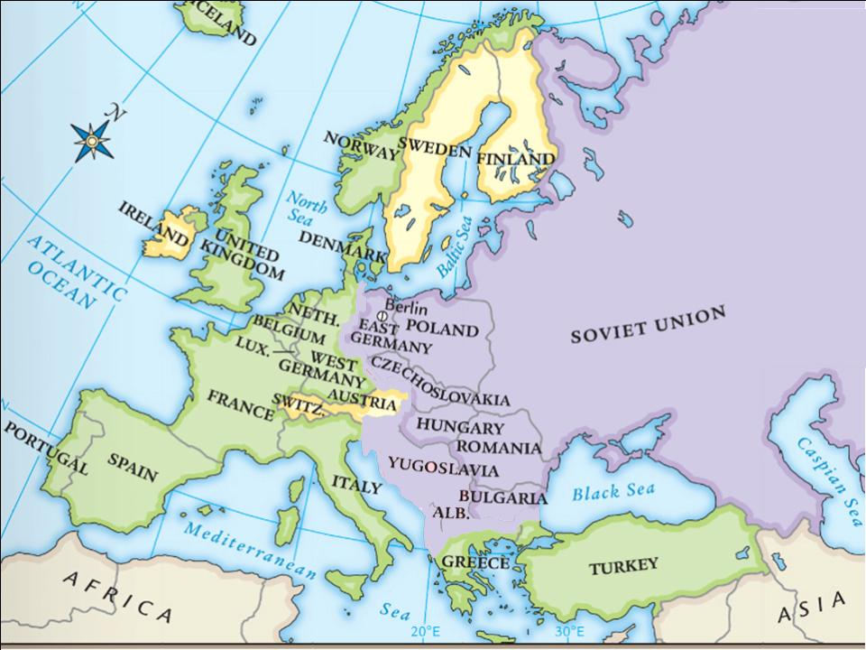
At the Yalta Conference, Stalin agreed to allow self-determination in Eastern Europe
But, Stalin wanted a “buffer zone” between
the USSR & the democratic nations in Western Europe
Stalin used his military to install communist gov’ts in Eastern European nations
Notes:
never did;

Slide 22
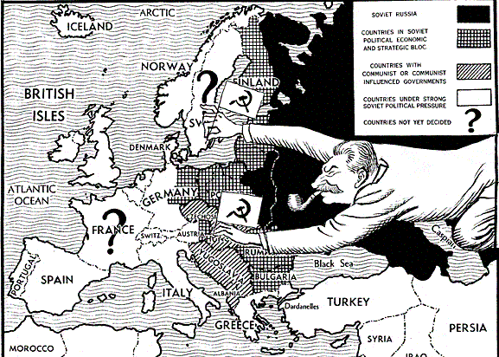
As a result, Eastern European nations
turned communist & became Soviet satellites:
nations that were influenced by the USSR
In the years after World War II, the USA began to view Stalin as a new Hitler—a dangerous dictator who wanted to take over the world

Slide 23
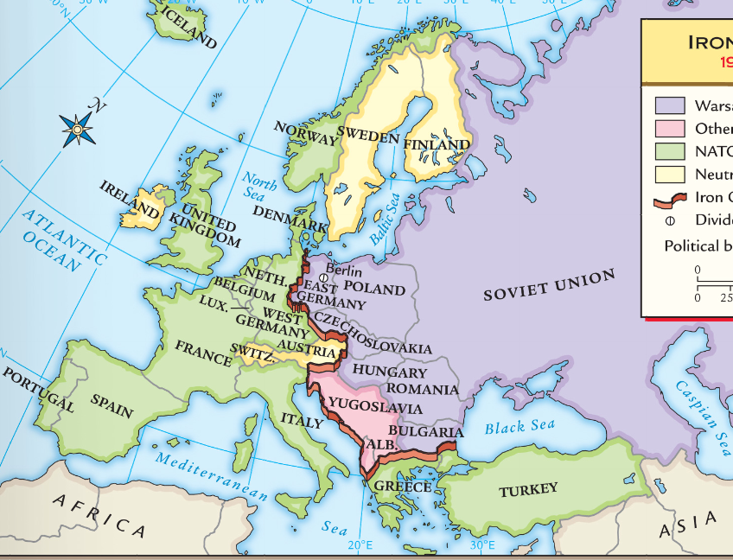

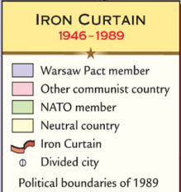
By 1946, Europe was divided by an “iron curtain” that separated democratic/capitalist Western Europe from communist/totalitarian Eastern Europe
Communism & Totalitarianism
Capitalism & Democracy

Slide 24
The U.S. created a foreign policy called containment to stop Soviet influence & the spread of communism
When the USSR began to pressure Greece & Turkey to turn communist, the U.S. created the
Truman Doctrine, promising economic & military help to any nation threatened by communism
The Truman Doctrine
worked & neither Greece nor Turkey fell to communism

Slide 25
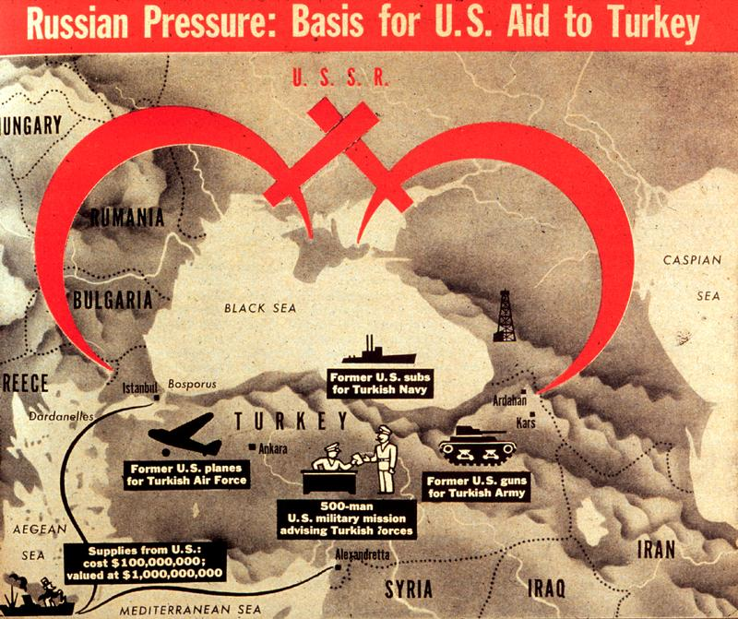
Notes:
Congress appropriated $400 million in aid to Greece & Turkey

Slide 26
European nations had difficulty recovering after WWII which led to fears of communism in Europe
The U.S. created the Marshall Plan which offered $13 billion to help rebuild post-war Europe
By 1952, Western Europe recovered & Communism never took root

Slide 27
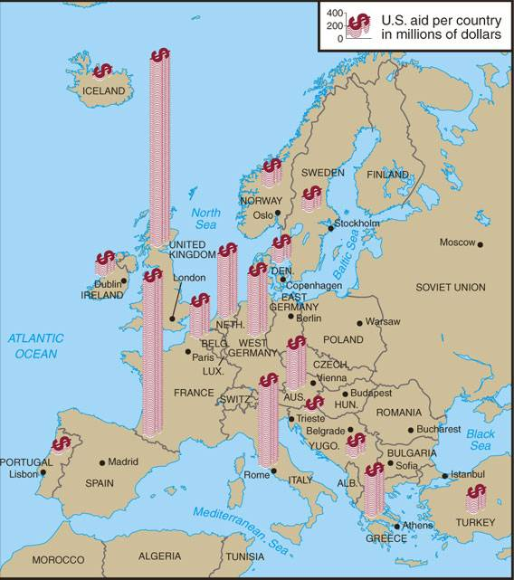
Marshall Plan to Aid Europe 1948-1952

Slide 28
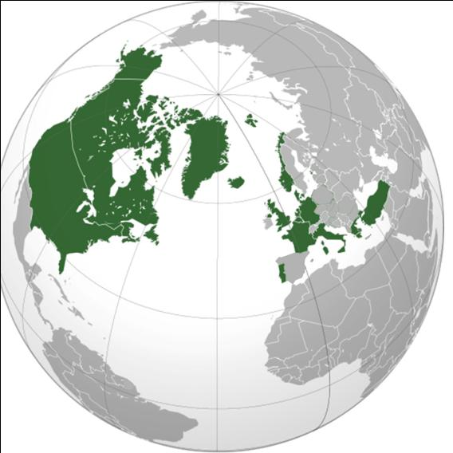
In 1948, the USSR used military force to turn Czechoslovakia to communism; This led to fears that Stalin would use similar tactics in Western Europe
In 1949, the United States formed the
North Atlantic Treaty Organization (NATO): a military alliance among democratic countries in Europe & North America

Slide 29
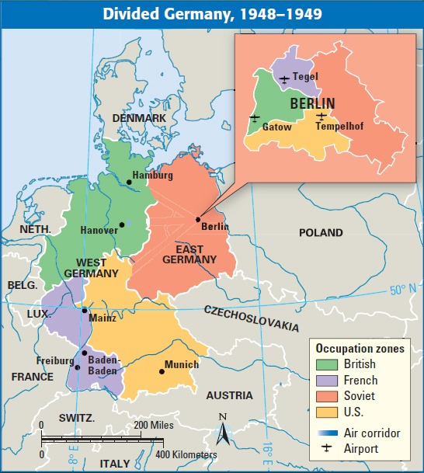
At the end of WWII, Germany was divided into
zones occupied by the USA, Britain, France,
& the USSR
Berlin, the German capital, was also divided but was located in the Soviet zone
In 1948, Stalin tried to turn all of Berlin communist & ordered the Berlin Blockade
which shut down all ground transportation to West Berlin

Slide 30
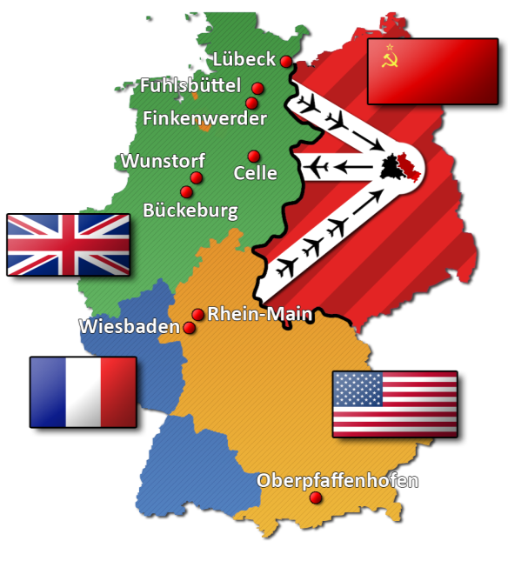
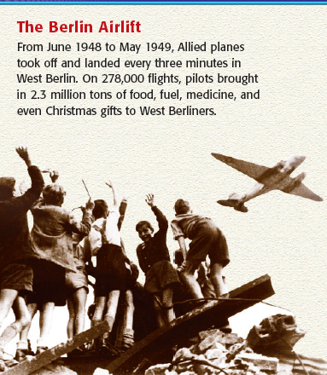
In response, the U.S. began the Berlin Airlift
For 11 months, U.S. & British planes supplies landed in Berlin to bring food, fuel, & supplies
Stalin admitted defeat & lifted the blockade in 1949
The United States successfully kept West Berlin from turning communist

Slide 31

From 1945 to 1949, the United States successfully contained communism in Europe
But over the next 40 years, the Cold War intensified as communism spread to Asia, Africa, and Latin America
The Cold War intensified as new nuclear weapons were introduced; espionage (spying ) increased;
& wars broke out in Korea, Vietnam, & Afghanistan

