Slide 1
Essential Question:
Why were the Tang and Song Dynasties considered the “golden age” of China?

Slide 2
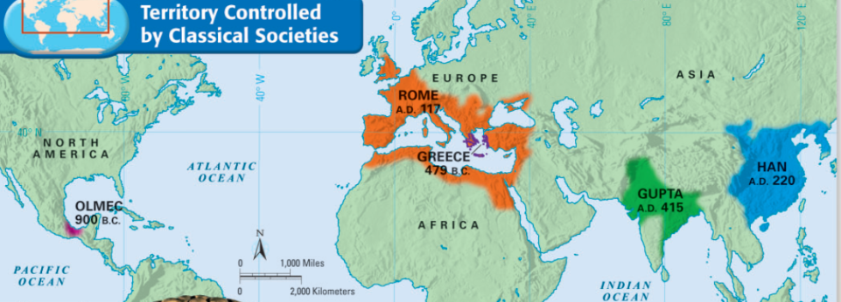
The Classical Era was a time when great civilizations (like Greece and Rome) existed and made enormous contributions to humanity
During the Classical Era, the emperors of Han China created a large empire and developed numerous innovations

Slide 3
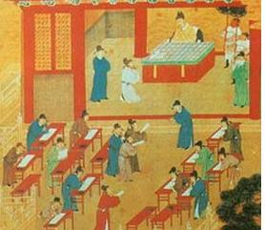
For example, the Chinese had civil service exams for government workers; the exams were based on the teachings of Confucius
This is so workers received their jobs based on their strong ethics (doing the right thing)

Slide 4
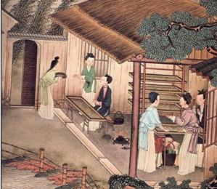
The Chinese invented silk-making technology that attracted great interest in trade from people outside of China

Slide 5
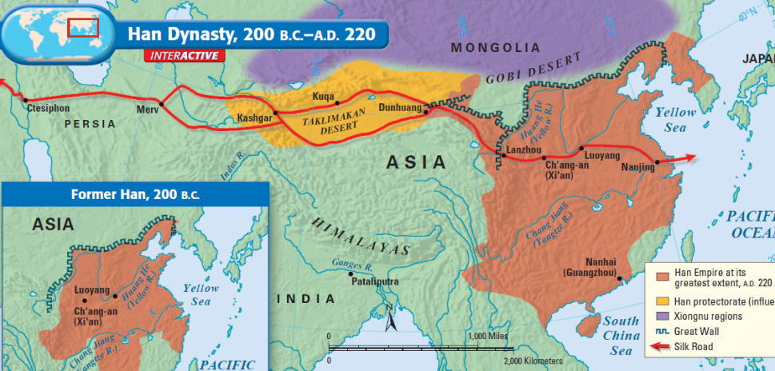
TO EUROPE
TO ASIA
FROM CHINA
The Silk Road trade route brought Chinese luxury goods to Europe and Asia and increased cultural diffusion (blending of cultures)

Slide 6
Much like the Roman Empire and the other Classical civilizations, Classical China under the Han Dynasty entered an era of decline and eventually fell

Slide 7
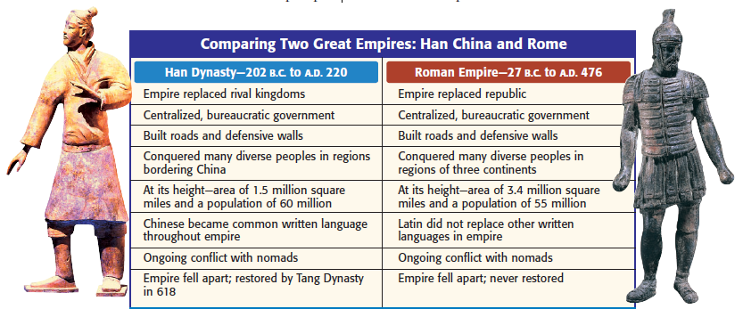
There were many similarities between Han China and Rome, especially with outside invaders bringing both empires down

Slide 8
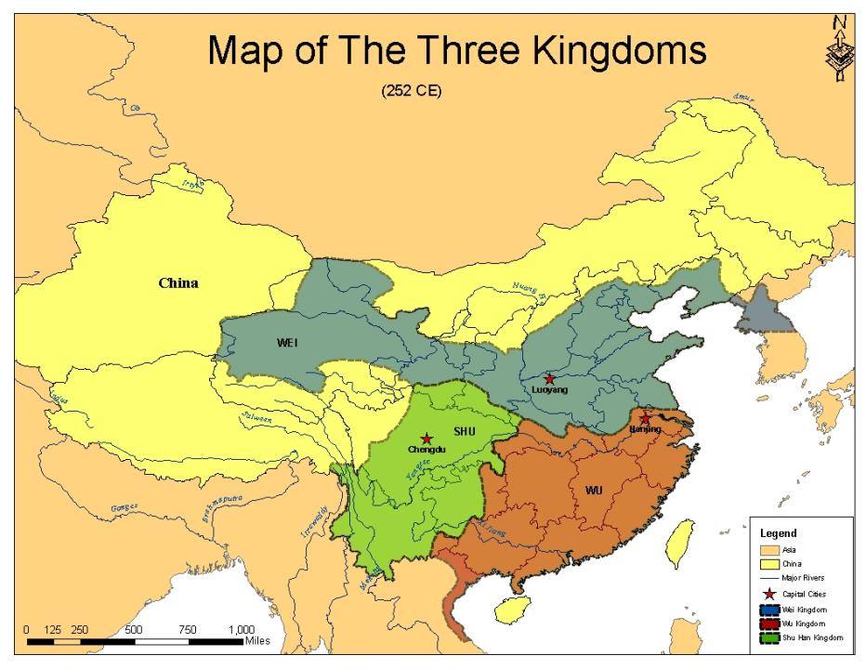
After the Han Dynasty collapsed in the year 220, no emperor was strong enough to unify the Chinese people into one single territory under one ruler
Over the next 350 years, China was divided into several small kingdoms; more than 30 local dynasties rose and fell
A “dynasty” is a ruling family or group that rules during a certain era or time period

Slide 9
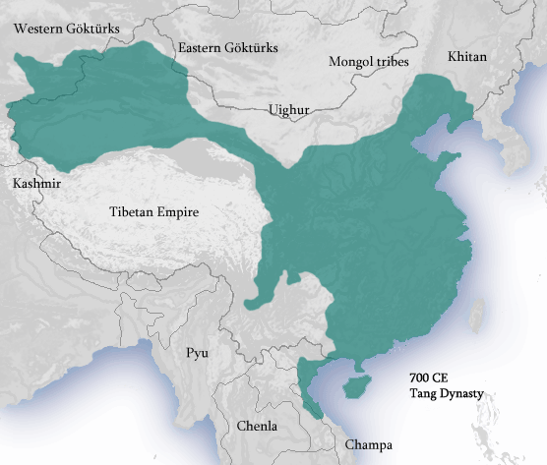
By the year 589, China was unified again and a strong central government was restored
Bringing back the Confucian examination system allowed intelligent bureaucrats to help manage the massive Chinese empire

Slide 10
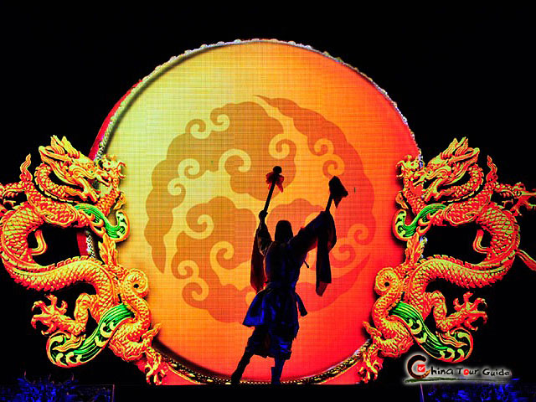
During the Tang and Song Dynasties, China experienced an extended “golden age”
China became the richest, most powerful, and most advanced country in the world

Slide 11
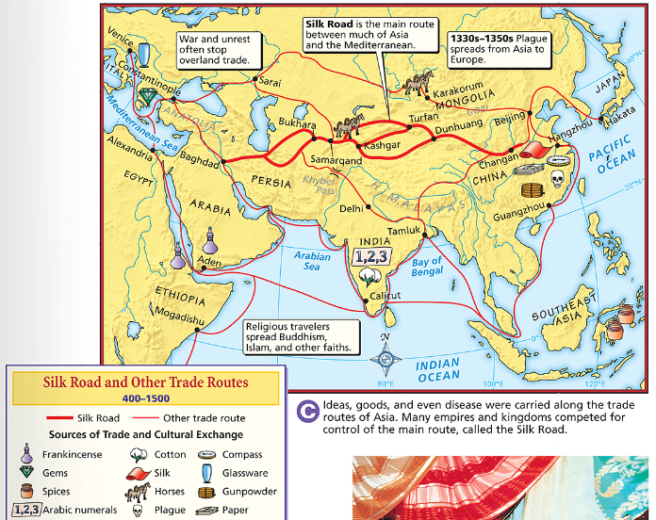
For the first time in China’s history, emperors actually encouraged foreign trade (previously, they had tried to avoid trading with foreigners)

Slide 12
Emperors did their best to protect the trade routes along the Silk Road
Chinese merchants relied on ocean routes as well to trade with India and Arabia

Slide 13
Increased trade led to the spread of Chinese culture (centralized government, Confucianism, and their writing system) to neighboring areas, like Korea, Japan, and Southeast Asia

Slide 14
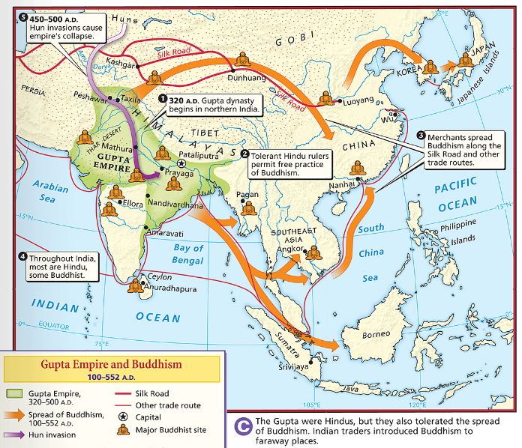
The orange arrows show where Buddhism spread in Asia
Increased trade helped spread Buddhism throughout China

Slide 15
Chinese Innovations
The Tang and Song Dynasties were eras of major technological advancement and innovation
INNOVATION: a good, a service, a product, a method, a technology, or an idea that is new and original
These innovative technologies helped make China the most advanced country in the world (at the time)
Much of China’s technological inventions spread to other people in Asia and Europe across trade routes (such as the Silk Road)
ACTIVITY: look at the following ten inventions and write down what you think each one is

Slide 16
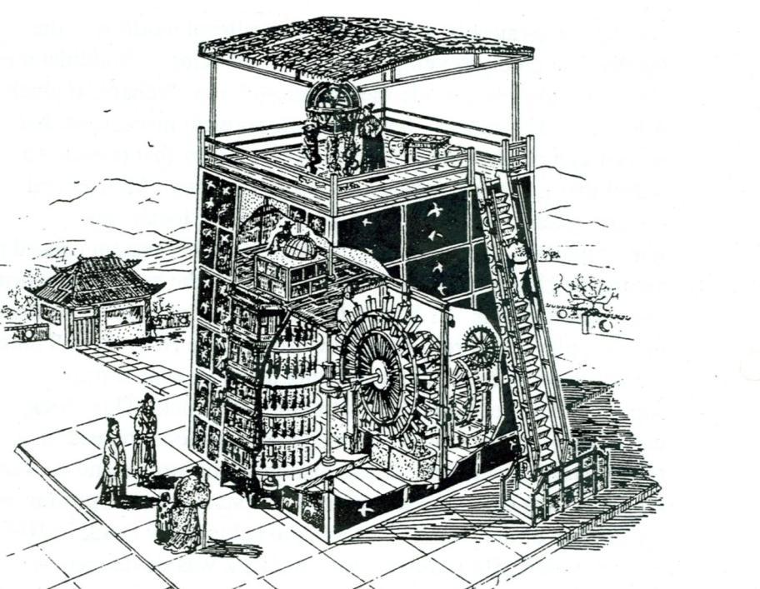
1. Mechanical Clock

Slide 17
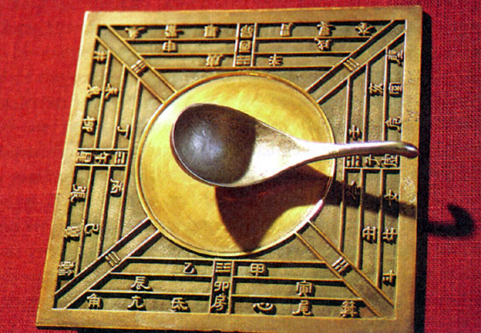
2. Magnetic compass

Slide 18
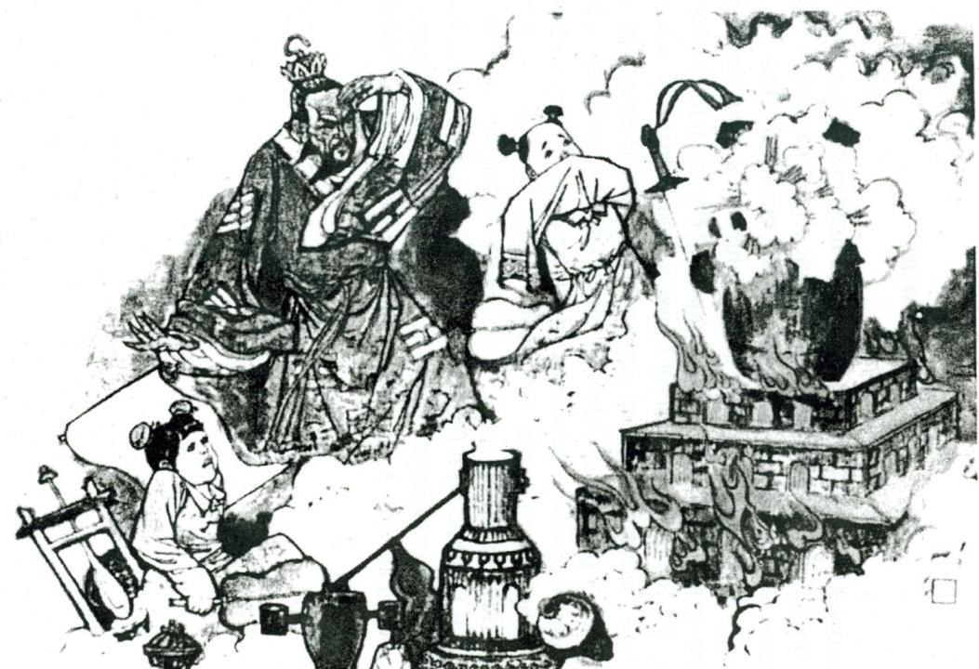
3. Gunpowder

Slide 19
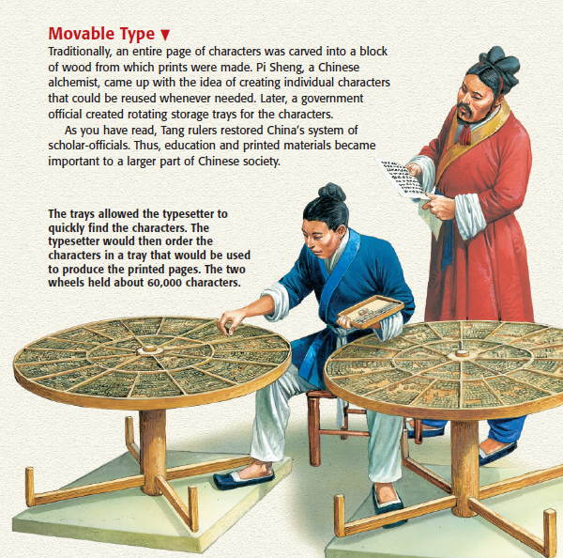
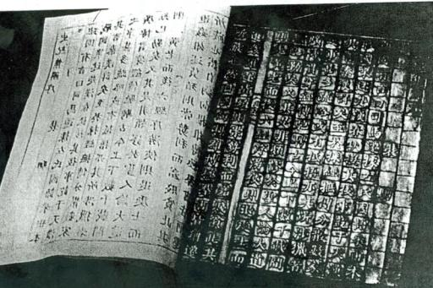
4. Printing Press

Slide 20
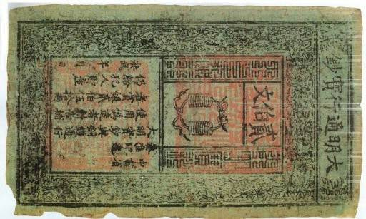
5. Paper money

Slide 21
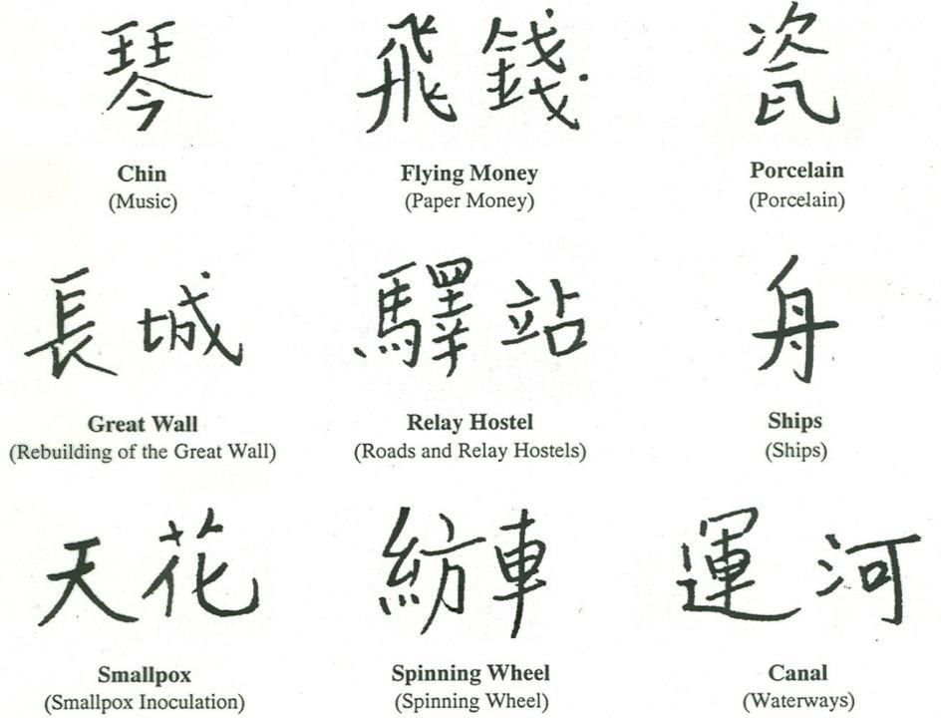
6. Chinese writing

Slide 22
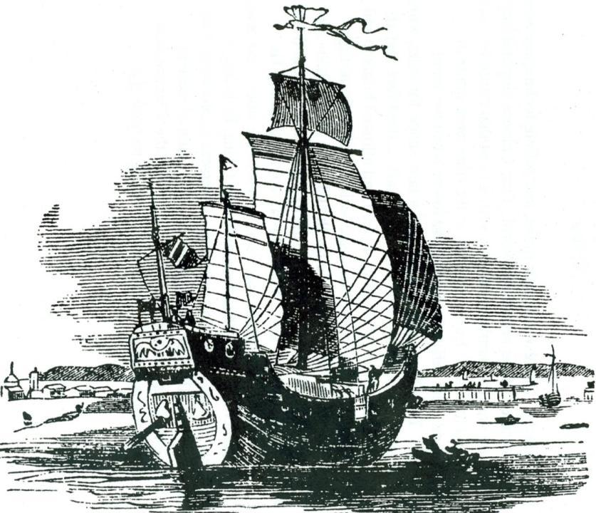
7. Ship building

Slide 23
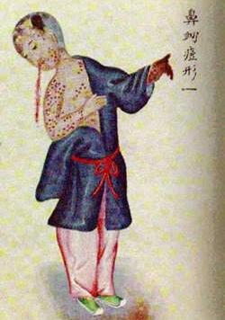
8. Vaccination

