Slide 1
  The Byzantine Empire
  What is the significance of the Byzantine Empire?

Slide 2
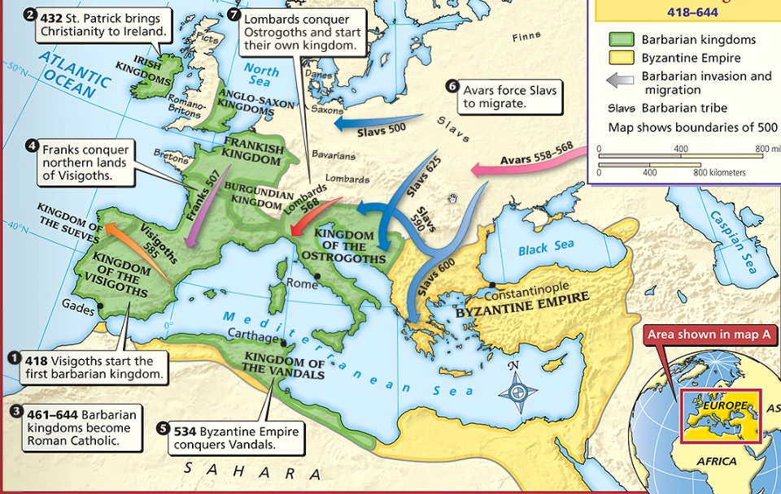
What happened to the
Roman Empire by 500 A.D.?

Slide 3
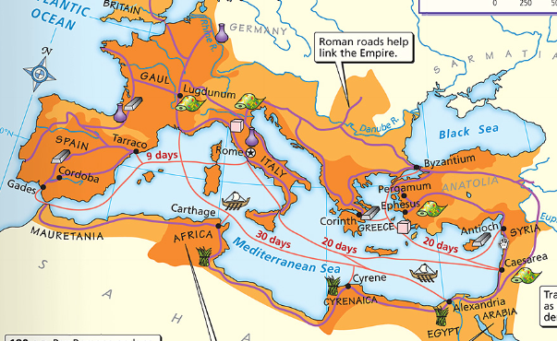
The Fall of the Roman Empire
After the Pax Romana, the Roman Empire entered an era of decline
The Roman Empire had a series of weak emperors
Romans had a large trade imbalance
(they bought more than they produced)
As Rome grew more in debt, the military became weak & began using foreign mercenary soldiers

Slide 4
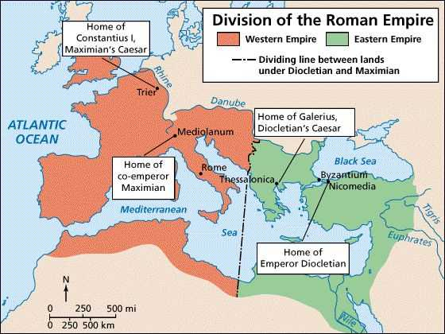
The Western Roman Empire continued to grow weak
Emperor Constantine moved the Roman capital to Constantinople in the Eastern Roman Empire
Text
Emperor Diocletian tried to save Rome by dividing the empire

Slide 5
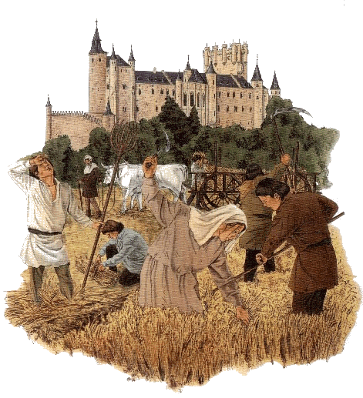
The Fall of the Roman Empire
By 476, barbarians conquered the Western Roman Empire
The Western Roman Empire
fell into the Middle Ages
(“Dark Ages”) from 500 to 1300 A.D.

Slide 6
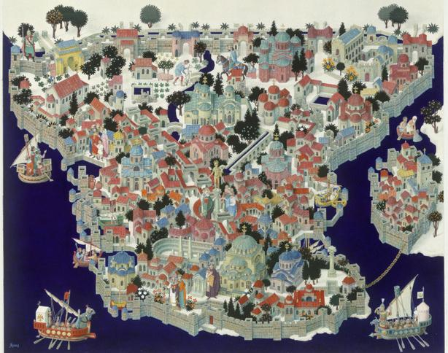
What happened in the Eastern Roman Empire?

Slide 8
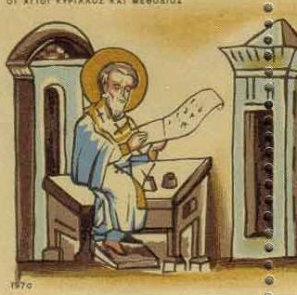
The Byzantine Empire
Byzantines thought of themselves as Romans & shared some similarities with the Roman Empire:
  kept alive
  Greco-Roman culture
  Constantinople was a
  center for learning:
  philosophy, medicine,
  Greek and Latin
  grammar, geometry

Slide 9
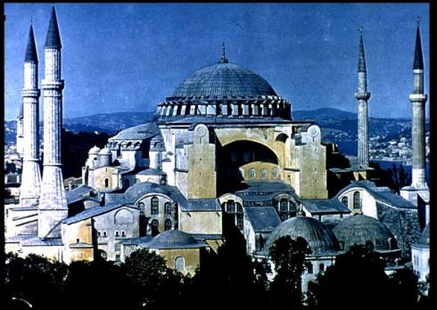
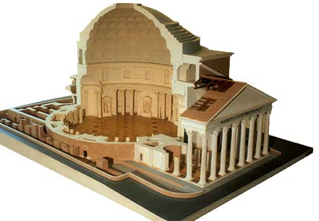
The Byzantine Empire
Citizens in the Byzantine Empire thought of themselves as Romans & shared some similarities with the Roman Empire:
Byzantine Hagia Sophia
Roman Pantheon
How was architecture similar?

Slide 10
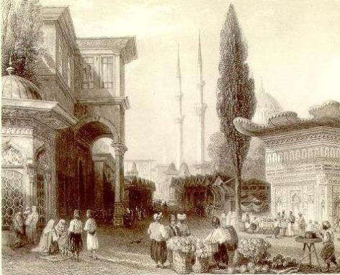
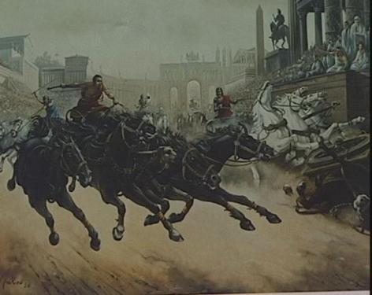
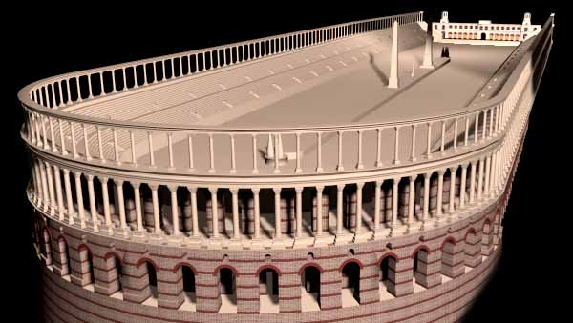
The Byzantine Empire
Citizens in the Byzantine Empire thought of themselves as Romans & shared some similarities with the Roman Empire:
  Constantinople used Roman-style architecture such
  as arches & domes
  Byzantine cities
  had forums for
  trade & arenas
  to entertain
  citizens

Slide 11
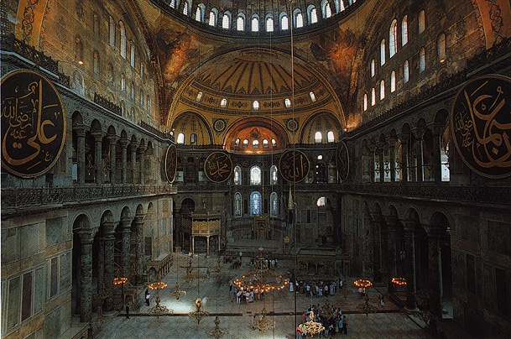
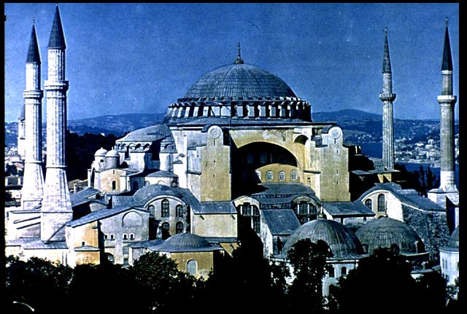
Christian Cathedral Hagia Sophia- One of the most impressive architectural buildings in the Byzantine Empire
http://www.youtube.com/watch?v=ng--WLT0Xjc

Slide 12
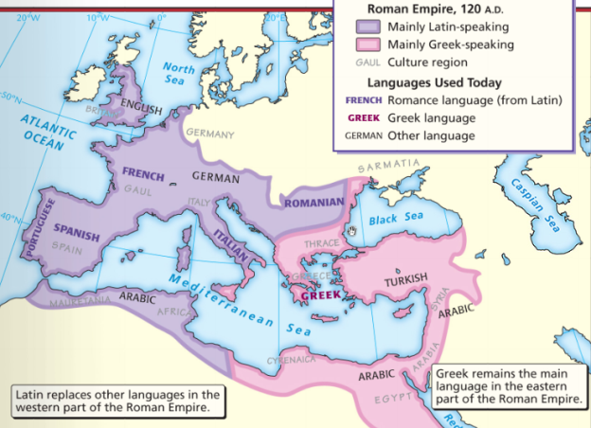
The Byzantine Empire
Citizens in the Byzantine Empire thought of themselves as Romans & shared some similarities with the Roman Empire:
  The official
  language
  Latin,
  but most
  Byzantines
  spoke
  Greek

Slide 13
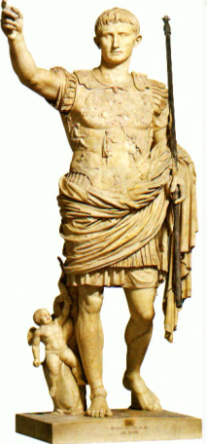
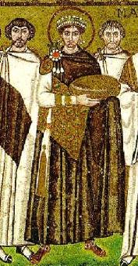
The Byzantine Empire
Citizens in the Byzantine Empire thought of themselves as Romans & shared some similarities with the Roman Empire:
  Both the Roman & Byzantine
  Empires were ruled by
  emperors who had absolute
  power over the empire
  Justinian was the most
  famous Byzantine Emperor
  88, 29 died violently, 13 abandoned
Roman government
Byzantine government
How was government similar?

Slide 14
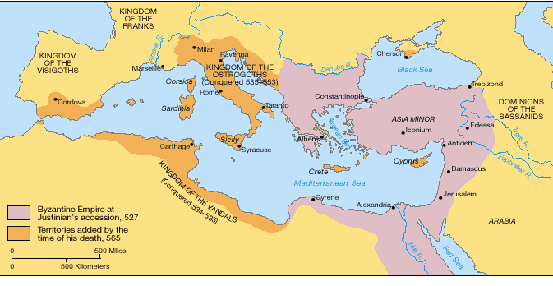
About 50 years after the fall of Rome, Byzantine Emperor Justinian reconquered Roman territories

Slide 15
The Justinian Code
To oversee his new empire, Justinian ordered legal experts to consolidate old Roman laws into a single law code
  The Justinian Code served as the legal basis for criminal justice, marriage, property, slavery, & women’s rights
  The law code became one of the most important legacies of the Byzantine Empire & served as the basis for laws for the next 900 years

Slide 16
Justinian Code
In partners, you will look over the handout comparing California law and the laws of the Justinian Code.
Each person must complete their chart giving similarities and differences between these two legal systems.

Slide 17
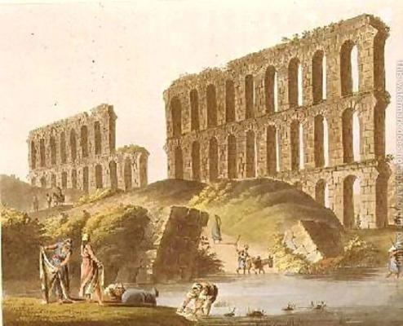
Justinian
In addition to expanding the empire & creating a uniform set of laws, Emperor Justinian also began large building projects
  He ordered the construction of the
  Hagia Sophia
  to show
  importance of
  the church
  He built hospitals,
  aqueducts,
  public baths,
  schools, & courts

Slide 18
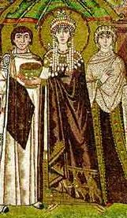
Empress Theodora
Justinian’s wife Theodora
had a lot of power &
influence in the
Byzantine Empire:
  She met with & wrote
  to foreign leaders
  She advised Justinian
  & helped him pass laws
  She encouraged
  building of Christian
  cathedrals
  http://www.youtube.com/watch?v=LQgdcP7vd9g

Slide 19
Justinian & Theodora
Empress Theodora ("Norwegian Wood" by the Beatles) – YouTube
Mixed views of Justinian and Theodora

Slide 20
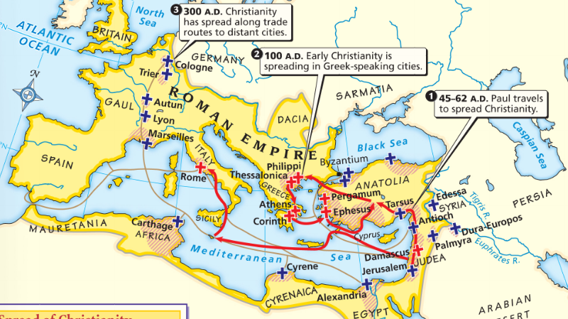
Because its close to Judea, Byzantines had converted to Christianity before the Western Roman Empire

Slide 21
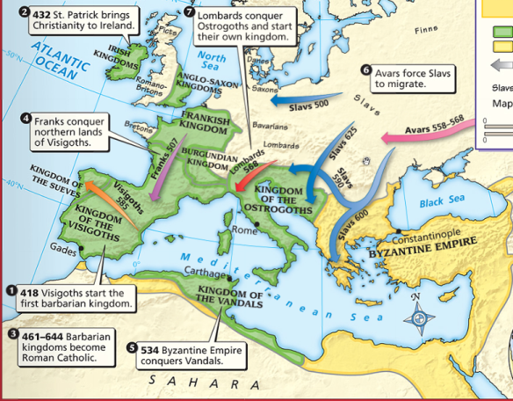
Distance & lack of contact between Byzantine Empire & Western Europe caused Christianity developed differently

Slide 22
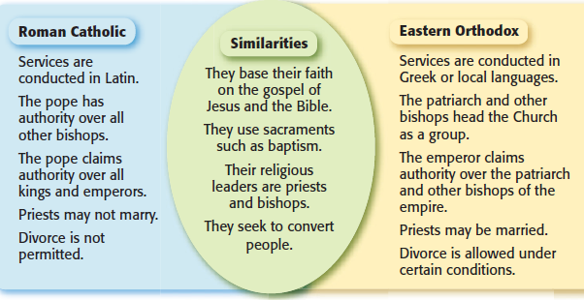
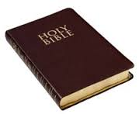
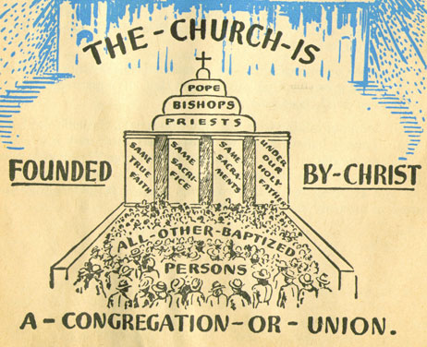
Christians in the East & West disagreed over leadership of the Church

Slide 23
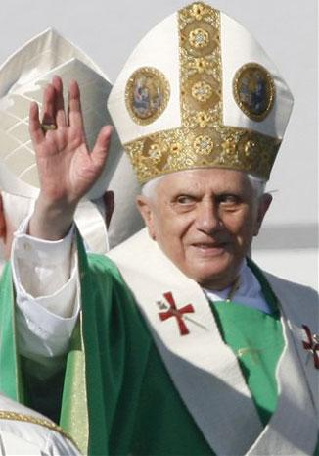
The Division of Christianity
Christians in Western Europe:
  there should be a Pope to oversee bishops &
  give authority to Christians

Slide 24
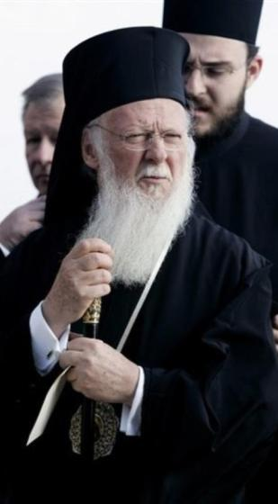
The Division of Christianity
Christians in Eastern Europe:
  Byzantine emperors relied on a Patriarch to oversee church, but emperor had final authority
  Did not accept the authority of the Pope

Slide 25
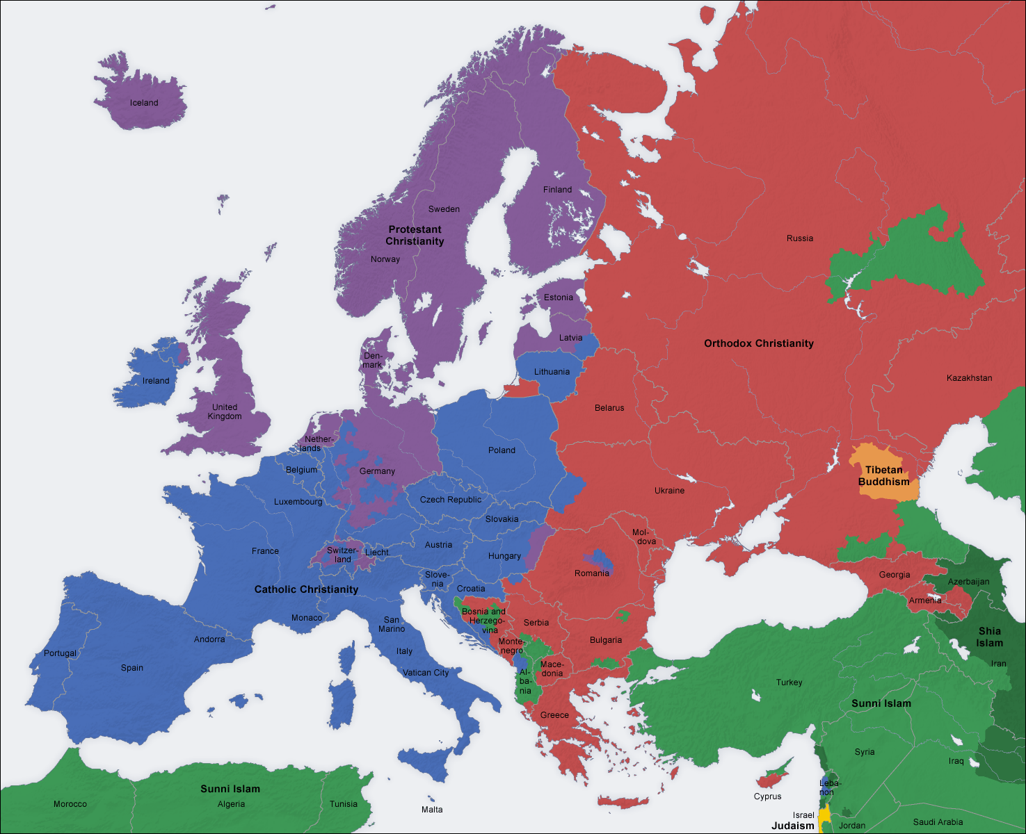
CUT/PASTE ACTIVITY :
The Division of Christianity
Roman Catholics & Eastern Orthodox Christians practice their regions differently

Slide 26
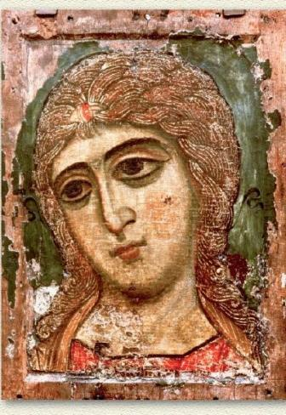
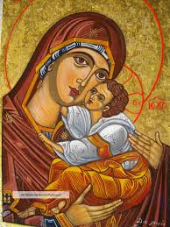
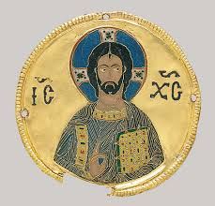
The Division of Christianity
A big controversy among Christians was the use of icons (religious images for prayer)
  Some Christians thought
  this was “idol worship”
  730, Byzantine
  Emperor banned icons

Slide 27
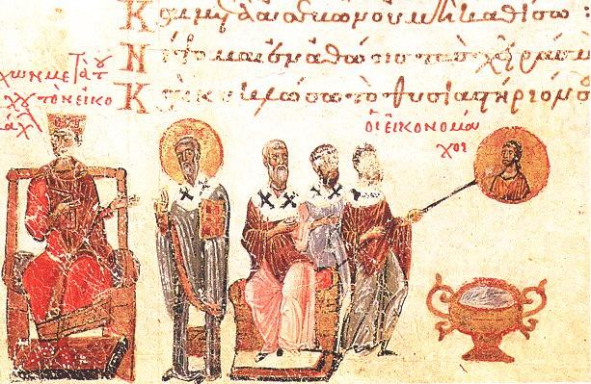
Emperor Leo III ordered the destruction of icons in the Byzantine Empire
Riots broke out between people who wanted icons & iconoclasts (those who wanted to ban icons)
The Pope excommunicated the emperor (kicked him out of the church)
The Pope in Western Europe supported the use of icons & called the Byzantine Emperor a heretic (a believer of false ideas)

Slide 28
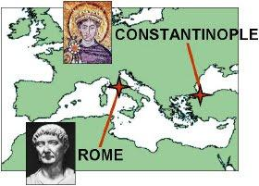
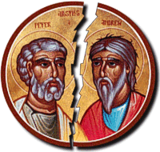
The Division of Christianity
The Great Schism 1054 – disagreements among Christians led to deep divisions in Christianity

Slide 29
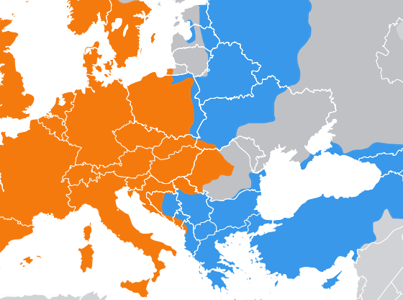
The Division of Christianity
  Christians in Western Europe became the Roman Catholic Church
  Christians in Eastern Europe became the Eastern Orthodox Church

Slide 30

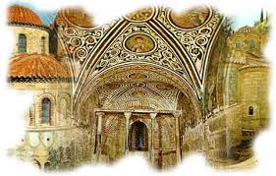
“Gettin’ Byzzy With It”
Song Lyric Analysis
Listen to the song as you read the lyrics
Analyze the song and think about what you know the song is talking about, and what you don’t know

Slide 31
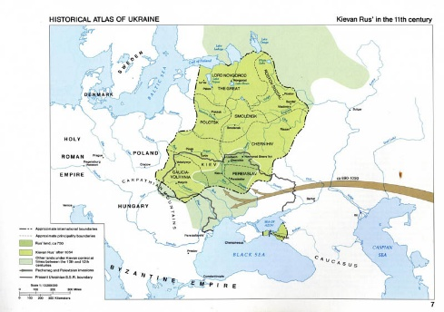
Influence on Russia
Vikings + Slavs = Kiev
Byzantines traded with Slavs – Slavs blended with Greek culture/traditions
Princess Olga converted Kiev to Orthodox Christianity
  Cyrillic alphabet

Slide 32
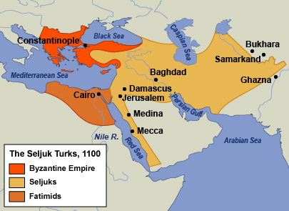
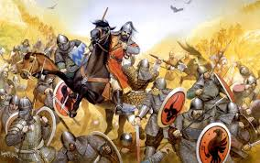
Decline of Byzantine Empire
Battled Slavs & Avars in North, Persia to East, and Islam in South
Seljuk Turks take Asia Minor in 1071
Fall of Constantinople 1453 by Ottoman Turks

Slide 33
Middle Ages

Slide 34
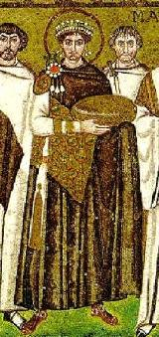
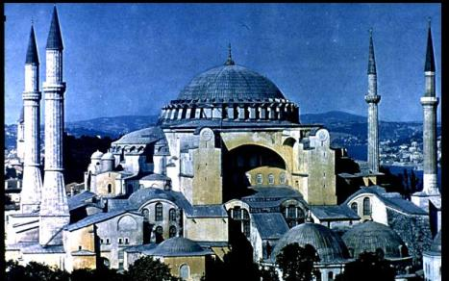
What happened to Europe after the fall of the Roman Empire?
In the East, the Byzantine Empire became a center for trade & Greco-Roman culture

Slide 35
The Middle Ages
In the West, Europe grew weak & fell into the Middle Ages from 500 to 1300
Also known as the “Dark Ages” or “Medieval” era
Dark Ages 1of10 History Channel - YouTube

Slide 36
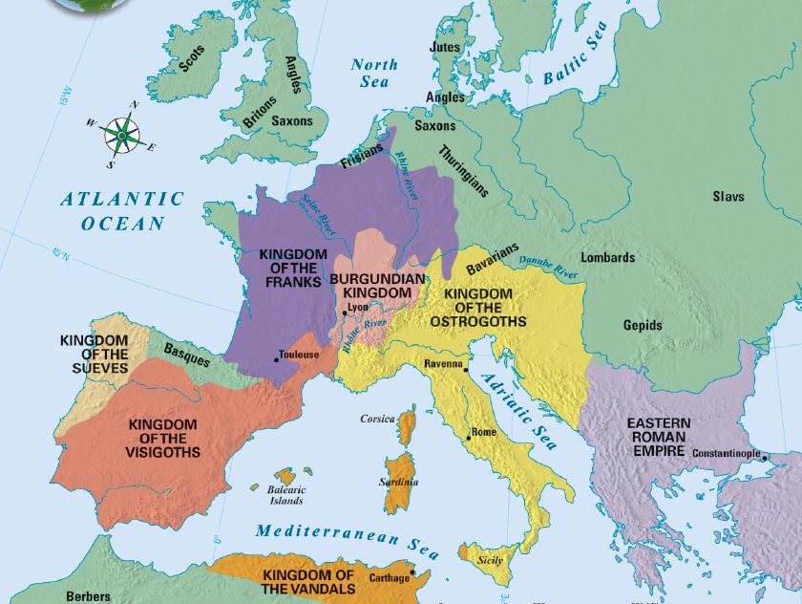
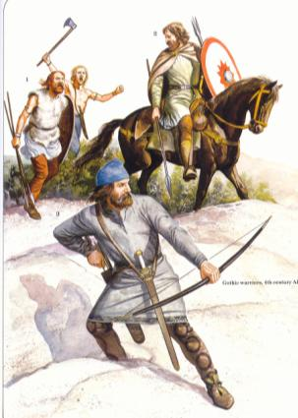
Europe After the Fall of Rome
When barbarian kingdoms conquered Rome, Europe was plagued by constant warfare
Warfare disrupted trade, destroyed Europe’s cities, & forced people to rural areas
Learning declined; Few people could
read or write
Greco-Roman
culture was forgotten
Europe lost a common language; Latin mixed with local languages to form Spanish, French, Italian
Notes:
• Disruption of Trade Merchants faced invasions from both land and sea. Their businesses collapsed. The breakdown of trade destroyed Europe’s
cities as economic centers. Money became scarce.
• Downfall of Cities With the fall of the Roman Empire, cities were
abandoned as centers of administration.
• Population Shifts As Roman centers of trade and government collapsed, nobles retreated to the rural areas. Roman cities were left without strong leadership. Other city dwellers also fled to the countryside, where they grew their own food. The population of western Europe became mostly rural.
The Decline of Learning The Germanic invaders who stormed Rome could not read or write. Among Romans themselves, the level of learning sank sharply as more and more families left for rural areas. Few people except priests and other church officials were literate. Knowledge of Greek, long important in Roman culture, was almost lost. Few people could read Greek works of literature, science, and philosophy. The Germanic tribes, though, had a rich oral tradition of
songs and legends. But they had no written language.
Loss of a Common Language As German-speaking peoples mixed with the Roman population, Latin changed. While it was still an official language, it was no longer understood. Different dialects developed as new words and phrases became part of everyday speech. By the 800s, French, Spanish, and other Roman-based languages had evolved from Latin. The development of various languages mirrored the continued breakup of a once-unified empire.

Slide 37
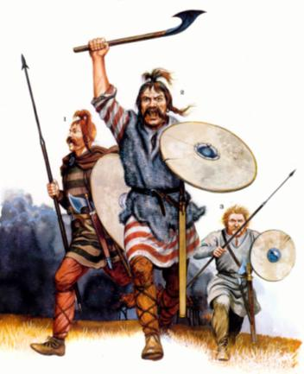
Germanic Tribes in the Middle Ages
Without the unity of the Roman Empire, Europe became divided into a series of Germanic kingdoms
Germanic people lived in small communities led by chiefs & his loyal warriors
Notes:
The Concept of Government Changes Along with shifting boundaries, the entire concept of government changed. Loyalty to public government and written law had unified Roman society. Family ties and personal loyalty, rather than citizenship in a public state, held Germanic society together. Unlike Romans, Germanic peoples lived in small communities that were governed by unwritten rules and traditions. Every Germanic chief led a band of warriors who had pledged their loyalty to him. In peacetime, these followers lived in their lord’s hall. He gave them food, weapons, and treasure. In battle, warriors fought to the death at their lord’s side. They considered it a disgrace to outlive him. But Germanic warriors felt no obligation to obey a king they did not even know. Nor would they obey an official sent to collect taxes or administer justice in the name of an emperor they had never met. The Germanic stress on personal ties made it impossible to establish orderly government for large territories.

Slide 38
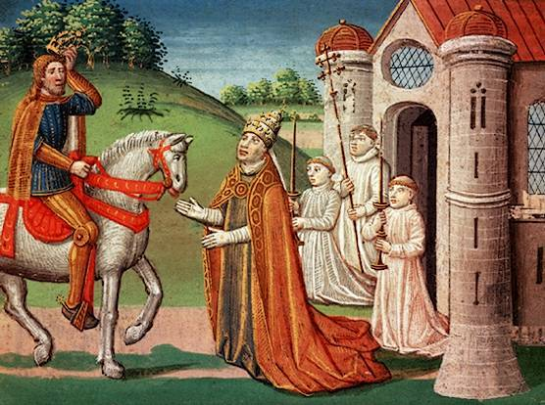
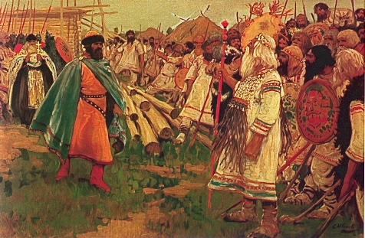
The Spread of Christianity
During early Middle Ages, Germanic kingdoms were slowly converted to Christianity

Slide 39
The Spread of Christianity
The Franks- largest & most powerful Germanic kingdom in the early Middle Ages
Frankish kings allied with Catholic Church & expanded their power
In 771, Charlemagne (“Charles the Great”) became king of the Franks

Slide 40
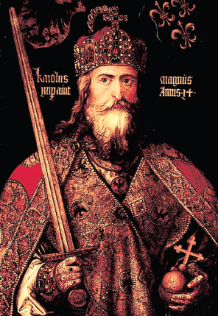
Charlemagne
http://www.youtube.com/watch?v=NUQxsvo7CdU

Slide 41
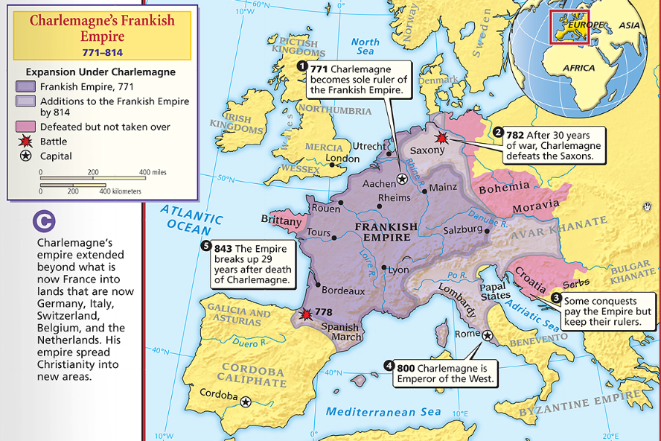
Charlemagne & the Frankish Empire
Charlemagne- the greatest Medieval king because he did something no other king was able to do…created an organized empire –
The Holy Roman Empire (First Reich)
He spread Christianity –
Missi Dominici
He created schools to train future priests
Charlemagne expanded the Frankish empire
He valued learning & built schools in his empire

Slide 42
Charlemagne & The Holy Roman Empire
After Charlemagne’s death in 814, his Frankish Empire was divided & lost power…
…This was the last opportunity to provide unity in medieval Europe

Slide 43
http://www.youtube.com/watch?v=cTTaVnZyG2g

Slide 44
Franks & Spread of Christianity
Person | Method of Spreading Christianity
Clovis
Benedict
Gregory I
Charles Martel
Charlemagne
Using the book. Pg. 318-321.
Glue into spiral.

Slide 45
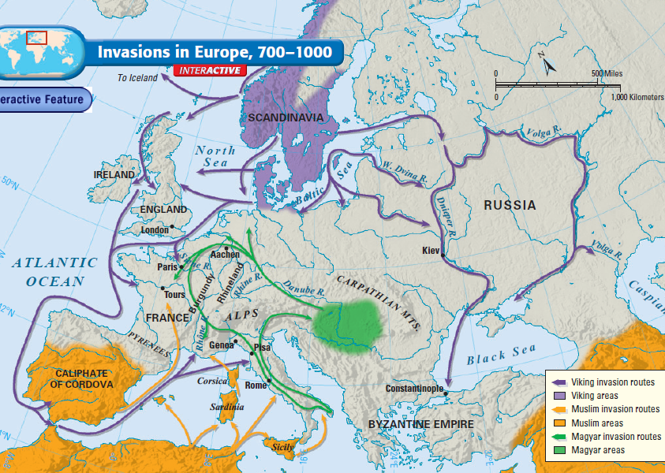
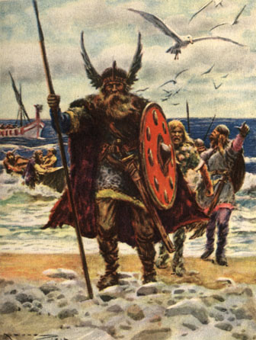
From 800 to 1000, a 2nd major wave of invasions
struck Europe led by Vikings, Muslims &Magyars
Text
These invasions caused widespread fear & suffering
Kings could not defend against invasion
People stopped looking to kings for protection
Notes:
The invasions by Vikings, Magyars, and Muslims caused widespread disorder and suffering. Most western Europeans lived in constant danger. Kings could not effectively defend their lands from invasion. As a result, people no longer looked to a central ruler for security. Instead, many turned to local rulers who had their own armies. Any leader who could fight the invaders gained followers and political strength.

Slide 46
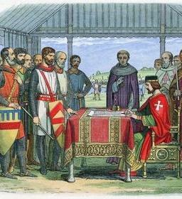

Feudalism
Feudalism began in Europe as a way to offer protection
Feudalism is based on land & loyalty
Land-owning lords offer land (called a fief) to knights in exchange for their loyalty & promise to protect the lord’s land
Feudalism came to England with Norman Invasion in 1066

Slide 47

Feudal Structure
Knights were specially trained soldiers who protected the lords & peasants – vassals took an oath of fealty (loyalty)
Some peasants were serfs & could not leave the lord’s estate
Kings had land but very little power
Lords (also called Nobles) were the upper-class landowners; they had inherited titles (“Duke,” “Earl,” “Sir”)

Slide 48


Lords built castles to protect their territory from outside invasions

Slide 49


The Manorial System
During the Middle Ages, the manorial system was the way in which people survived
The lord’s land was called a manor
The lord provided peasants with housing, farmland, & protection
In exchange, peasants repaid the lord by working his land & providing a portion of the food they produced

Slide 50

Peasant life was hard: They paid taxes to use the lord’s mill, had to get permission to get married, & life expectancy was about 35 years old
Manors were self-sufficient communities; Everything that was needed was produced on the manor

Slide 51





High Middle Ages—Crusades
After the Crusades, people wanted more luxury goods & began to trade
Medieval fairs brought iron & salt to the feudal manors; this was a very rare thing
Trade led to the growth of cities

Slide 52



One reason for decline of manorial system was the Black Death
In 1347, a trade ship arrived in Italy carrying plague-infested rats
The plague swept quickly throughout Europe along trade routes

Slide 53

The Black Death

Slide 54



Slide 55

Attempted “cures” for the plague
Bathing in urine
Isolation
Leaches
Prayer
Placing dead animals in the home
Pomanders

Slide 56

The plague killed 25 million people in 5 years
The plague caused a labor shortage; those that survived could demand higher wages & more rights
Notes:
56

Slide 57

Conclusions
The role of religion in the Middle Ages:
  The Roman Catholic Church played an
  important role in the lives
  of Europeans both before
  & after the Middle Ages
  The Crusades failed to
  secure Jerusalem from
  the Islamic Empire, but
  these holy wars increased
  cultural diffusion &
  helped bring an end to the Middle Ages

