Slide 1
Unit 10 : Review
1970 - 2018

Slide 2
1970s
Carter’s Administration
Stagflation
The Oil Crisis
Camp David Accords
Panama Canal
Iranian – Hostage Crisis

Slide 3
“Crisis of Confidence”
“In a nation that was proud of hard work, strong families, close-knit communities, and our faith in God, too many of us now tend to worship self-indulgence and consumption. Human identity is no longer defined by what one does, but by what one owns. But we've discovered that owning things and consuming things does not satisfy our longing for meaning. We've learned that piling up material goods cannot fill the emptiness of lives which have no confidence or purpose.”

Slide 4
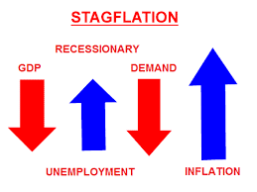
Stagflation
The Cost of the Vietnam War
Expansion of Social Programs
Tax increase
American jobs shift to the service sector
Lower wages
Fewer benefits

Slide 5
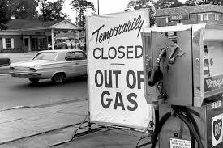
The Oil Crisis
In October 1973, the U.S. supported Israel in the Yom Kippur War.
Oil-Rich nations of the Middle East, were already frustrated with the U.S. for devaluing the dollar.
OPEC reacts by placing an oil embargo.
Against the United States and Israel’s European Allies.

Slide 6
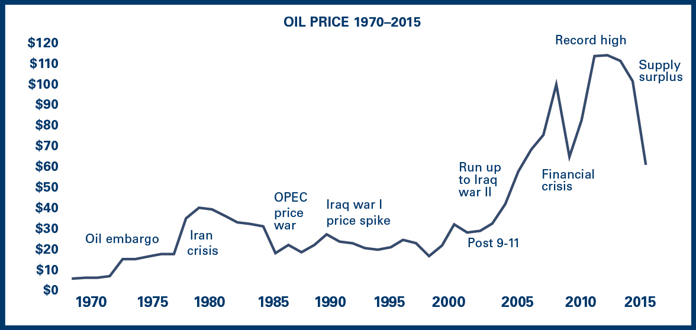
Oil Crisis
The price of oil shot up to $11.65 per barrel, an increase of 387%.
The U.S. consumed one third of the world’s oil at this time.

Slide 7
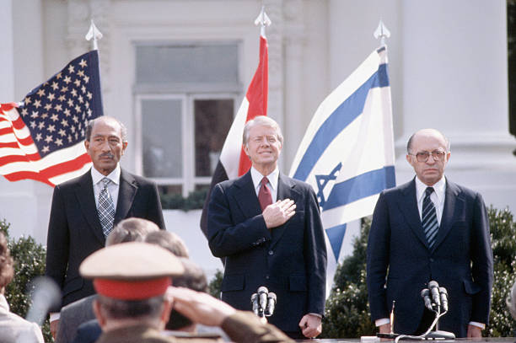
Camp David Accords
Egypt agreed to recognize Israel in return for regaining control of the Sinai Peninsula.
Egypt
Anwar el-Sadat
Israel
Menachem Begin
United States
Jimmy Carter

Slide 8
Panama Canal

Slide 9
USSR Invades Afghanistan
Notes:
SALT II broke down again
1980 Summer Olympic Boycott

Slide 10
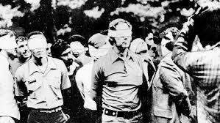
Iranian Revolution
Ayatollah Khomeini
Mohammad Reza Pahlavi (CIA 1953)
November 1979, Iranian militants seized the US Embassy in Tehran.
66 American hostages.
Demanded the return of the Shah
14 hostages released within a few months
52 hostages 444 days
Released on Ronald Reagan’s inauguration day.

Slide 11
1980s
Election
Reagan Domestic Politics
Reagan Foreign Policy
The Aids Crisis

Slide 12
Ronald Reagan
Serves Two Terms
The Great Communicator
“New Right”
Economic Conservatives
Christian
Working-class whites
Aggressive Cold War FP

Slide 13
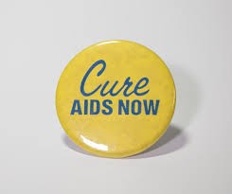
The AIDS Crisis
1982 – Congress allocated $12 million for AIDS research and treatment.
Executive order – HIV Epidemic
Increased federal funding for research and education on HIV/AIDS to 500 million.
FDA approved the drug AXT which inhibits HIV and delays the onset.
1986 – 12, 000 deaths
1988 – 20,000 deaths

Slide 14
Reaganomics
Cut taxes & deregulate some industries.
Supply- side economics
Corporations & wealthy individuals would reinvest the money they save by lowering taxes to build businesses, create jobs, boost profits and spur economic rowth.

Slide 15
Reaganomics
Large tax cuts
Proposed select tax increases.
Inflation and unemployment fell.
National debt tripled.

Slide 16
Reagan – Foreign Policy
Challenges of the Cold War
Growing threat of terrorism in the Middle East and North Africa.
“Freedom Fighters”
Afghanistan
Angola
Nicaragua

Slide 17
USSR
1983 – “evil empire”
Strategic Defense Initiative (Star Wars)
Deployed five medium-range nuclear missiles to five NATO countries.
1987 “Mr. Gorbachev, tear down this wall.”

Slide 18
USSR
1987 – Reagan and Gorbachev signed the first ever nuclear arms reduction treaty.
The Cold War was coming to an end.
Glasnost
Perestroika

Slide 19
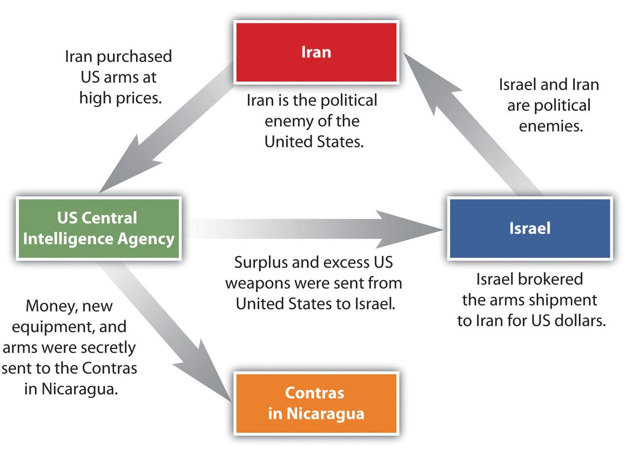
Iran – Contra Affair
US officials secretly sold weapons to Iran and used the profits to aid Nicaraguan rebels.

Slide 20
1990s
The Gulf War
Clinton Administration
Globalization

Slide 21
The Gulf War
August 1990 - Iraq invaded Kuwati
The US and UN Security Council demanded the Hussein withdraw his troops.
Six weeks (January and February 1991) a US led coalition of 34 nations started a bombing campaign.
Four day ground campaign.
Operation Desert Storm

Slide 22
The Gulf War
At the end of February, Hussein signed a cease fire agreement and released Kuwait.
Iraq was inspected to make sure they had no chemical or other weapons of mass destruction.

Slide 23
The Clinton Administration
1992 & 1996
The Omnibus Budget Reconciliation Act
Raised taxes on the wealthiest 1.2 %
Cut taxes for small businesses & lower income wage earners.
Balanced the federal budget
Result = a federal budget surplus

Slide 24
Bush Administration
The Election of 2000
September 11th
The Great Recession

Slide 25
Obama Administration
The Affordable Health Care Act.
Don’t Ask Don’t Tell
Same – Sex Marriage is legalized

Slide 26
Obama Administration
August 2010 – US forces are withdrawn from Iraq.
The Islamic State in Iraq and the Levant intensified.
Mosul & Tikrit
May 2, 2011 US Navy Seals capture and kill Osama Bin Laden in Abottabad, Pakistan.

Slide 27
Obama Administration
Renewed diplomatic relations with Cuba.
International agreement on Iran’s nuclear program.

