Slide 1
Dictators of Europe
US Honors

Slide 2
Why do Dictator rise in Europe in so many countries?
Economic instability (Great Depression)
Weak governments (new governments created from the Treaty of Versailles)
Lingering trauma from WWI
People in Europe are poor, hungry, and frustrated. They are looking for someone to help solve their problems
How does Economic instability lead to political instability?

Slide 3
Fascism
Fascism was originally the government of Italy under Benito Mussolini
Fascism is the governmental system adopted in Italy, Germany, and Japan in the 1930s and 1940s (no coincidence that these are the Axis powers)
Characteristics:
Conservative (on the political spectrum) - FAR RIGHT
Few Freedoms (Freedom of Speech, Freedom of the Press, etc.)
Total conformity to the ideal - attacks on individualism and pluralism
Strong Nationalism
Glorifies military service and military action (militarism)
1 dictator, who holds all the power, and controls the country
Desire for power, and expansion of national borders

Slide 4
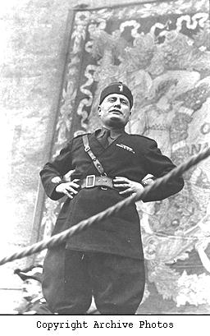
Benito Mussolini

Slide 5
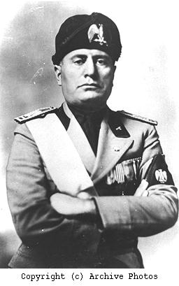
Founder of the Fascist Party
Marched on Rome and overthrew the King in 1922
First Fascist State in Europe

Slide 6
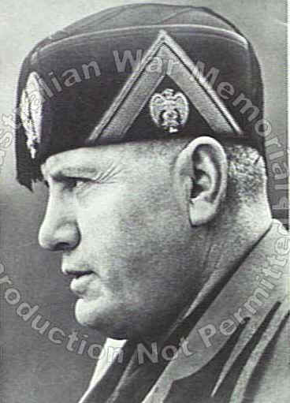
Curbed Free speech and free press
Suppressed all opposition
Wanted to create a modern Roman Empire (retake territories that were part of the Roman Empire)

Slide 7
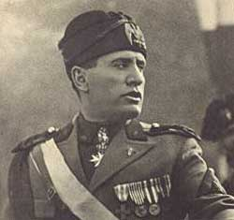

Slide 8
Communism
Economic elements - state-controlled economy, no private enterprise or property
Political elements - one political party, suppress opposition
Far LEFT on the political spectrum (extreme liberalism)
Theory vs. Practice
Theoretical communism: Equality, Total Freedom, no government, no police, no law, because everyone does the right thing and shares everything
In practice: Limit personal freedoms, 1 dictator, strong sense of nationalism, values the state over individualism, desire to expand borders, totalitarianism
Sound familiar?
In theory, Fascism and communism are polar opposites. But in practice: They are almost identical

Slide 9
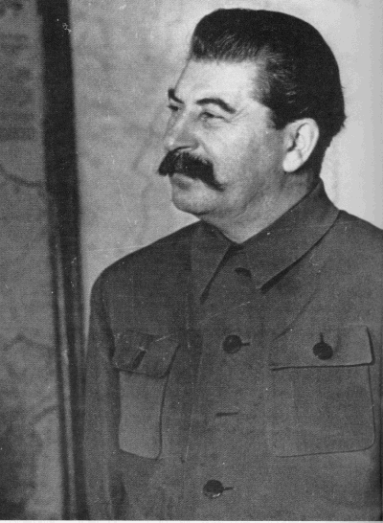
Joseph Stalin
Secretary General under Lenin
Took power in the USSR in 1928

Slide 10
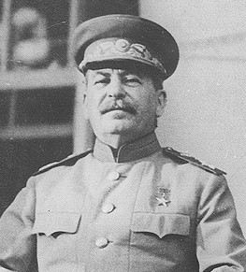
Began the collectivization of peasant plots (seizing private property
Silences all opposition and critics of his policies (work camps, assassinations)
Severe oppression of his people

Slide 11
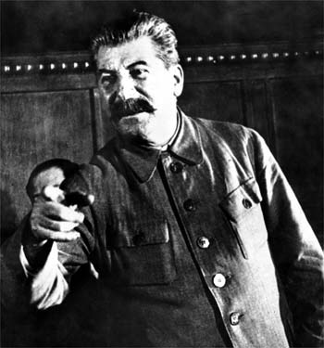
The Great Purge - he imprisoned educated people who criticized him

Slide 12
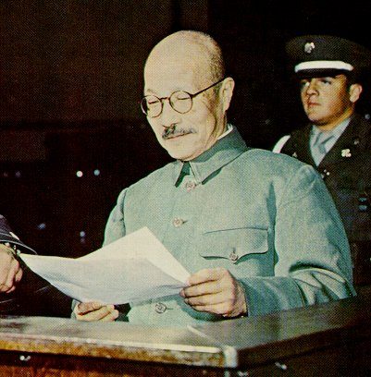
Hideki Tojo

Slide 13
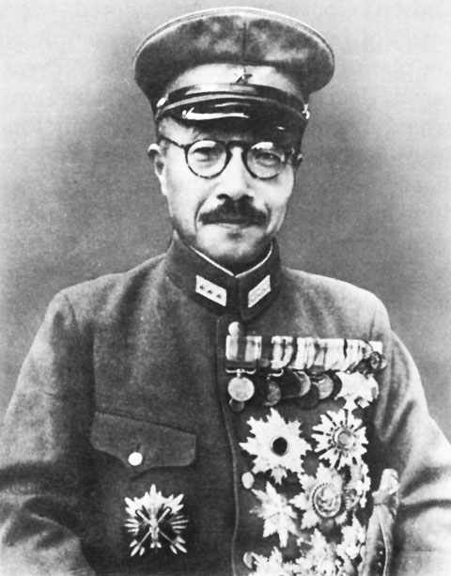
Prime Minister of Japan from 1941-1945
sought to consolidate control of the government
Expanded the military
Was an expansionist
Masterminded the attack on Pearl Harbor

Slide 14
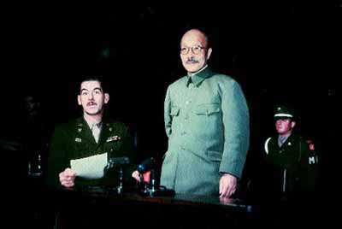
Later convicted as a war criminal and executed
He is blamed for Japan’s wartime disaster

Slide 15
Nazism
An example of Fascism
One added element: Genocide of “undesirable” people
Poles, Hungarians, Russians, Jews, Roma (Gypsies), those with physical or mental disabilities, etc.

Slide 16
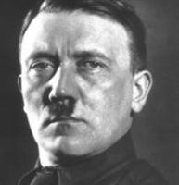
Adolf Hitler

Slide 17
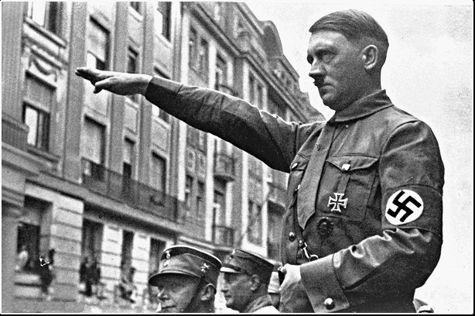
Became chancellor of Germany
Was granted emergency powers (Germany was in an economic crisis)

Slide 18
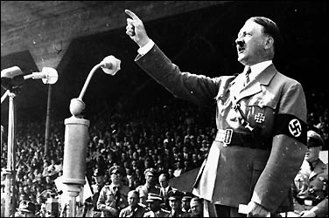
Transformed Germany’s Republican government into a dictatorship and appointed himself the leader (Fuhrer)

Slide 19
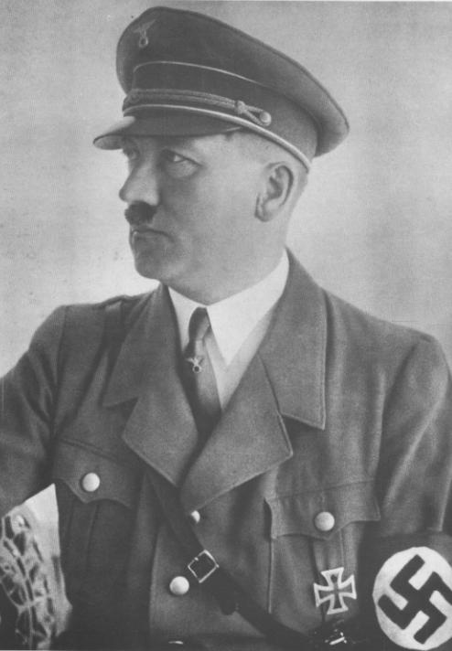
Nazis exercised total control of everyday life
Demanded that Germans give everything to the Nazi party

Slide 20
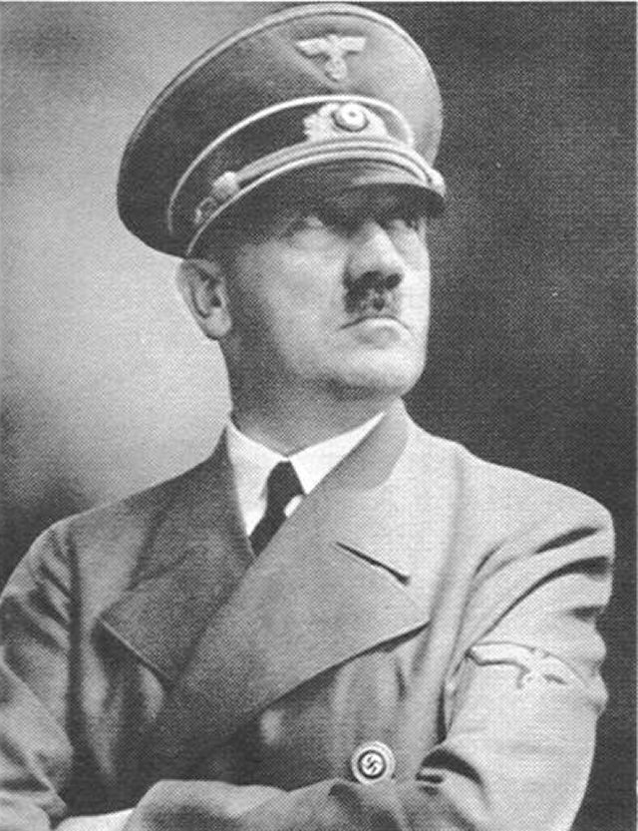
Created the Storm Troopers
Gestapo (Secret Police)
Targeted political radicals (communists, anarchists)
Began a campaign of harassment of German Jews

Slide 21
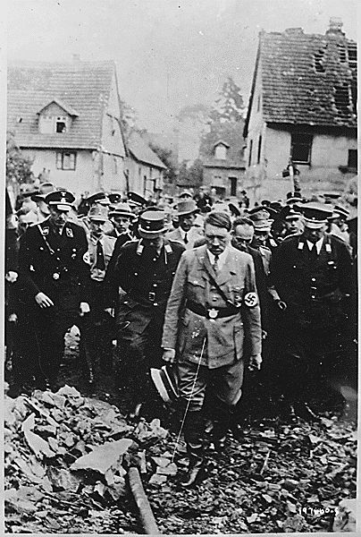
Well Known for his “Final Solution”

