Slide 1
WWII Propaganda
Posters and Movies

Slide 2
Three Reasons for Using Propaganda
Encourage Americans to support the War (financially, emotionally, in their work)
To recruit troops in the military
To Justify the war effort
PLEASE NOTE: Many of these propaganda posters and videos employ racist stereotypes, that, while true of the historical time period, are unacceptable today. Please keep that in mind as we look at them today

Slide 3
Five Themes We will See
Rally the nation together
Recruiting Troops
Training/Education
Define the Enemy (demonize the enemy)
Entertainment (give Americans a break from the worry and stress of the war)

Slide 4
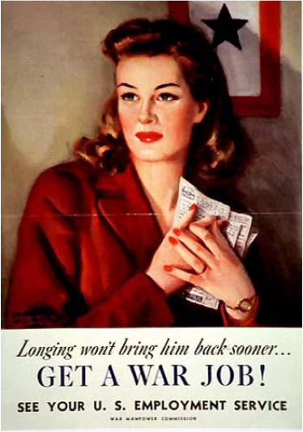
Get a War Job

Slide 5
Waste Helps The Enemy

Slide 6
Car-Sharing Club

Slide 7
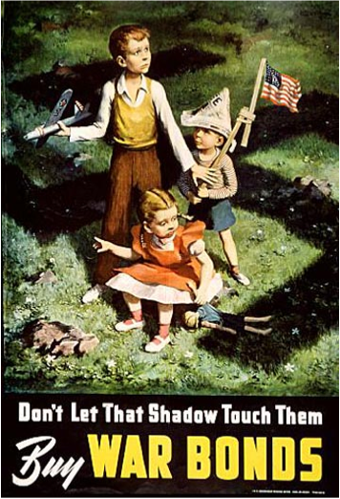
The Shadow

Slide 8
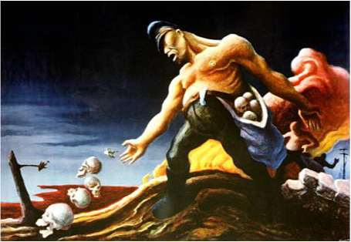
The Sowers

Slide 9
Watchers

Slide 10
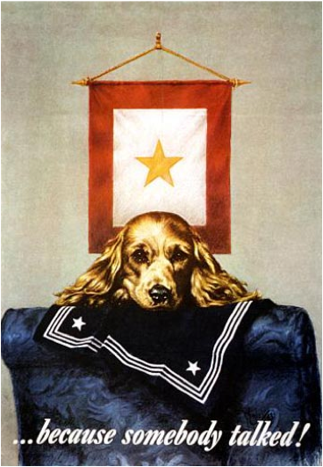
Because Somebody Talked

Slide 11
Keep These Hands Off

