Slide 1
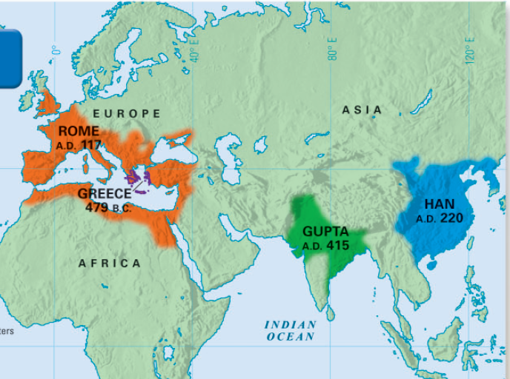
After the river valley era, a number of classical civilizations developed in the Mediterranean and in Asia
The first major classical civilization was ancient Greece
Classic cultures created high levels of achievement in art, science, & technology that impacted future ages

Slide 2
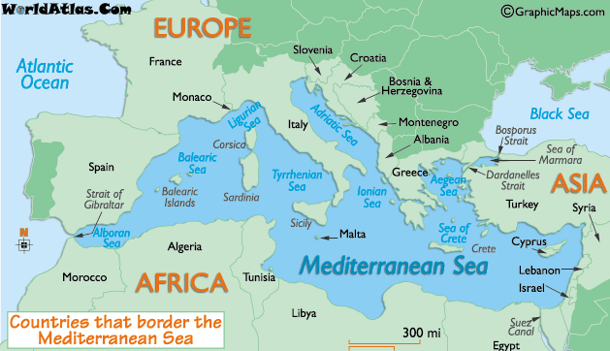
Impact of Geography on Greece: Identify 1 geographic feature & propose how it might impact the culture of Greece

Slide 3
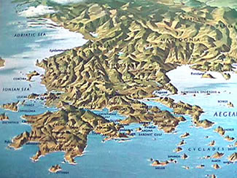
Impact of Geography on Greece: Identify 1 geographic feature & propose how it might impact the culture of Greece

Slide 4
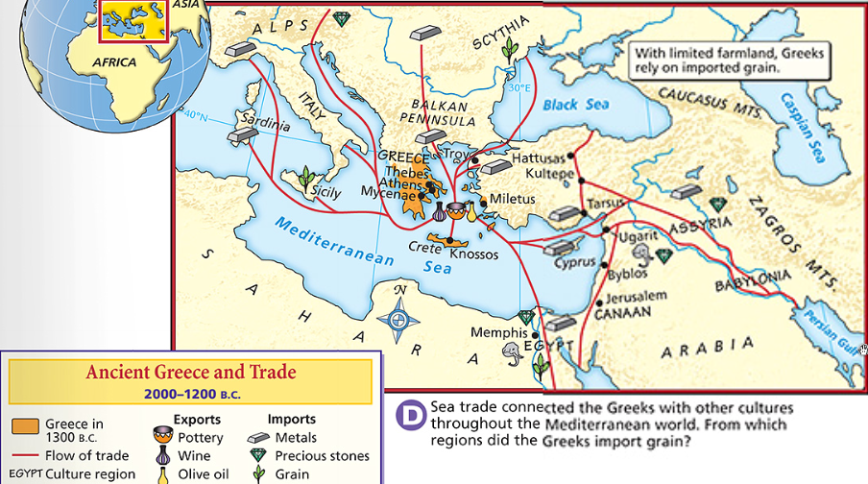
Greece’s lack of natural resources & location on the Mediterranean Sea encouraged Greek trade with neighboring societies
Notes:
Geography Shapes Greek Life
The Sea The sea shaped Greek civilization just as rivers shaped the ancient civilizations of Egypt, the Fertile Crescent, India, and China. In one sense, the Greeks did not live on a land but around a sea. Greeks rarely had to travel more than 85 miles to reach the coastline. The Aegean Sea, the Ionian Sea, and the neighboring Black Sea were important transportation routes for the Greek people. These seaways linked most parts of Greece. As the Greeks became skilled sailors, sea travel connected Greece with other societies. Sea travel and trade were also important because Greece lacked natural resources, such as timber, precious metals, and usable farmland.
The Land Rugged mountains covered about three-fourths of ancient Greece. The mountain chains ran mainly from northwest to southeast along the Balkan Peninsula. Mountains divided the land into a number of different regions. This significantly influenced Greek political life. Instead of a single government, the Greeks developed small, independent communities within each little valley and its surrounding mountains. Most Greeks gave their loyalty to these local communities. In ancient times, the uneven terrain also made land transportation difficult. Of the few roads that existed, most were little more than dirt paths. It often took travelers several days to complete a journey that might take a few hours today. Much of the land itself was stony, and only a small part of it was arable, or suitable for farming. Tiny but fertile valleys covered about one-fourth of Greece. The small streams that watered these valleys were not suitable for large-scale irrigation projects. With so little fertile farmland or fresh water for irrigation, Greece was never able to support a large population. Historians estimate that no more than a few million people lived in ancient Greece at any given time. Even this small population could not expect the land to support a life of luxury. A desire for more living space, grassland for raising livestock, and adequate farmland may have been factors that motivated the Greeks to seek new sites for colonies

Slide 5
Mountains covered about 75% of Greece which divided the people & made unifying the Greek people nearly impossible
Notes:
Geography Shapes Greek Life
The Land Rugged mountains covered about three-fourths of ancient Greece. The mountain chains ran mainly from northwest to southeast along the Balkan Peninsula. Mountains divided the land into a number of different regions. This significantly influenced Greek political life. Instead of a single government, the Greeks developed small, independent communities within each little valley and its surrounding mountains. Most Greeks gave their loyalty to these local communities. In ancient times, the uneven terrain also made land transportation difficult. Of the few roads that existed, most were little more than dirt paths. It often took travelers several days to complete a journey that might take a few hours today. Much of the land itself was stony, and only a small part of it was arable, or suitable for farming. Tiny but fertile valleys covered about one-fourth of Greece. The small streams that watered these valleys were not suitable for large-scale irrigation projects. With so little fertile farmland or fresh water for irrigation, Greece was never able to support a large population. Historians estimate that no more than a few million people lived in ancient Greece at any given time. Even this small population could not expect the land to support a life of luxury. A desire for more living space, grassland for raising livestock, and adequate farmland may have been factors that motivated the Greeks to seek new sites for colonies

Slide 6
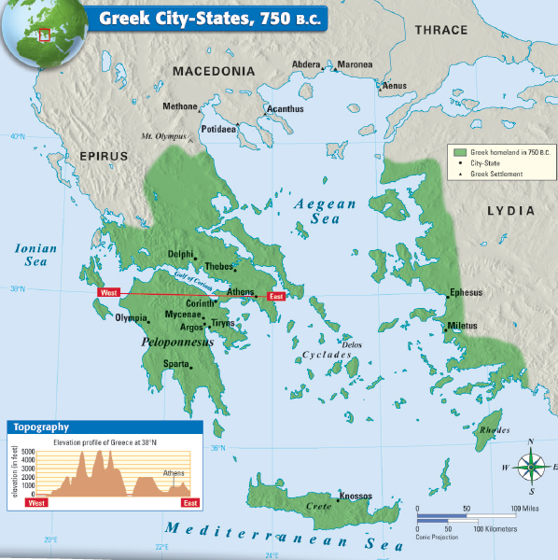
The Greeks developed independent city-states, called polis, within each valley & its surrounding mountains
Notes:
Geography Shapes Greek Life
The Land Rugged mountains covered about three-fourths of ancient Greece. The mountain chains ran mainly from northwest to southeast along the Balkan Peninsula. Mountains divided the land into a number of different regions. This significantly influenced Greek political life. Instead of a single government, the Greeks developed small, independent communities within each little valley and its surrounding mountains. Most Greeks gave their loyalty to these local communities. In ancient times, the uneven terrain also made land transportation difficult. Of the few roads that existed, most were little more than dirt paths. It often took travelers several days to complete a journey that might take a few hours today. Much of the land itself was stony, and only a small part of it was arable, or suitable for farming. Tiny but fertile valleys covered about one-fourth of Greece. The small streams that watered these valleys were not suitable for large-scale irrigation projects. With so little fertile farmland or fresh water for irrigation, Greece was never able to support a large population. Historians estimate that no more than a few million people lived in ancient Greece at any given time. Even this small population could not expect the land to support a life of luxury. A desire for more living space, grassland for raising livestock, and adequate farmland may have been factors that motivated the Greeks to seek new sites for colonies

Slide 7
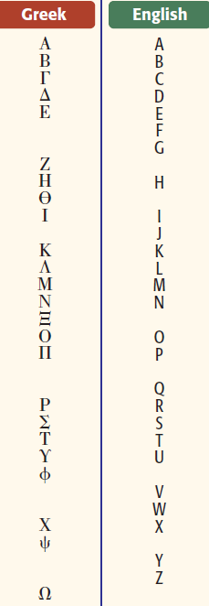
Greek Culture
Despite their lack of unity, the Greeks shared some common characteristics:
Greeks shared the same language
Greek writing was influenced by the Phoenician alphabet & became the basis for Latin
Notes:
Greeks were polytheistic & believed that the gods

Slide 8
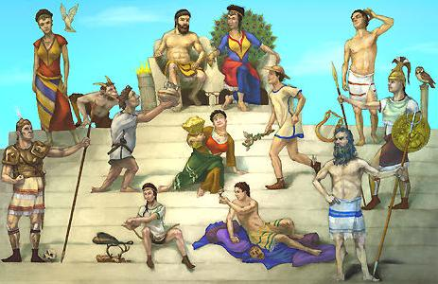
Greeks were polytheistic & believed that the gods were immortal but had human qualities; Religion became the basis for Greek mythology
Zeus King of the gods
Athena Goddess of wisdom
Aphrodite Goddess of love
Apollo God of sun & music
Ares God of war
Hades God of underworld
Hera Goddess of family
Poseidon God of the seas
Notes:
Aphrodite The sensual goddess of Love and Beauty
Apollo The youthful god of the Sun and the Music
Ares The fierce god of War
Artemis The wild goddess of the Hunt
Athena The sophisticated goddess of Wisdom and Arts
Demeter The natural goddess of the Harvest
Dionysus The joyful god of the Wine
Hades The gloomy god of the Underworld
Hephaestus The ill-favored god of Metallurgy
Hera The mature goddess of the Family
Hermes The cunning god of the Trade
Hestia The calm goddess of the Hearth
Poseidon The moody god of the Seas
Zeus The heavenly King of the Gods and ruler of mankind

Slide 9
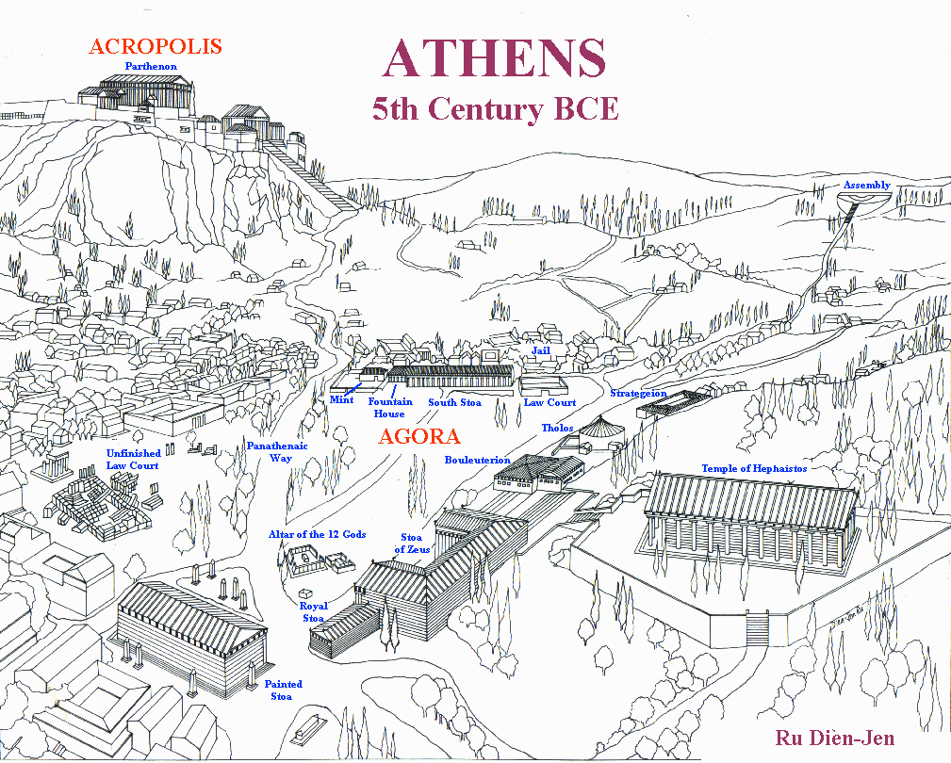
Most Greek city-states had an agora that was the center for trade & government
City-states had an acropolis, a temple on a hill dedicated to a sacred god
Notes:
Most Greek city-states had an agora that was the center for trade & government
the gods

Slide 10
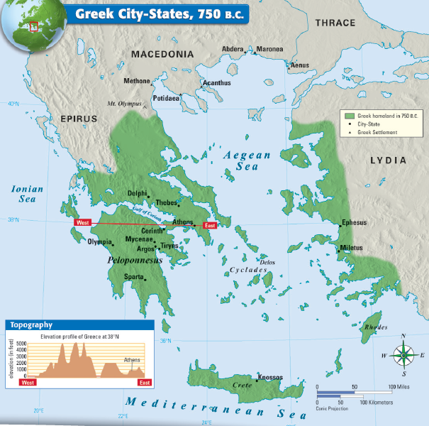
Despite similar language & religion, the Greek polis were very different from each other, especially how they were governed
Differences Among Greek City-States
Notes:
Geography Shapes Greek Life
The Land Rugged mountains covered about three-fourths of ancient Greece. The mountain chains ran mainly from northwest to southeast along the Balkan Peninsula. Mountains divided the land into a number of different regions. This significantly influenced Greek political life. Instead of a single government, the Greeks developed small, independent communities within each little valley and its surrounding mountains. Most Greeks gave their loyalty to these local communities. In ancient times, the uneven terrain also made land transportation difficult. Of the few roads that existed, most were little more than dirt paths. It often took travelers several days to complete a journey that might take a few hours today. Much of the land itself was stony, and only a small part of it was arable, or suitable for farming. Tiny but fertile valleys covered about one-fourth of Greece. The small streams that watered these valleys were not suitable for large-scale irrigation projects. With so little fertile farmland or fresh water for irrigation, Greece was never able to support a large population. Historians estimate that no more than a few million people lived in ancient Greece at any given time. Even this small population could not expect the land to support a life of luxury. A desire for more living space, grassland for raising livestock, and adequate farmland may have been factors that motivated the Greeks to seek new sites for colonies

