Slide 1
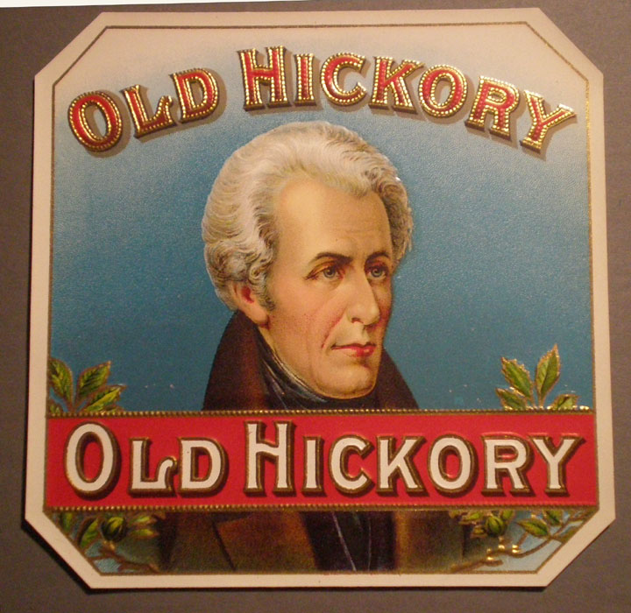
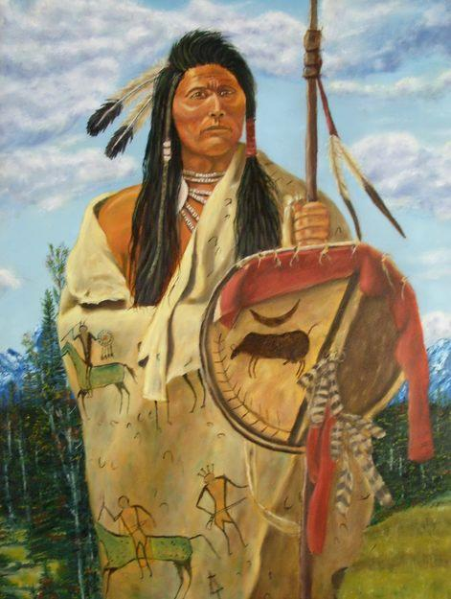
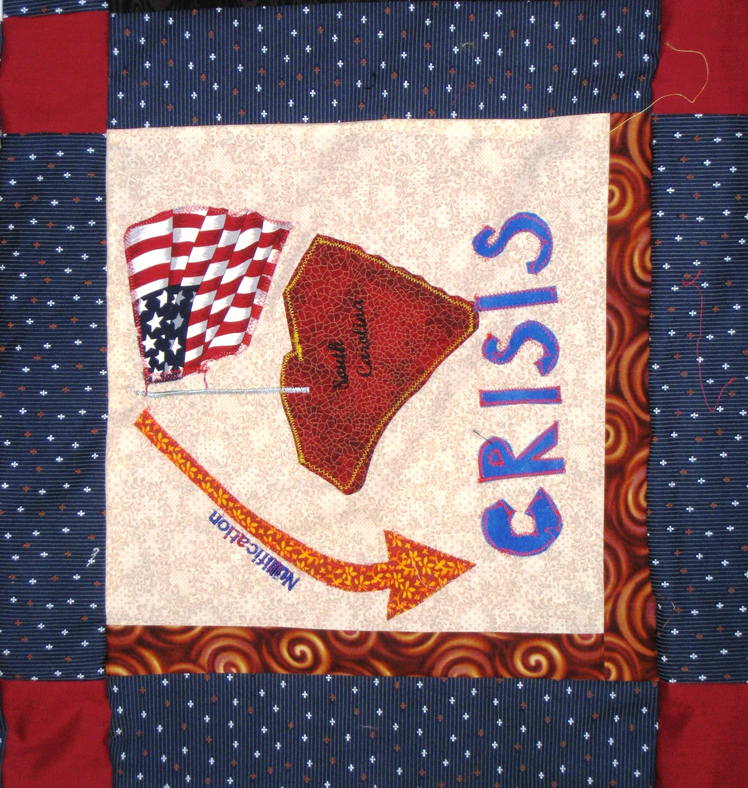
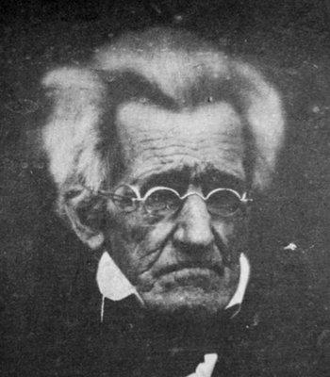
The Presidency of Andrew Jackson and Manifest Destiny
(Unit II, Segment 2 of 3)

Slide 2
Essential Question:
How did America evolve towards greater democracy between 1800 & 1840?
How did President Jackson reflect this change?
Warm-Up Question:
What was the most important social reform of the 1830s? Explain why

Slide 3
Class Discussion: How did America change from 1800 to 1830?

Slide 4
The Growth of Democracy
From 1800 to 1840, democracy increased in America:
Before 1800, less than 50% of white men could vote because of property & tax restrictions
By 1840, these restrictions were removed which allowed 90% of “common” white men to vote (“universal white male suffrage”)

Slide 5
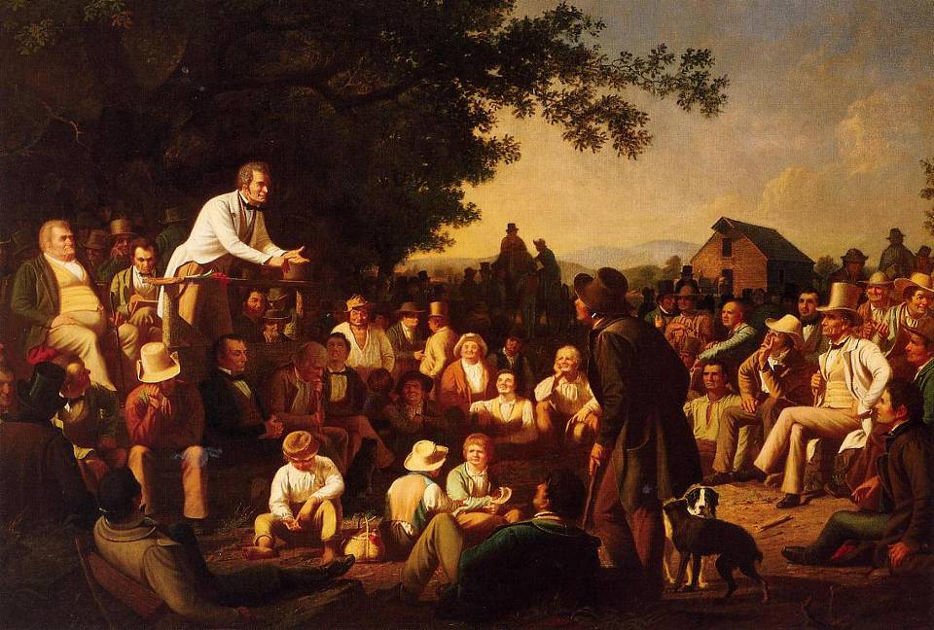
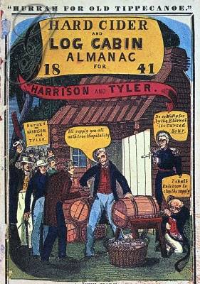
Because more “common men” could vote, political parties used new techniques to get votes
Campaigns, parades, & slogans that appealed to the “common man”
Well organized political parties to rally voters
As a result of these changes, the 1830s & 1840s saw massive voter turnout in elections

Slide 6
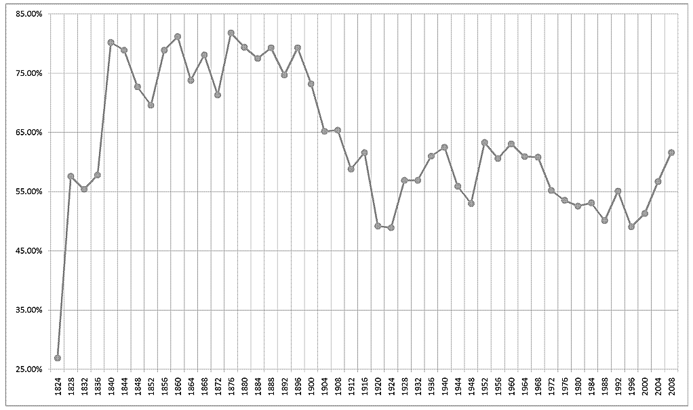
What is voter turnout like today?

Slide 7
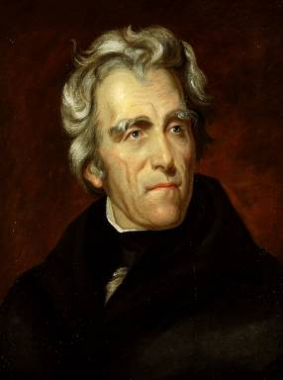
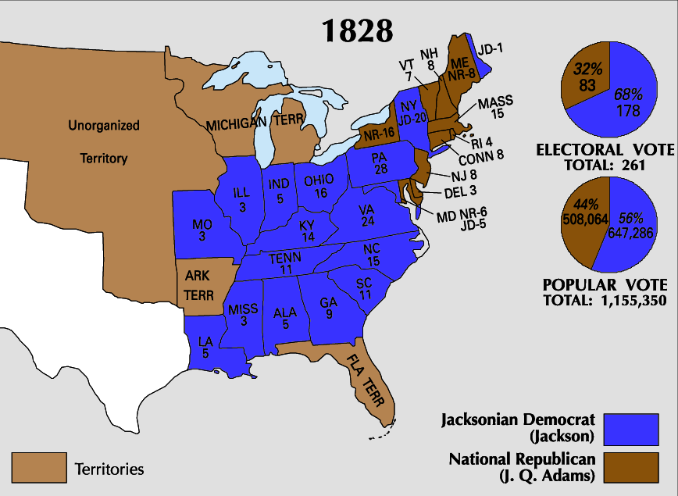
George Washington
John Adams
Thomas Jefferson
James Madison
James Monroe
John Q. Adams
Andrew Jackson
In 1828, Andrew Jackson was elected president:
The 1st “common man” candidate (Old Hickory)
He split from Jefferson’s Democratic-Republican Party & helped form the Democratic Party (the 1st modern party)
He greatly expanded presidential power

Slide 8
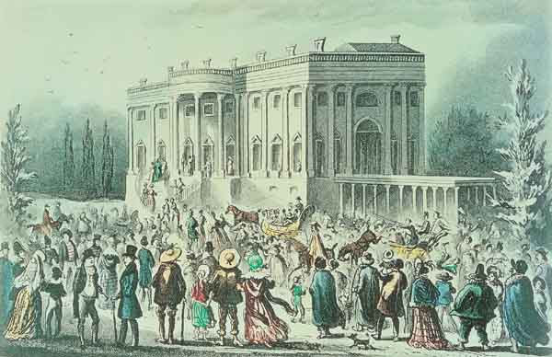
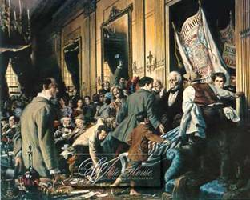
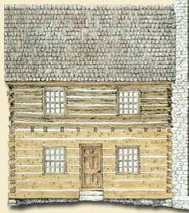
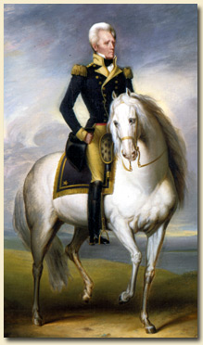
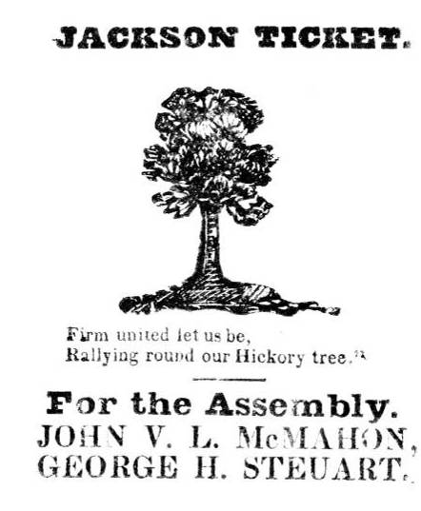
Who is Andrew Jackson?
Jackson’s wild & rowdy inauguration

Slide 9
Changing Politics Under Jackson
President Jackson changed American government:
He rewarded loyal supporters with gov’t jobs (spoils system)
He used the presidential veto more often than any president for the next 100 years
Critics of Jackson’s Democrats formed the Whig Party (which maintained the two-party system)

Slide 10
Key Events of Jackson’s Presidency
Jackson’s 8 years as president were defined by 3 controversies (two we will focus on):
In 1830, Jackson signed the Indian Removal Act to remove remaining Indians from the East

Slide 11
Native American Removal
Jackson faced a problem with Native Americans in the American South:
Gold was discovered in north Georgia in 1828 in lands controlled by the Cherokee who refused to move from GA
Jackson asked Congress for the Indian Removal Act of 1830 to relocate Native Americans across the Mississippi River

Slide 12
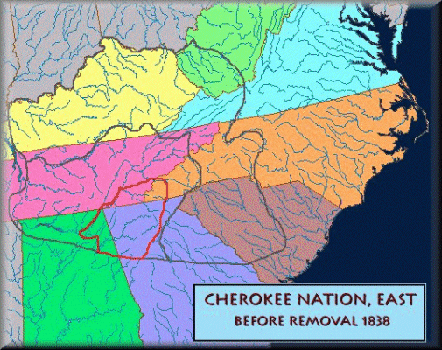
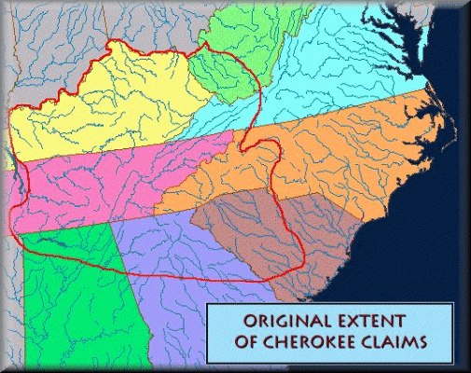
Since the arrival of Europeans, the Cherokee saw their territory slowly taken away
One reason the Cherokee still remained east of the Mississippi was because their land was mountainous & not ideal for cash-crop farming

Slide 13
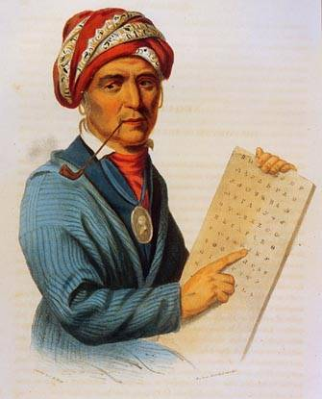
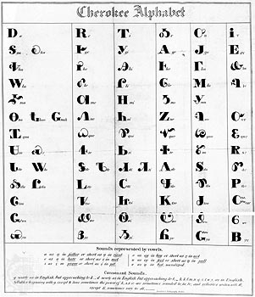
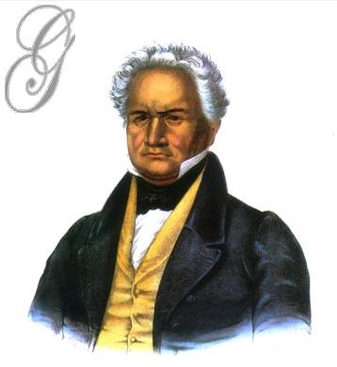
The Cherokee were not removed earlier than the 1830s was because they were highly civilized & did not fit the “traditional Indian stereotype”
The Cherokee had a written alphabet, democratically elected leaders, & were skilled farmers
The Cherokee did not go to war when Congress passed the Indian Removal Act, they sued in the Supreme Court…and won!
But, the state of Georgia & President Jackson ignored the Supreme Court & took Native American lands anyway
Sequoyah’s Syllabary
Notes:
syllabary Sequoyah

Slide 14
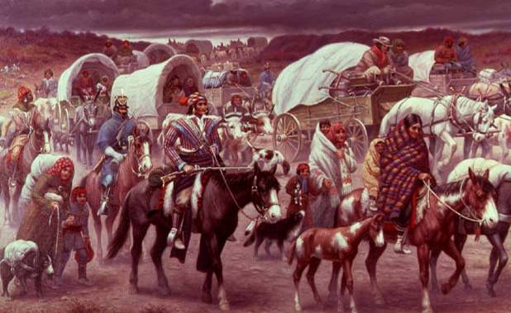
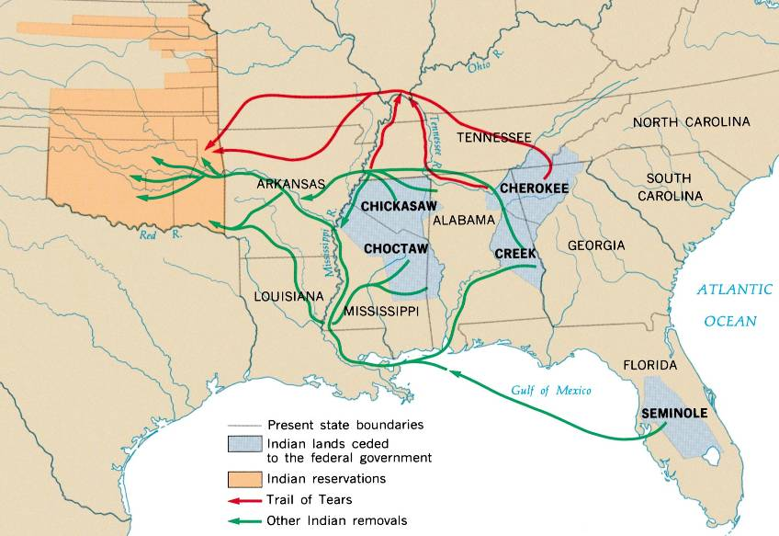
In 1838, the U.S. Army forced the Cherokees west on the “Trail of Tears”

Slide 15
Key Events of Jackson’s Presidency
Jackson’s 8 years as president were defined by 3 controversies:
In 1830, Jackson signed the Indian Removal Act to remove remaining Indians from the East
The Nullification Crisis (1832-33) exposed sectionalism between the states & national government

Slide 16
The Nullification Crisis
By the 1830s, sectionalism was becoming more obvious, especially over the issue of tariffs:
Southerners argued that tariffs helped Northern industry but made prices higher for farmers
When Congress passed a high tariff in 1832, Southerners claimed “states’ rights” & threatened to nullify the tariff
Nullification is the argument that states have the right to ignore federal laws that they think are unfair

Slide 17
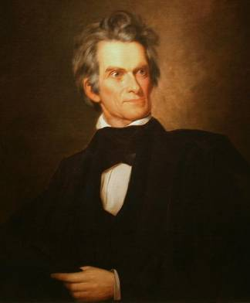
Nullification Crisis, 1832
President Jackson viewed nullification as a threat to U.S.
The national gov’t is supreme over the individual states
Urged Congress to pass the Force Bill to enforce the tariff
VP John C. Calhoun from South Carolina urged nullification
States have the right to protect themselves from the national government
As a last resort, states can secede from the Union
Jackson threatened to “hang Calhoun from the nearest tree”

Slide 18
The Nullification Crisis
In 1833, Congress created a compromise tariff & the crisis ended
Significance of Nullification Crisis:
Revealed sectionalism between North & South
The South used “states’ rights” to argue that secession was possible
President Jackson was willing to use force to protect the power of the national gov’t over the states

Slide 19
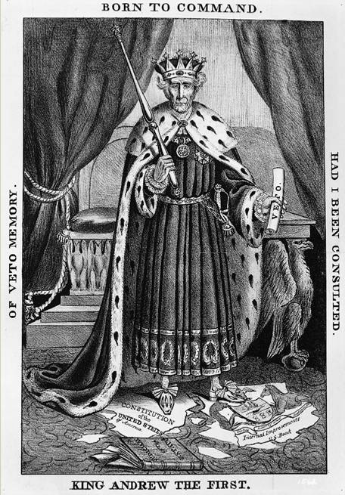
“King” Andrew?
Jackson was criticized as abusing his Constitutional powers as president

Slide 20
Conclusions
Andrew Jackson represented a new era in American democracy:
Forming the Democratic Party, campaigning for the votes of the “common man,” & spoils system
Jackson’s use of the veto strengthened presidential power
Opposition to Jackson led to the permanent two-party political system

Slide 21
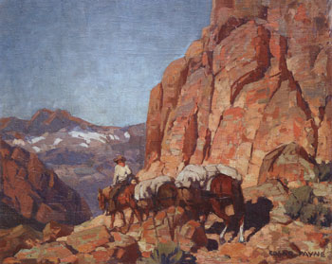
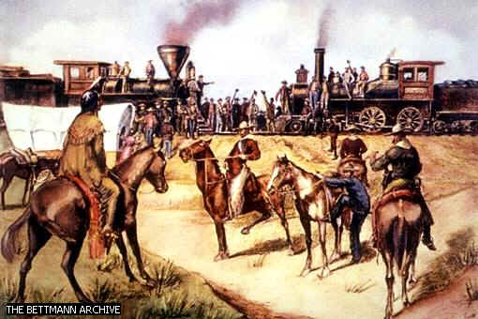
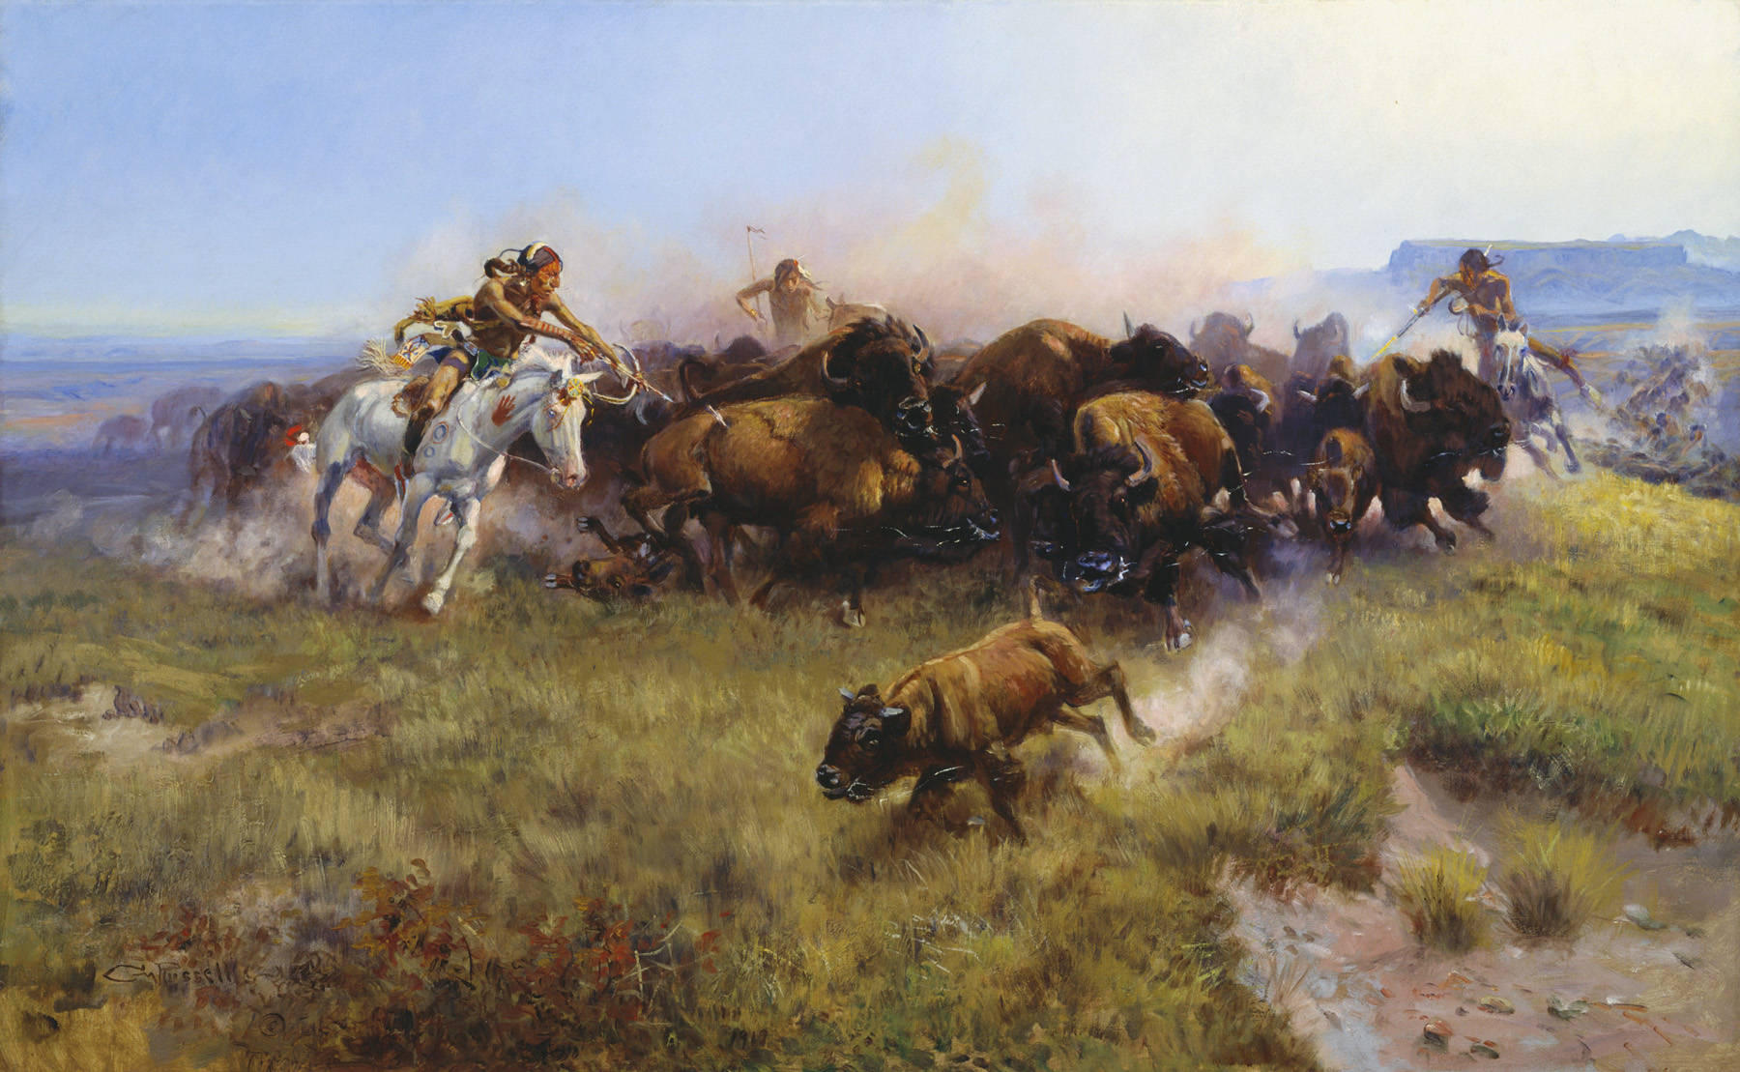
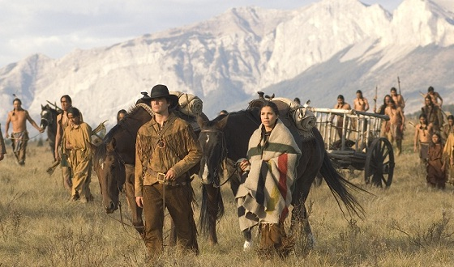
Essential Question:
What were the main causes & effects of Manifest Destiny?
Warm-Up Question—Use the next image to answer these Qs:
What major change took place in America in the 1840s?
How might America have benefitted from this change? What were some negatives?

Slide 22
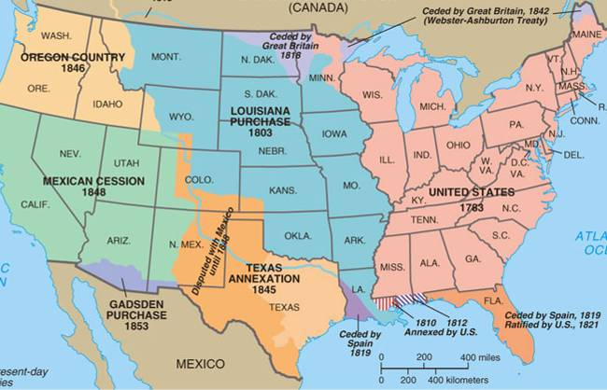
What has changed in the 1840s?
Use this image to search for clues: What major change occurred in America in the 1840s?

Slide 23
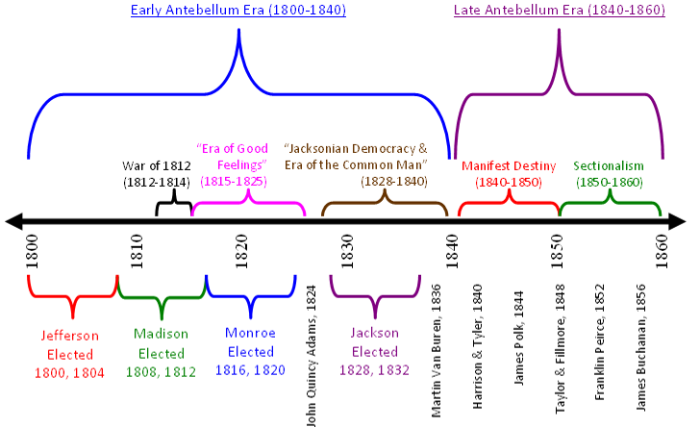
The period of time in U.S. history before the Civil War is known as the Antebellum Era (1800-1860)
Early Antebellum (1800-1840)
American nationalism
Age of the “common man”
Industrial revolution, rise of “king cotton,” market economy
Late Antebellum (1840-1860)
Manifest Destiny into the West
Sectionalism divided North & South

Slide 24
Image Analysis
Examine the image on the next slide & answer these questions:
What point might the artist be making about the American West?
What type of American traveled West? Was this an easy journey?
Why would Americans make the journey into the West?

Slide 25
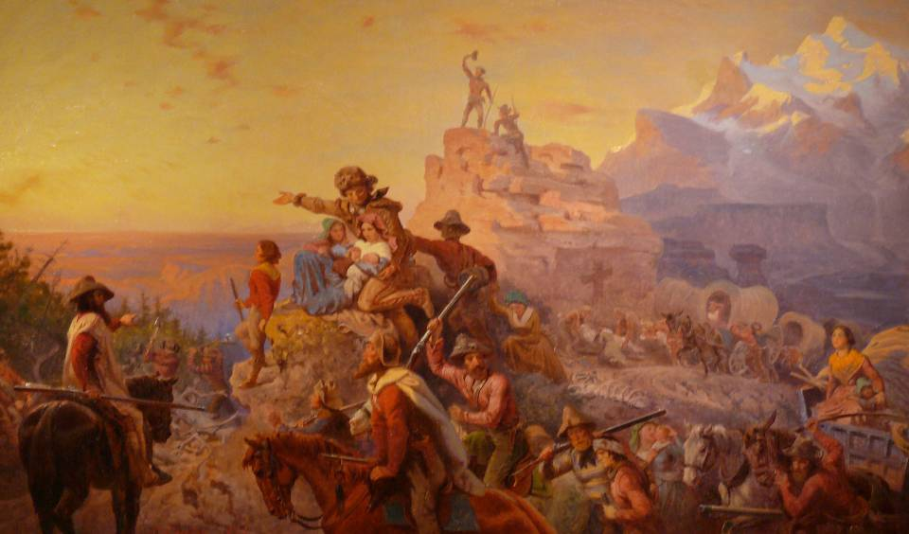
“Westward the Course of Empire” by Emanuel Leutze

Slide 26
Primary Source Analysis: Manifest Destiny
Use the following primary sources to answer these questions:
What do the terms “manifest” & “destiny” mean?
What were the perceived benefits of this westward expansion?
How did Americans justify their westward expansion?

Slide 27
“The whole continent appears to be destined...to be peopled by one nation. The acquisition of a definite line of boundary to the [Pacific] forms a great epoch in our history.” John Quincy Adams, 6th President of (1825-1829), written in 1811

Slide 28
“...It is confidently believed that our system may be safely extended to the utmost bounds of our territorial limits, and that as it shall be extended the bonds of our Union, so far from being weakened, will become stronger...” From the inaugural address of James K. Polk, 11th President (1845-49)

Slide 29
“The American claim is by the right of our manifest destiny to overspread and to possess the whole of the continent which Providence has given us for the development of the great experiment of liberty and federative self-government entrusted to us. It is a right such as that of the tree to the space of air and earth suitable for the full expansion of its principle and destiny of growth...It is in our future far more than in the past history of Spanish exploration or French colonial rights, that our True Title is to be found” Journalist John L. O' Sullivan, New York Morning News (1845)
Notes:
~ "."

Slide 30
Manifest Destiny
In the 1840s, westward expansion led Americans to acquire all lands from the Atlantic to Pacific in a movement called Manifest Destiny
Americans flooded into the West for new economic opportunities
The U.S. gained Texas, Oregon, California, & other territories through treaty or war
“Obvious”
“Future”

Slide 31
Reasons for Manifest Destiny
Changes in the early Antebellum era (1800-1840), encouraged westward expansion in the 1840s
Jefferson’s Louisiana Purchase doubled the size of the USA
Lewis & Clark’s exploration confirmed the economic potential of the western territory
What changed in the 1840s that encouraged westward expansion?

Slide 32
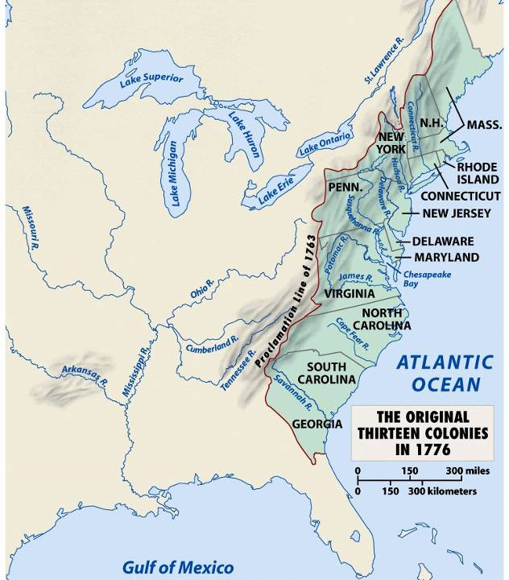
When Americans were colonists (1607-1783), the western border was the Appalachian Mountains

Slide 33
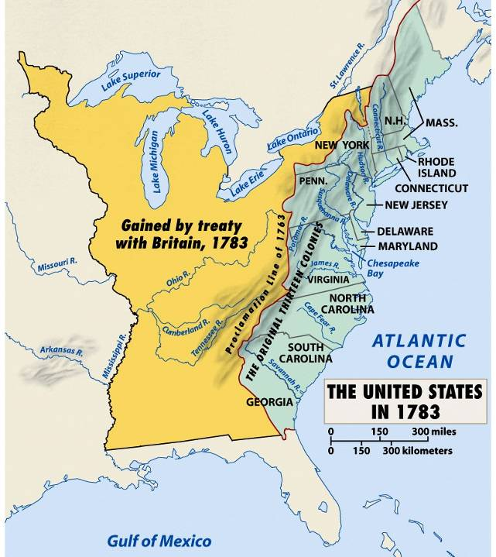
After the Revolutionary War, the western border of the U.S. was the Mississippi River

Slide 34
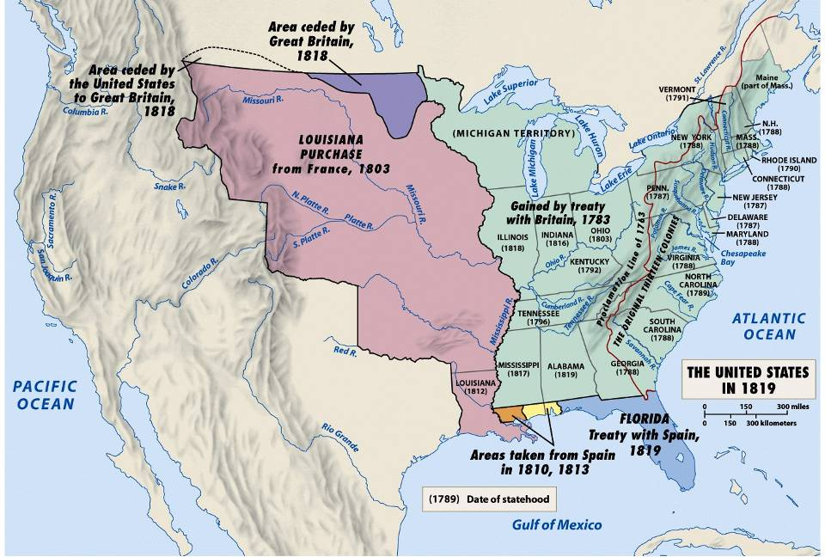
After Jefferson’s Louisiana Purchase in 1803, the western border was the Rocky Mountains

Slide 35
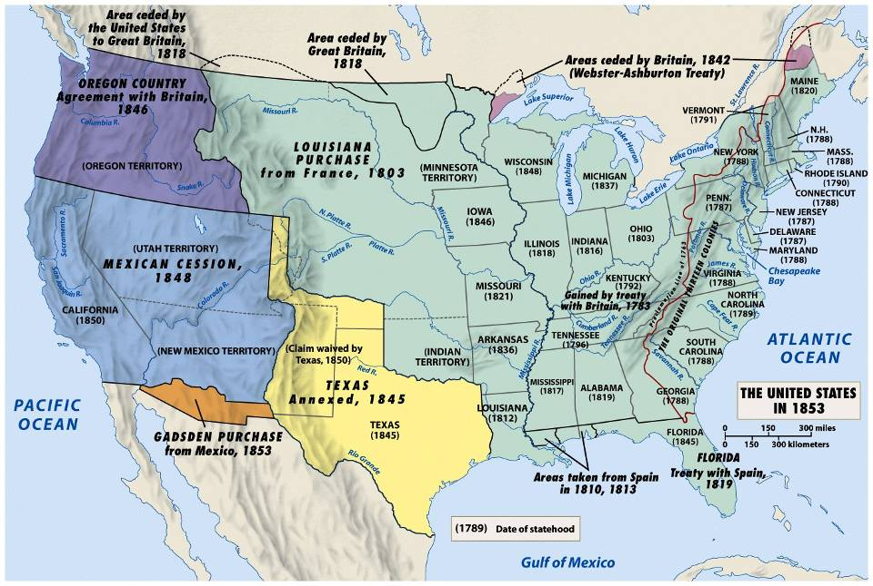
By 1850, the western border was the Pacific Ocean from Oregon to California

Slide 36
Reasons for Manifest Destiny
Changes in the early Antebellum era (1800-1840), encouraged westward expansion in the 1840s
The growth of “King Cotton” & commercial farming led to a desire for more western lands
Improved transportation such as canals, steamboats, & railroads increased speed & profitability

Slide 37
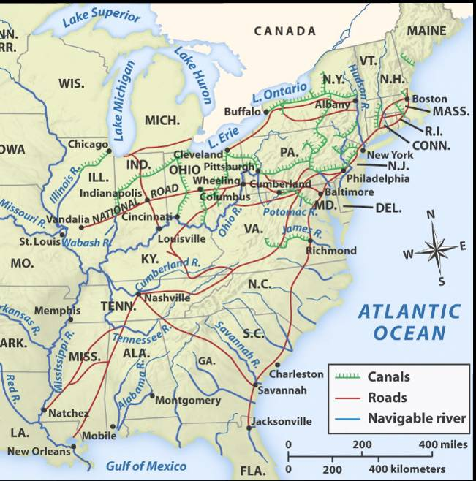

Slide 38
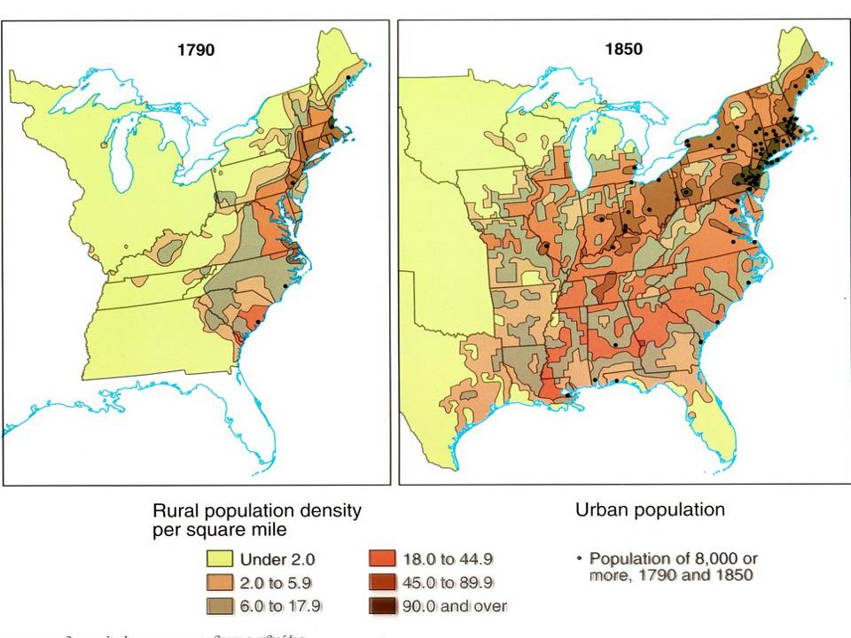
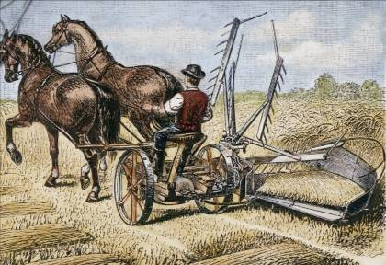
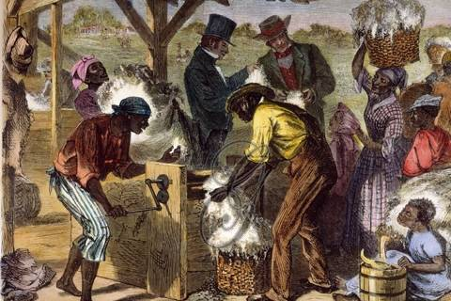

Slide 39
Reasons for Manifest Destiny
Changes in the early Antebellum era (1800-1840), encouraged westward expansion in the 1840s
The U.S. population grew 300%
The number of U.S. states grew from 13 to 26
Western state populations exploded (Ohio’s population grew from 50,000 to 1.5 million)

Slide 40
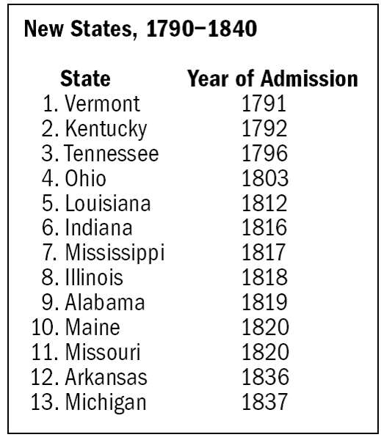
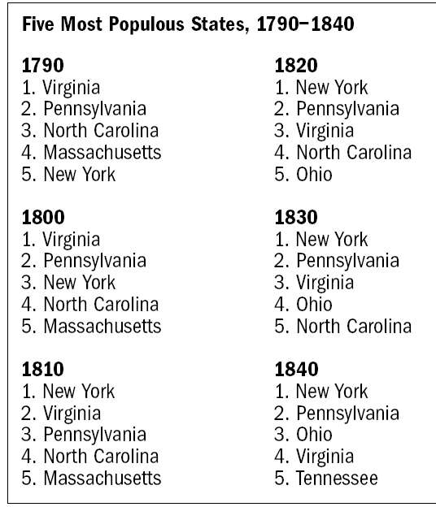
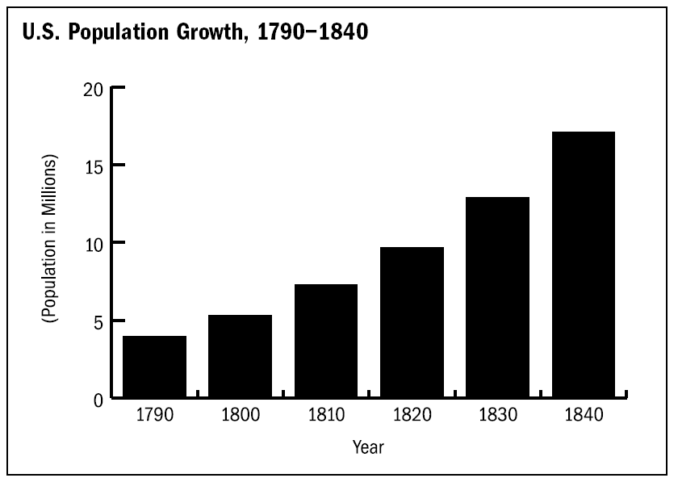

Slide 41
Motivations of Westward Expansion
The journey West was dangerous & unpredictable, yet thousands of Americans traveled along the Oregon, Santa Fe, & Mormon Trails
The earliest pioneers were fur traders, land speculators, & poor farmers looking for cheap land
Soon, farmers, miners, ranchers, & religious groups flooded West
Why would pioneers risk their lives to travel West?

Slide 42
Western Trails
Joseph Smith’s murder forced new LDS leader Brigham Young to resettle in Salt Lake, Utah where he built a Mormon community
The Santa Fe Trail allowed the U.S. to sell goods to Mexico
In 1830, Joseph Smith founded the Mormon Church of Latter-day Saints in New York, but were persecuted & forced to move West
The Oregon Trail led thousands of farmers to the fertile lands of Oregon in the 1840s

Slide 43
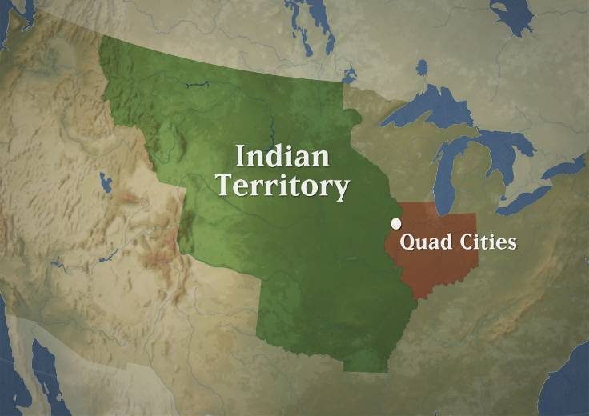
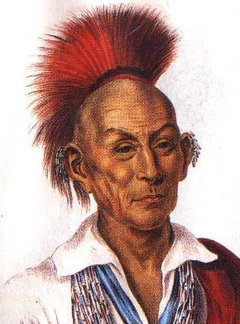
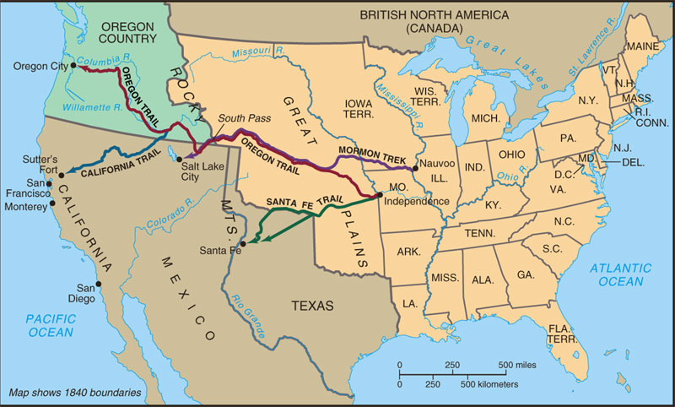
Westward Expansion
Westward expansion brought conflict with Native Americans, such as the Black Hawk War, as trails disrupted hunting grounds & violated previous treaty agreements
The Treaty of Fort Laramie created a vast Native American Territory but was repeatedly ignored by whites expanding West

Slide 44
What is Manifest Destiny?
Examine the image on the next slide & answer the following questions:
Identify 3 reasons Americans moved West
Identify 3 consequences of American westward expansion
What does the women in the center of the image represent?
What point is the artist trying to make with his use of light?

Slide 45
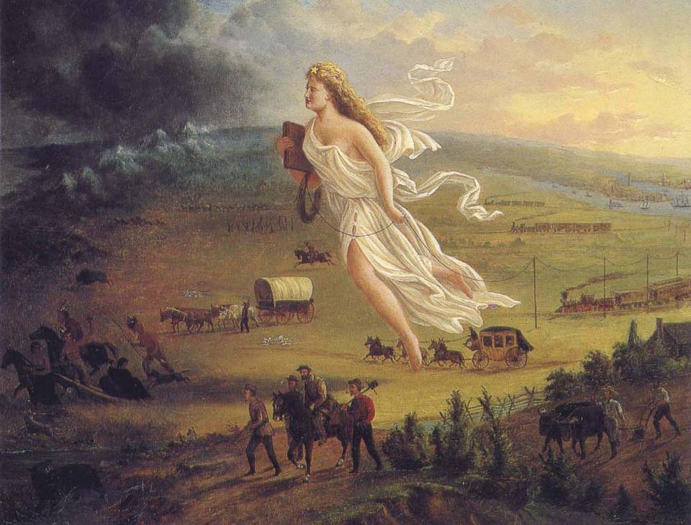

Slide 46
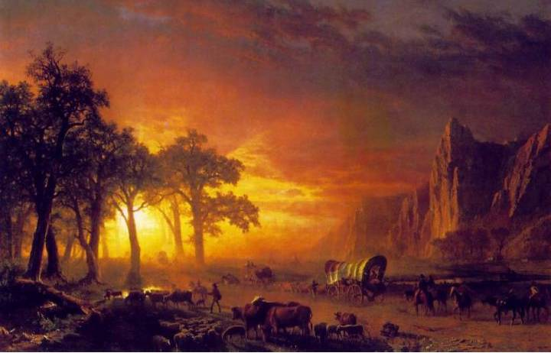
What was the journey west across the Oregon Trail like? Use three adjectives (or descriptive words) to describe pioneer experiences on the Oregon Trail.

Slide 47
“Life on the Oregon Trail” Excerpt #1
“Pioneers along the Oregon Trail averaged 15 miles per day, almost exclusively on foot, for nearly 6 months”

Slide 48
“Life on the Oregon Trail” Excerpt #2
“Covered wagons dominated traffic on the Oregon Trail. The typical wagon was about 11 feet long, 4 feet wide, and 2 feet deep, with bows of hardwood supporting a bonnet that rose about 5 feet above the wagon bed. With only one set of springs under the driver's seat and none on the axles, nearly everyone walked along with their herds of cattle and sheep.”

Slide 49
“Life on the Oregon Trail” Excerpt #3
“A typical day started before dawn with breakfast of coffee, bacon, and dry bread. The wagon was repacked in time to get underway by 7 o'clock. At noon, they stopped for a cold meal of coffee, beans, and bacon. Then back on the road again. Around 5 in the afternoon, they circled the wagons for the evening. The men secured the animals and made repairs while women cooked a hot meal of tea, boiled rice, and bacon”

Slide 50
“Life on the Oregon Trail” Excerpt #4
“When the Trail got crowded (in 1849 and later) camping became more difficult. The biggest problem was finding fuel for the campfires. Soon trees were scarce and there was only one alternative: buffalo dung. No one liked collecting it, but it did burn and gave off a consistent odorless flame”

Slide 51
“Life on the Oregon Trail” Excerpt #5
“Weather-related dangers included thunderstorms, hailstones, lightning, tornadoes, & high winds. The intense heat of the deserts caused wood to shrink & rims to fall of axles. The pioneers’ lips blistered and split in the dry air, and their only remedy was to rub axle grease on their lips. River crossings were often dangerous: even in slow currents & shallow water, wagon wheels could be damaged by rocks or become mired in the muddy bottom.”

Slide 52
“Life on the Oregon Trail” Excerpt #6
“Nearly 1 in 10 who set off on the Oregon Trail did not survive. The two biggest causes of death were disease and accidents. The worst disease was cholera, caused by unsanitary conditions. People in good spirits in the morning could be dead by evening. Symptoms started with an intense stomach ache, then came diarrhea and vomiting causing dehydration. If death did not occur within the first 12 to 24 hours, the victim usually recovered”

Slide 53
“Life on the Oregon Trail” Excerpt #7
“Indians were usually the least of the pioneers’ problems. Tales of hostile encounters far overshadowed actual incidents. Indian conflicts occasionally resulted from trigger-happy emigrants who shot at Indians for target practice. A few massacres were highly publicized. The Ward Train was attacked by Shoshones who tortured & murdered 19 emigrants”

