Slide 1
Essential Question:
What were the important themes of Periodization 1: Foundations?
What are some things we will see in Periodization 2: The Post-Classical Era?
Warm-Up Question:
Why is history divided into eras?
What might historians use to divide history into eras?

Slide 2
Periodization Overview
A periodization is a major era in history. The fall of Rome corresponds to the end of the first major periodization in world history, “Foundations: 5000 BC to 600 AD”
Examine the timeline provided & answer the questions in each box
When finished, be prepared to share your answers

Slide 3
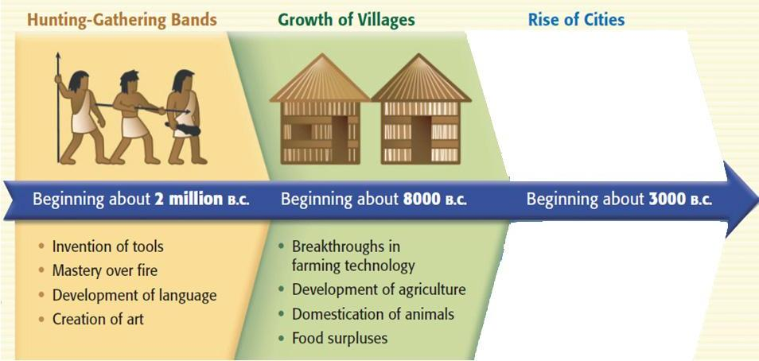
Periodization 1: Foundations Neolithic Revolution
The discovery of farming & domestication of animals
Before farming, people were nomadic hunters & gatherers

Slide 4
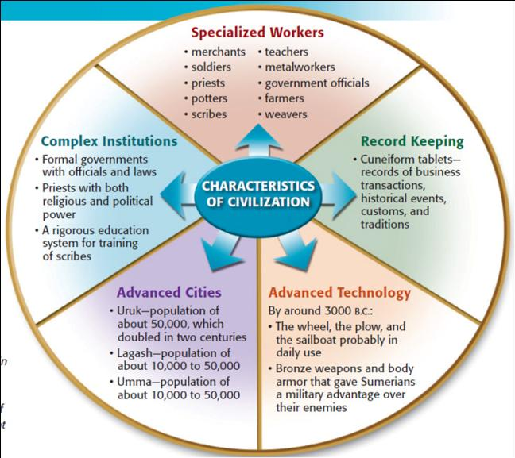
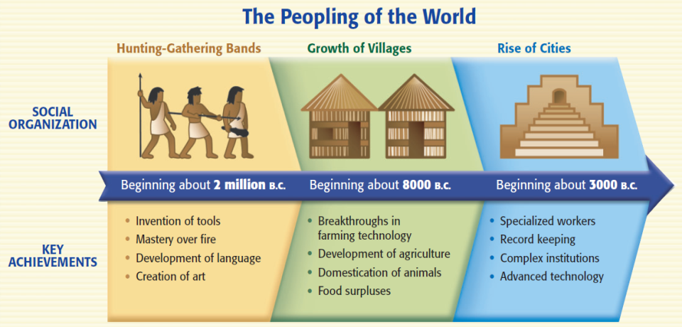
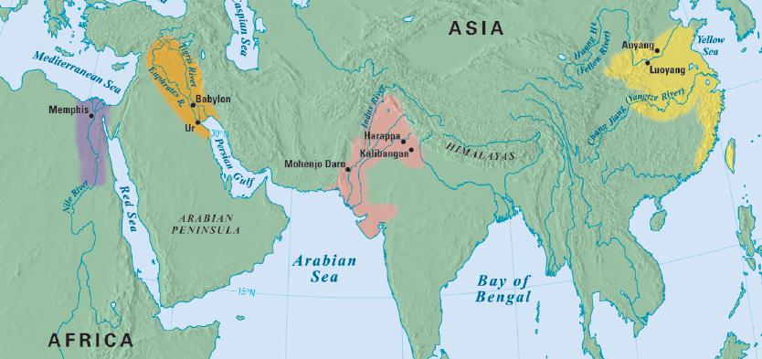
Periodization 1: Foundations Rise of Civilizations
Cities, specialized workers, gov’t/religion, technology, writing
River flooding left behind fertile soil for farming
Mesopotamia, Egypt, India, China

Slide 5
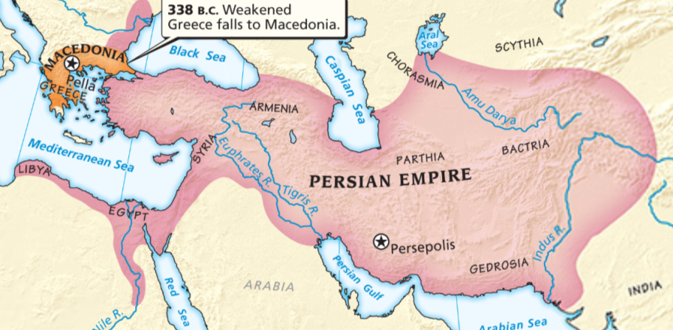
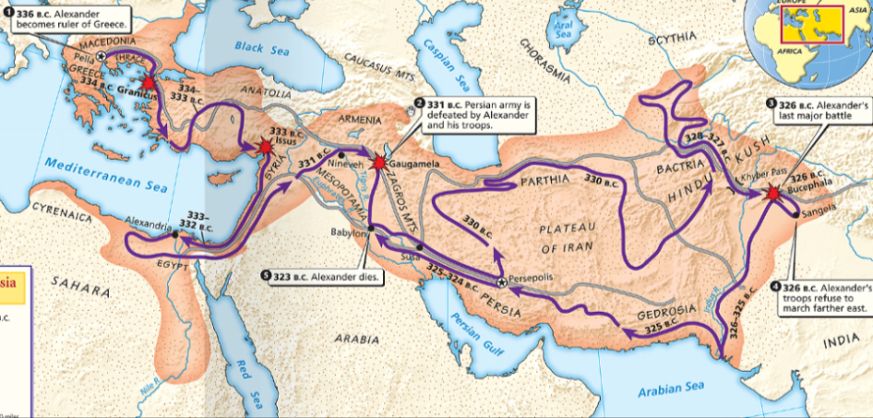
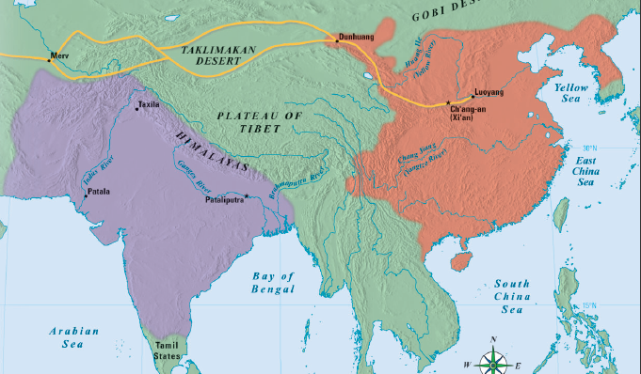
Periodization 1: Foundations Rise of Empires
Empires are bigger, they conquer their neighbors, & have complex gov't to oversee a large territory
Persia, Maurya/Gupta India, Han China, Alexander

Slide 6
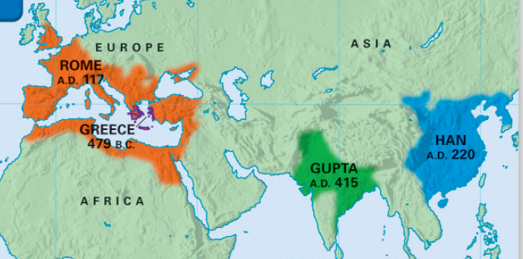
Periodization 1: Foundations Classical Civilizations
Classical civs develop achievements that we still use today
Greece, Rome, Gupta India, Han China

Slide 7
Definition of Periodization 1: Foundations
A time after the discovery of farming when civilizations began for form along the fertile soils of river valleys. Over time, many river valley societies developed into advanced civilizations which then led to the rise of large empires. Finally, some societies developed such important cultural achievements that they became “classical” civilizations because their achievements influenced other societies and the modern world.

Slide 8
Periodization 2 Predictions
What will happen in world history during Periodization 2: 600-1450 AD
Examine the next four images and make a prediction about what will happen in Periodization 2
Be prepared to discuss your answers

Slide 9
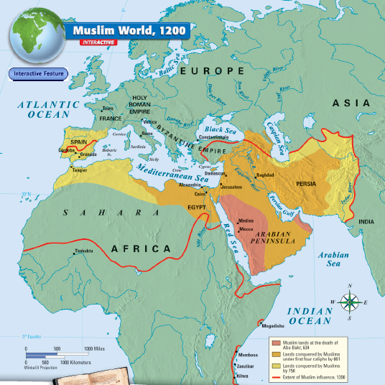
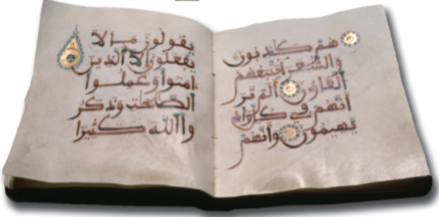
#1
The beginning of a new world religion, Islam

Slide 10
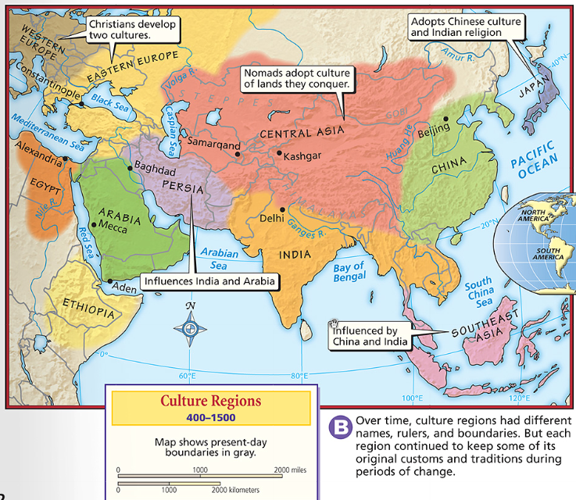
#2
The spread of civilization to new areas of the world

Slide 11
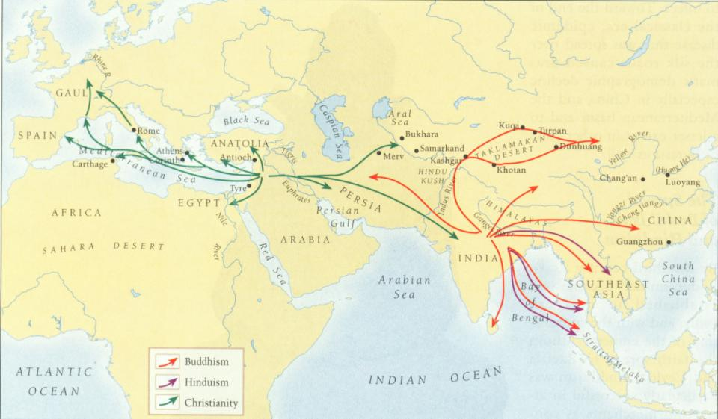
#3
Spread of Christianity, Islam, & Buddhism & creation of “world” religions

Slide 12
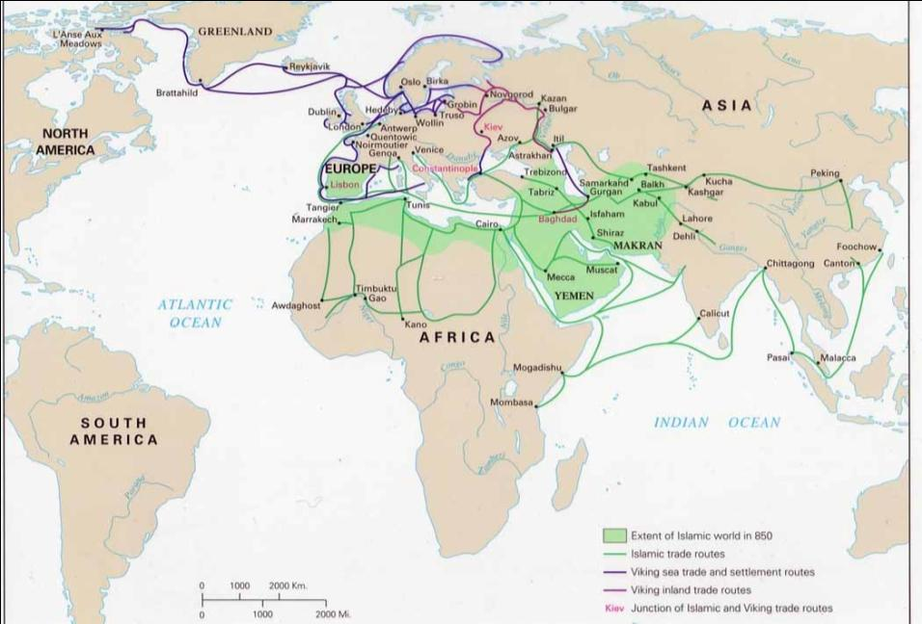
#4
The formation of a world trade network

Slide 13
Definition of Periodization 2: Post-Classical Era
A time when numerous societies became more connected to each other due to an increase in trade. New trade routes led to cultural diffusion, spread technology, and helped form major world religions.

Slide 14
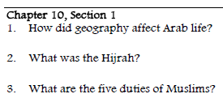
Closure Activity
Answer the first set of questions on your reading guide on the back of the Unit Organizer for Unit 3.
Do these key terms and phrases.
Muhammad
Arabic
Mecca

