Slide 1
Resources
Renewable and Non-Renewable

Slide 2
What is a Natural Resource?

Slide 3


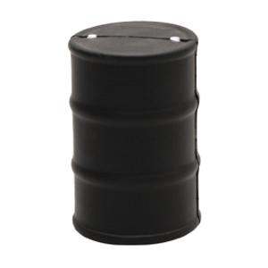
Definitions
Renewable
  Resources that natural processes in the earth continuously replace
Non-Renewable
  Resources that cannot be replaced naturally after they have been used; or that take too long to replenish for human use
Oil

Slide 4
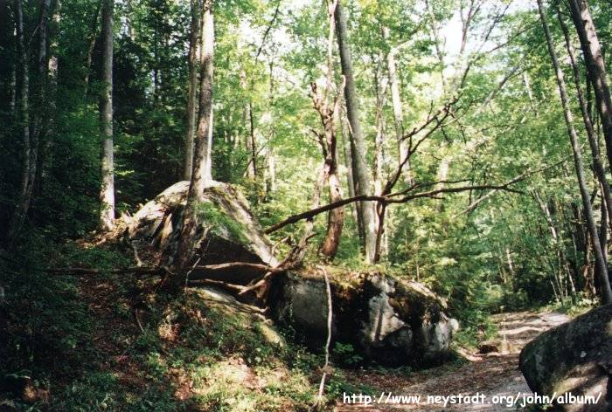
Forests (A Renewable Resource)
Importance
  Protection
  Habitats
  Useful products

Slide 5
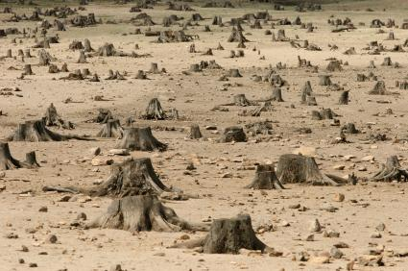
Deforestation

Slide 6
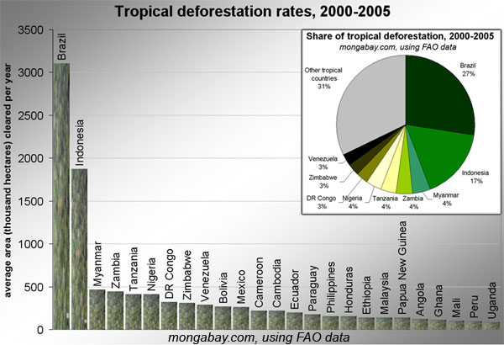
Deforestation
Tropical deforestation rates from 2000-2005, ranked in descending order by the highest amount of average annual forest loss for 25 countries based on data from the U.N. Food and Agriculture Organization (FAO).

Slide 7
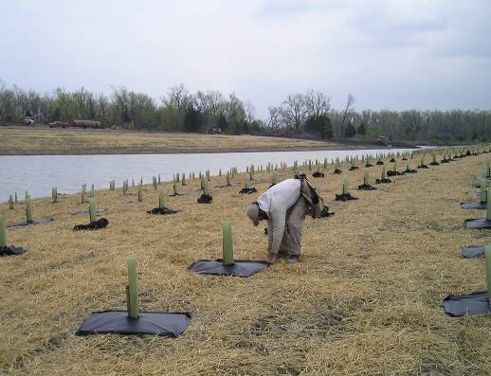
Reforestation

Slide 8

Air (A Renewable Resource)
Pollution threatens air supply
  Smog
  Acid Rain
  Damage to the ozone

Slide 9
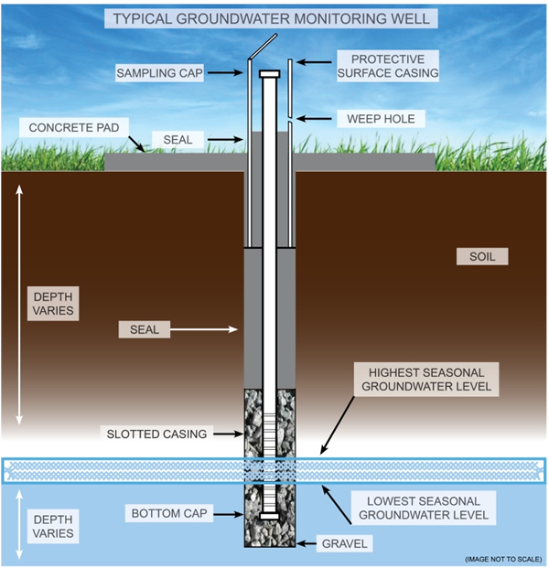
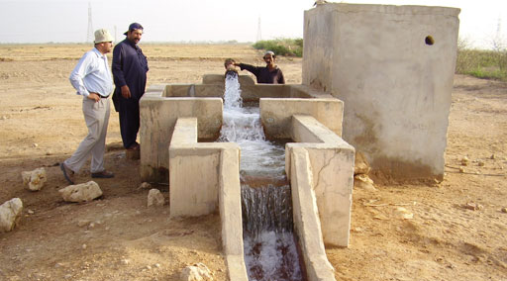
Water (A Renewable Resource)
Maintaining CLEAN water is a challenge
  Groundwater wells will run dry someday
**All bodies of water are valuable resources

Slide 10
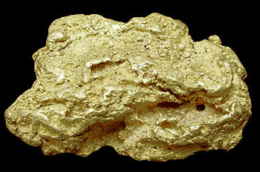
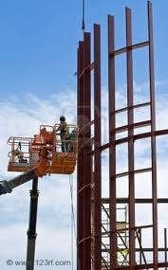
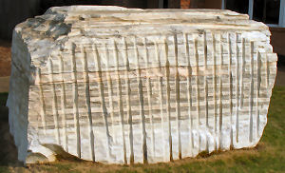
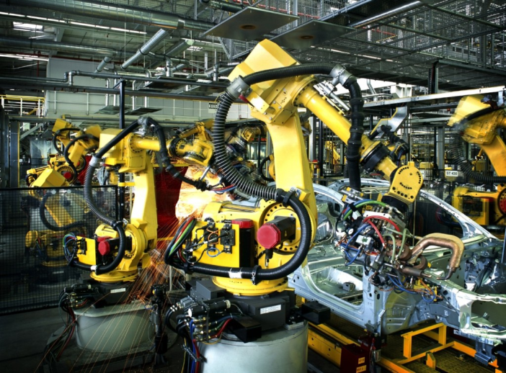
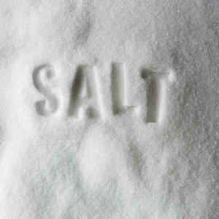

Mineral Uses (Renewable and Non-Renewable)
Solid substances that come out of the ground
  Metals
  Rocks
  Salt
Used in:
  Construction
  Manufacturing
  Jewelry

Slide 11
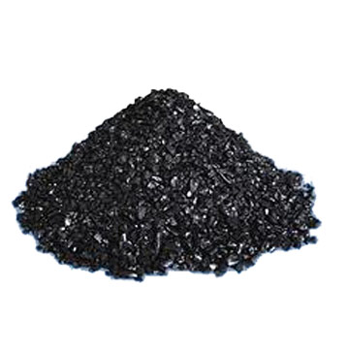
Fossil Fuels
Non-Renewable
Coal
solid and often found near the land surface
an important fuel for electric power generation
Contains minerals that don’t burn
      is plentiful and will be around for centuries

Slide 12
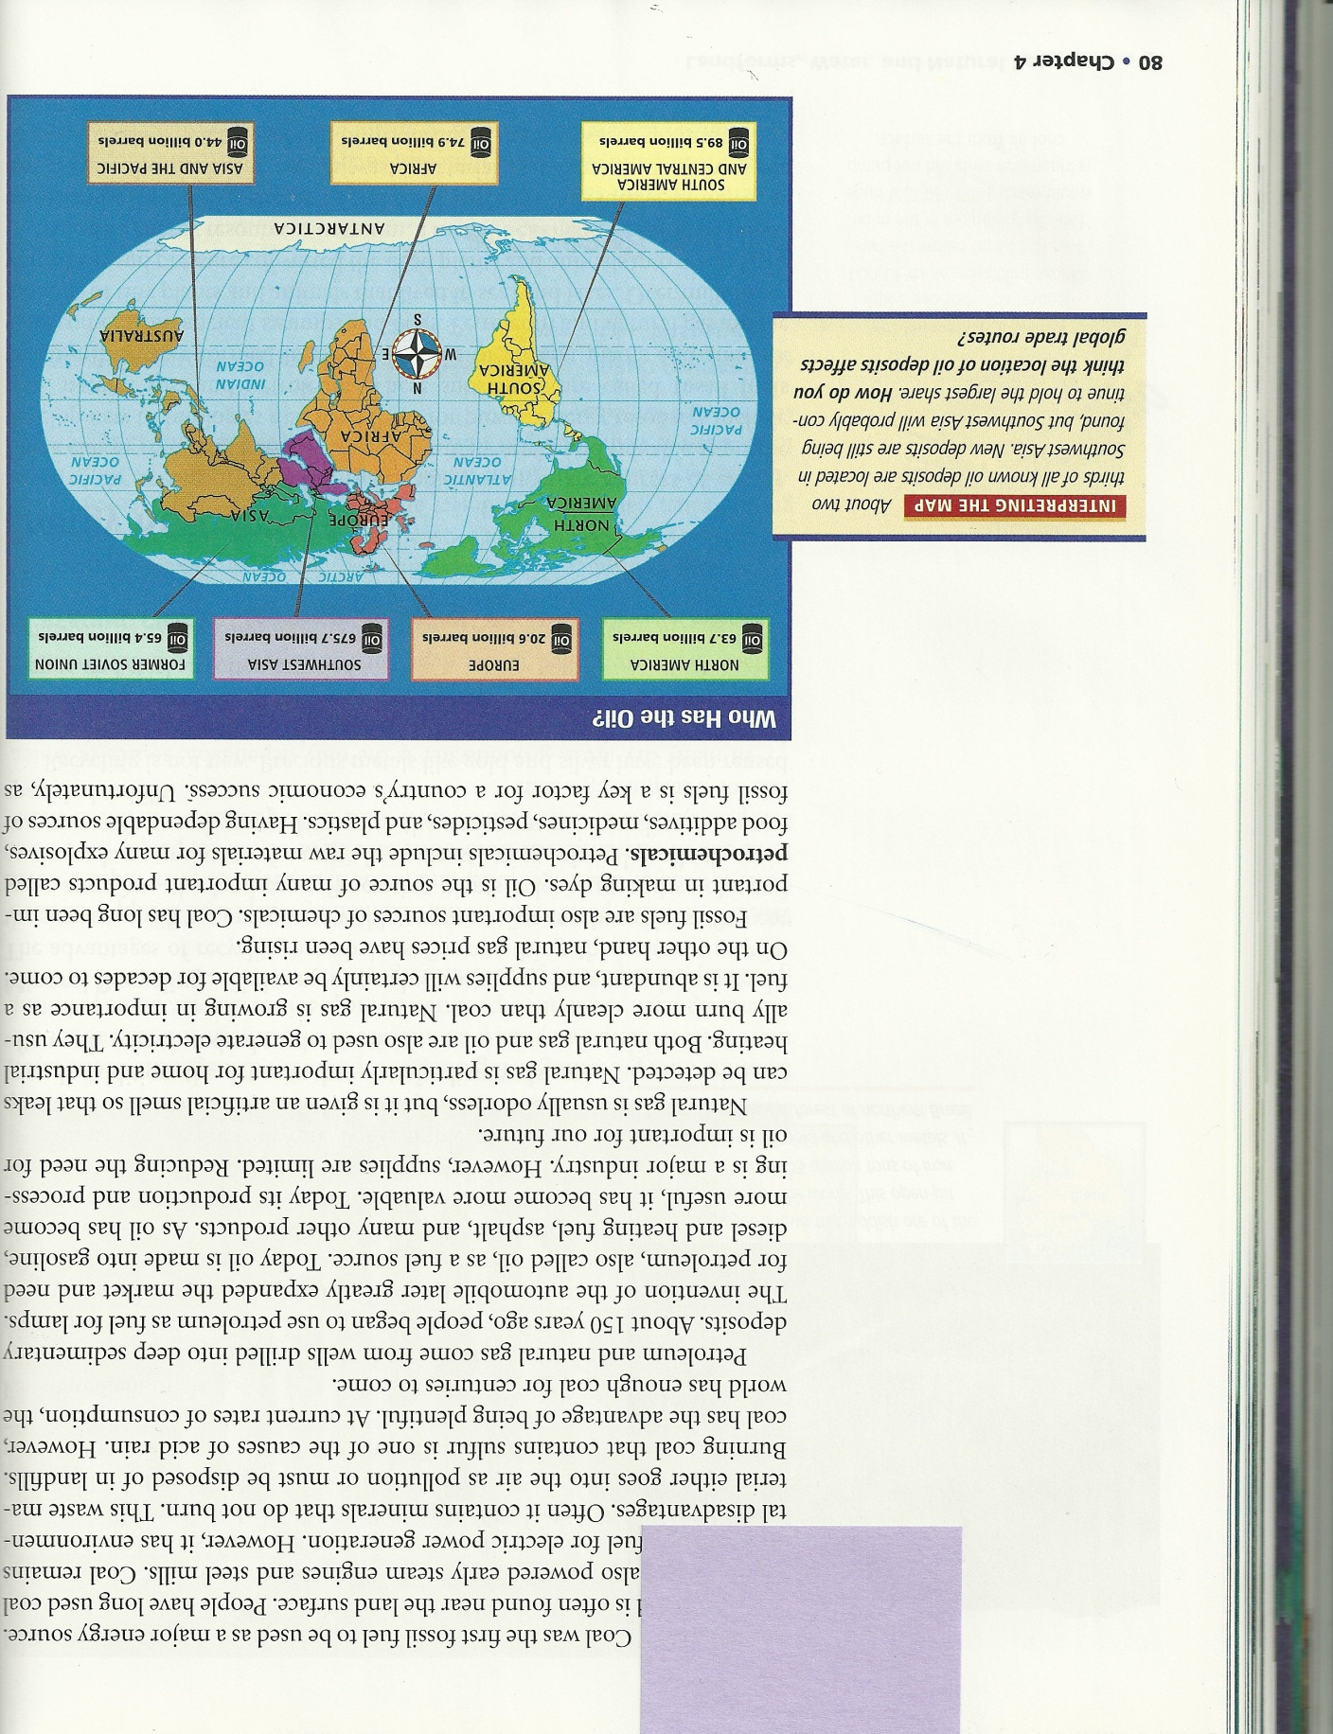
Fossil Fuels
Petroleum and Natural Gas
Come from wells drilled deep into the ground
Today oil is made into gasoline, heating fuel, asphalt, etc.
Natural gas is used to generate electricity and burns more cleanly than coal
  abundant and will last for decades, but it getting more expensive
Non-Renewable

